Slide 1



ANTICIPATE COST Action: extended-range multi-hazard predictions and early warnings
Christopher J. White¹; Pauline Rivoire²; Owen Walpole¹; Alexandre Ramos³; Martin Wegmann⁴; Ana Russo⁵; Ilias Pechlivanidis⁶; Hannah Bloomfield⁷; Morten Larsen⁸; Joanne Robbins⁹; Marcello Arosio¹⁰; Robert Šakić Trogrlić¹¹; Marleen de Ruiter¹²; Silvia De Angeli¹³; Fiachra O'Loughlin¹⁴; Daniela Domeisen²; Nico Caltabiano¹⁵; Andreia Ribeiro¹⁶ and Stanislav Hronček¹⁷
¹ University of Strathclyde, Glasgow, United Kingdom; ² Université de Lausanne, Lausanne, Switzerland; ³ Karlsruhe Institute of Technology, Karlsruhe, Germany; ⁴ University of Bern, Bern, Switzerland; ⁵ Instituto Superior de Agronomia da Universidade de Lisboa, Lisbon, Portugal; ⁶ Swedish Meteorological and Hydrological Institute (SMHI), Norrköping, Sweden; ⁷ Newcastle University, Newcastle upon Tyne, United Kingdom; ⁸ Danish Meteorological Institute (DMI), Copenhagen, Denmark; ⁹ Met Office, Exeter, United Kingdom; ¹⁰ Istituto Universitario di Studi Superiori di Pavia (IUSS), Pavia, Italy; ¹¹ International Institute for Applied Systems Analysis (IIASA), Vienna, Austria; ¹² Vrije Universiteit Amsterdam, Amsterdam, Netherlands; ¹³ Université de Lorraine, Metz, France; ¹⁴ University College Dublin, Dublin, Ireland; ¹⁵ World Meteorological Organization, Geneva, Switzerland; ¹⁶ Helmholtz Centre for Environmental Research (UFZ), Leipzig, Germany; ¹⁷ Global Water Partnership Central and Eastern Europe, Bratislava, Slovakia
UK COST Action Webinar
22 June 2026

Slide 2

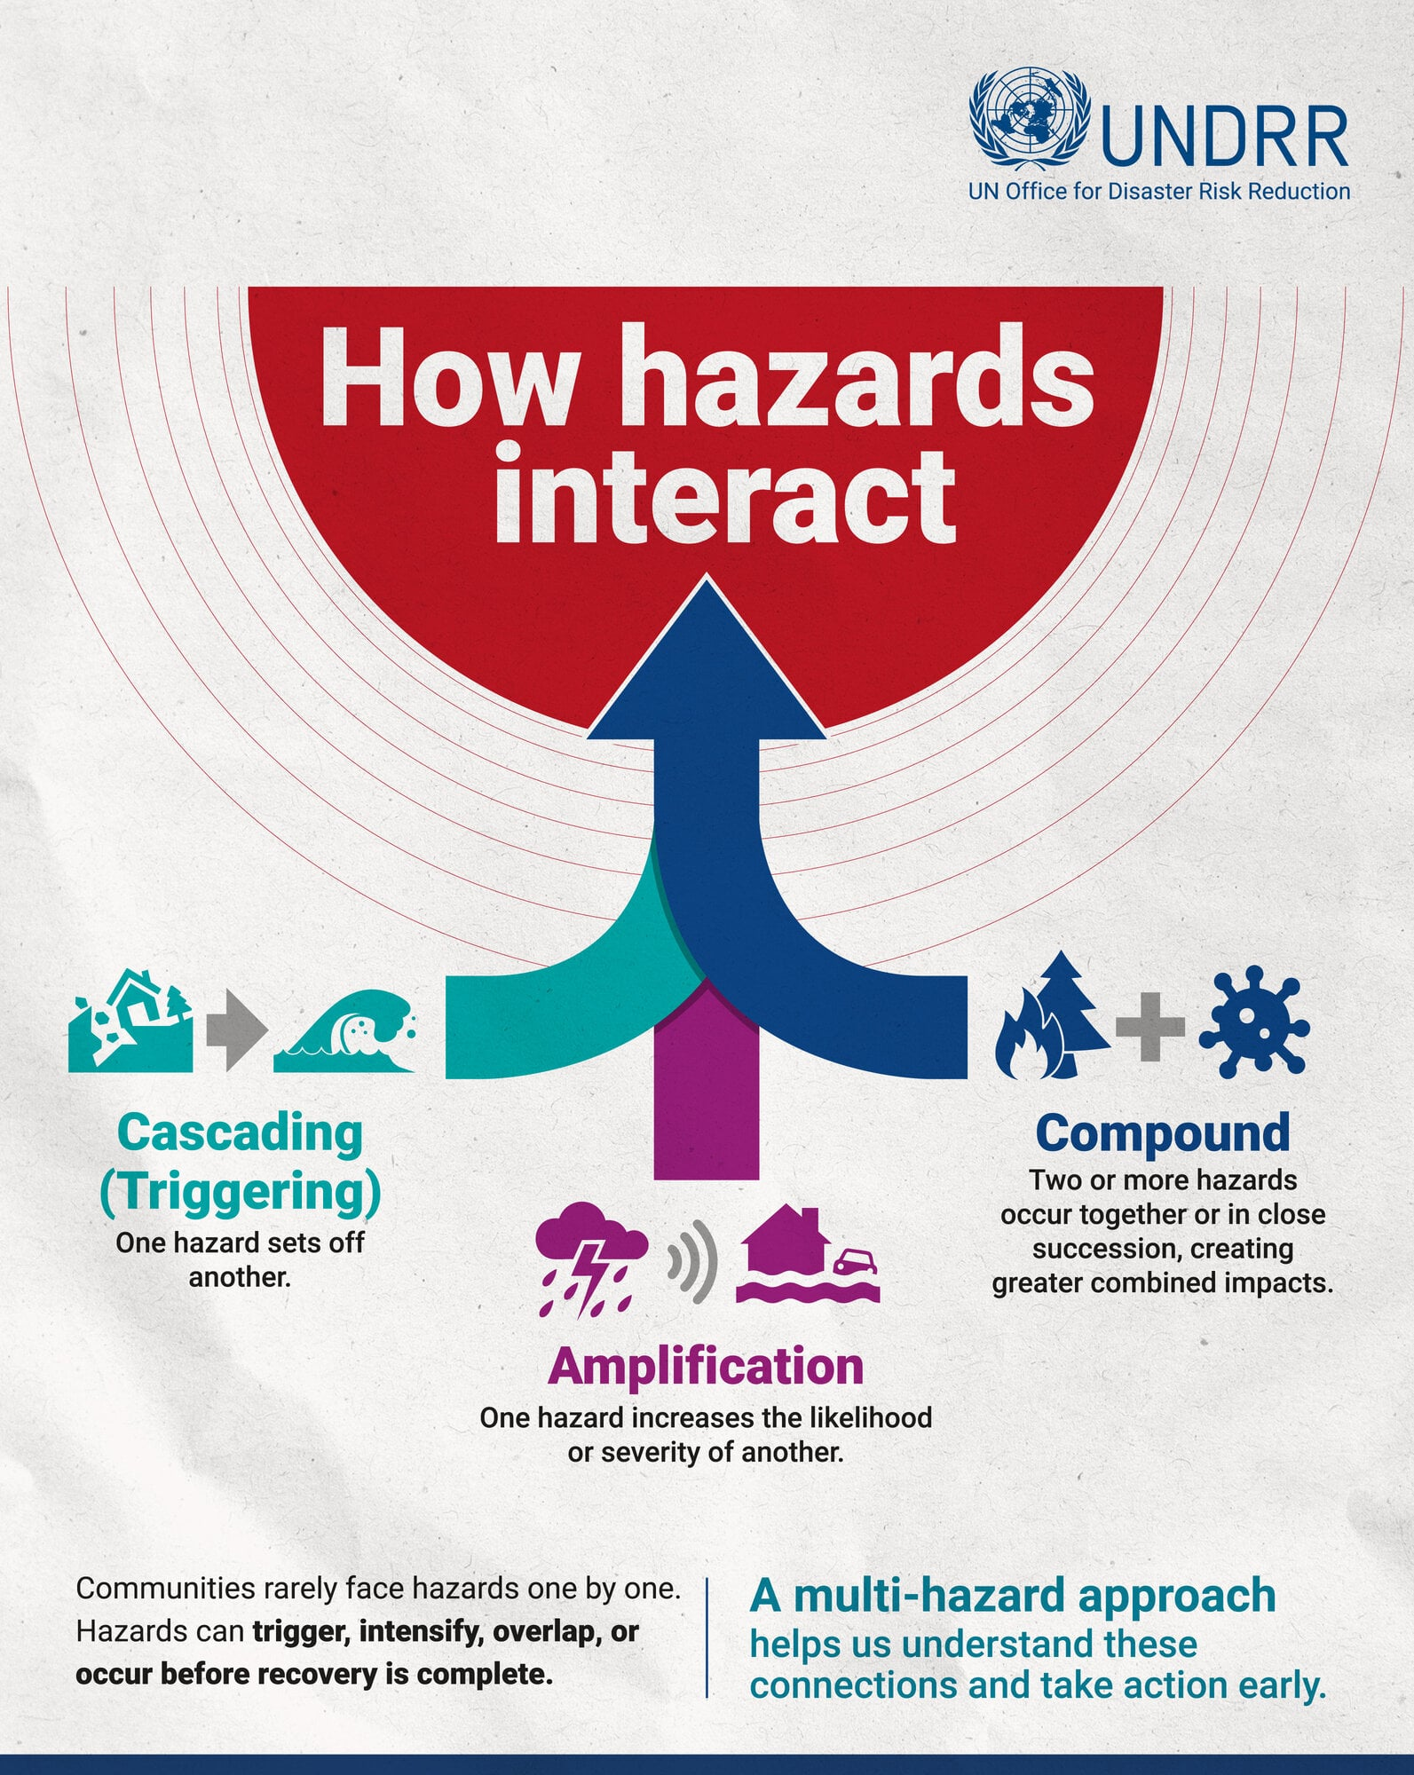
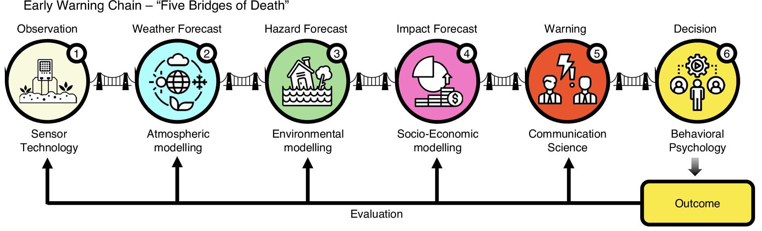

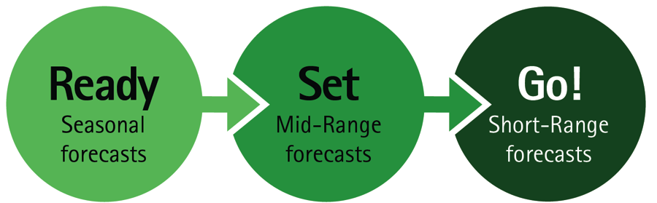
ANTICIPATE challenge setting
Multi-hazard interactions… forecasting chain… people-centred early warnings

Slide 3
ANTICIPATE COST Action
The aim of the ANTICIPATE COST Action for extended-range multi-hazard predictions and early warnings is to bring together the research communities and operational practitioners to forward the science and implementation of extended-range multi-hazard predictions and warnings.
WG1. Setting the capability landscape: Sources of multi-hazard predictability
WG2. Linking multi-hazards with extended-range predictions
WG3. Multi-hazard impacts and databases
WG4. Exploring multi-hazard early warning products for anticipatory actions
WG5. Cross-cutting co-design, stakeholder engagement and dissemination

Slide 4
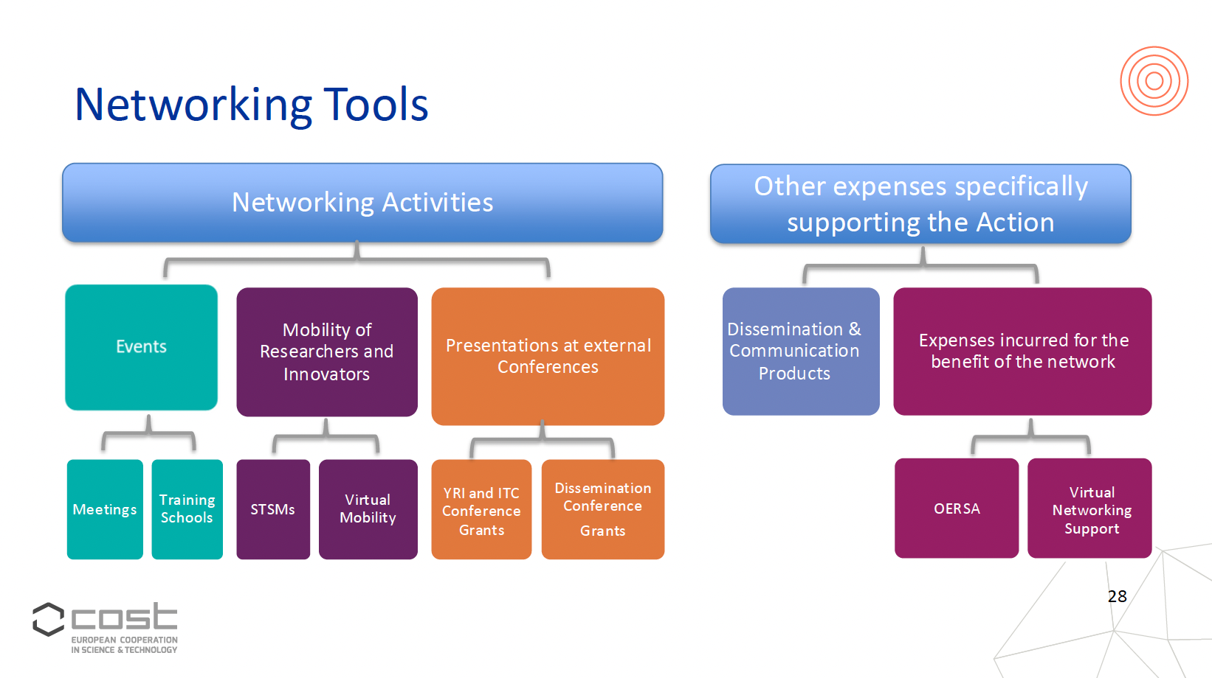
How are we doing it?

Slide 5
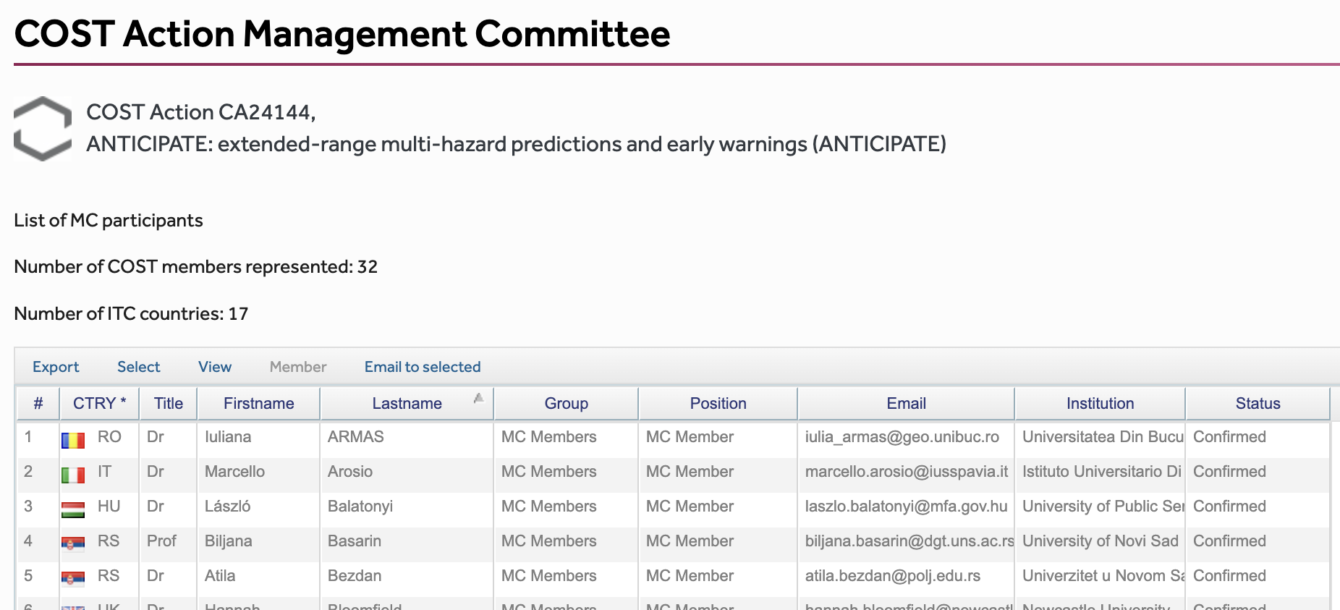





Growing a large community
>250 members, >50 MCs and 32 countries so far…

Slide 6
Leadership roles
Leadership role | Leaders
Chair | Christopher White (UK)
Vice Chair | Pauline Rivoire (Switzerland)
WG1 | Ana Russo (Portugal); Ilias Pechlivanidis (Sweden)
WG2 | Hannah Bloomfield (UK), Morten Larsen (Denmark)
WG3 | Joanne Robbins (UK), Marcello Arosio (Italy)
WG4 | Robert Šakić Trogrlić (Austria); Marleen de Ruiter (Netherlands)
WG5 | Silvia De Angeli (France); Fiachra O'Loughlin (Ireland)
Grant Awarding Coordinator | Alexandre Ramos (Germany)
Science Communications Coordinator | Martin Wegmann (Switzerland)
Cross-cutting WG Coordinator | Daniela Domeisen (Switzerland)
WMO Coordinator | Nico Caltabiano (International)
YRI Network Coordinator | Andreia Ribeiro (Germany)
ITC Coordinator | Stanislav Hronček (Slovakia)

Slide 7
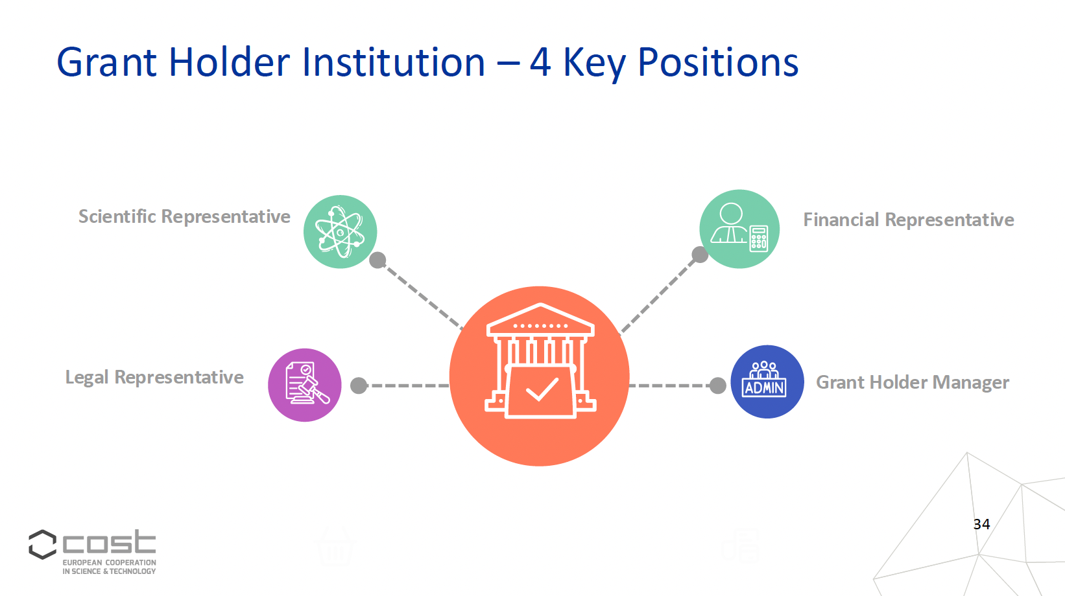
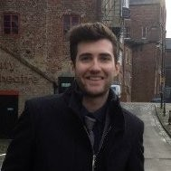

Grant holder
Chair, Vice Chair:
Chris White (UK), Pauline Rivoire (Switzerland)
Grant Holder:
Institution: University of Strathclyde
Financial Representative: Linda Tuzcu
Grant Manager: Owen Walpole
Legal Representative/Signatory: Daniela Bolle-Joyce
Scientific Representative: Chris White

Slide 8
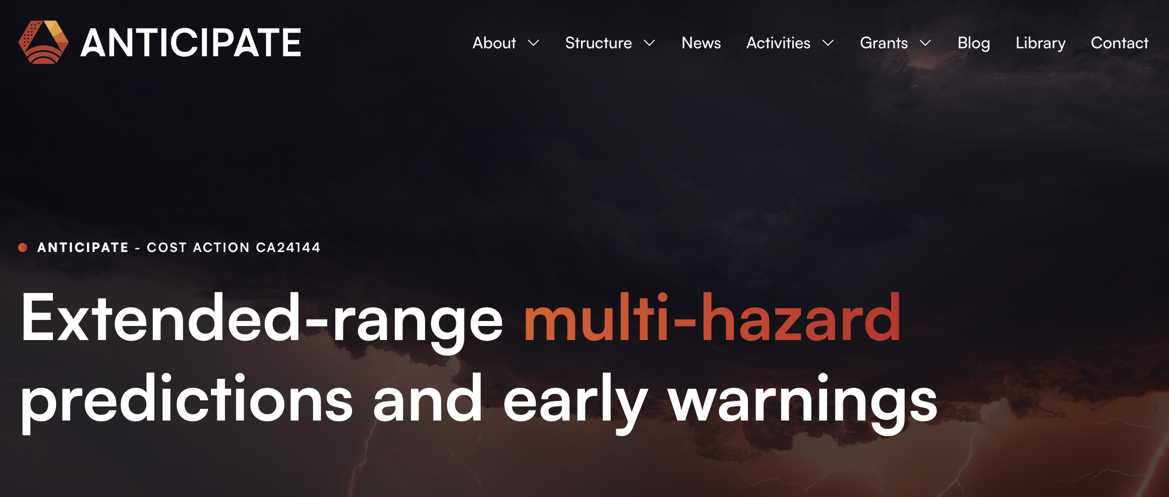


Slide 9




ANTICIPATE outreach
  Follow us on social media to join the community, contribute and get the latest updates!
  LinkedIn: https://linkedin.com/company/cost-anticipate
  Bluesky: @anticipate-action.bsky.social
  YouTube: COSTActionANTICIPATE​
  Website: https://cost-anticipate.eu/

Slide 10
Some concluding remarks
  Think about the management structure and leadership early
  Build a strong core group – a lot falls to the Chair to manage so spread the responsibility where possible
  Have regular meetings and good comms – core group, MCs and side meetings
  Have a potential grant holder in-line from the outset – ideal if the institution has done the role before
  The same institution as the Chair has benefits (and a few drawbacks!)
  UK grant holders have to deal with EUR to GBP transfers

Slide 11
ANTICIPATE COST Action CA24144:
The ANTICIPATE COST Action for extended-range multi-hazard predictions and early warnings
https://cost-anticipate.eu/
Prof Christopher J. White
Chair of the ANTICIPATE COST Action
Department of Civil and Environmental Engineering, University of Strathclyde, Glasgow, UK
chris.white@strath.ac.uk

