Slide 1
Horizon Europe
WP 2026-2027
European Commission, DG rtD
Common Implementation Centre
9 December 2025

Slide 2
Novelties in WP2026-2027
Attention: subject to final adoption of WP 22026-2027!
The work programme is designed to be more strategic, focused, simpler, and accessible, with a reduction in fragmentation of the available budget.
It includes a new part called "Horizontal Activities" which groups the horizontal calls and aims to create critical mass and avoid duplication of budget.
It allocates €50 million to the "Choose Europe for Science" initiative to improve long-term fellowships and postdoctoral career stability.
It encourages international cooperation, but also imposes restrictions on participation in certain topics, including those related to 5G, 6G, and communication network equipment.
It has been simplified, with a 33% reduction in length, fewer and more concise topics, and a relative decrease in one-project-only topics.
It has increased the use of lump sums, with at least 50% of the Horizon Europe call budget allocated through lump sums.
It includes simplified proposal forms implying a reduction of the standard page limits by 5 pages.

Slide 3
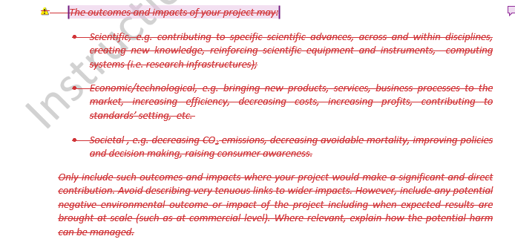
Simplification of proposal template
Impact section
Attention: subject to final adoption of WP 22026-2027!
No longer need to explain the general scientific, economic and societal expected impacts. Those were already taken into account when drafting the topic expected impact.
No longer need to explain the scale and significance of the expected outcomes and impact.

Slide 4
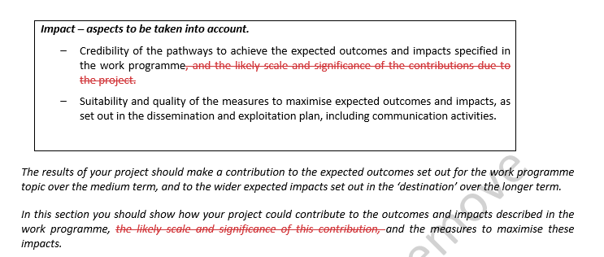
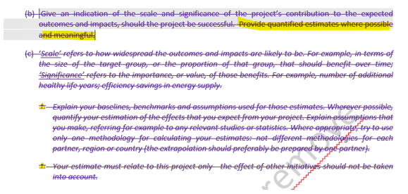
Simplification of proposal template
Impact section
Attention: subject to final adoption of WP 22026-2027!
No longer need to explain the general scientific, economic and societal expected impacts. Those were already taken into account when drafting the topic expected impact.
No longer need to explain the scale and significance of the expected outcomes and impact. It includes a modification in the impact evaluation criterion.
Sentence in yellow stays

Slide 5
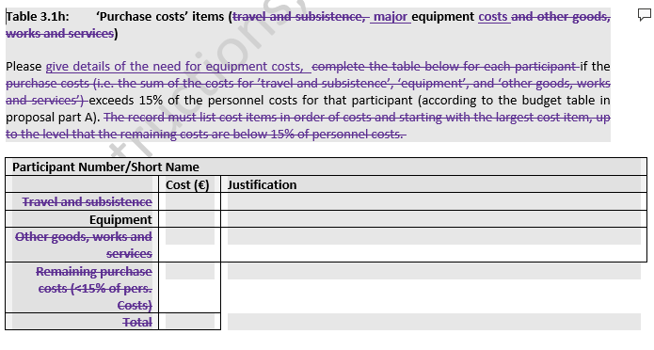
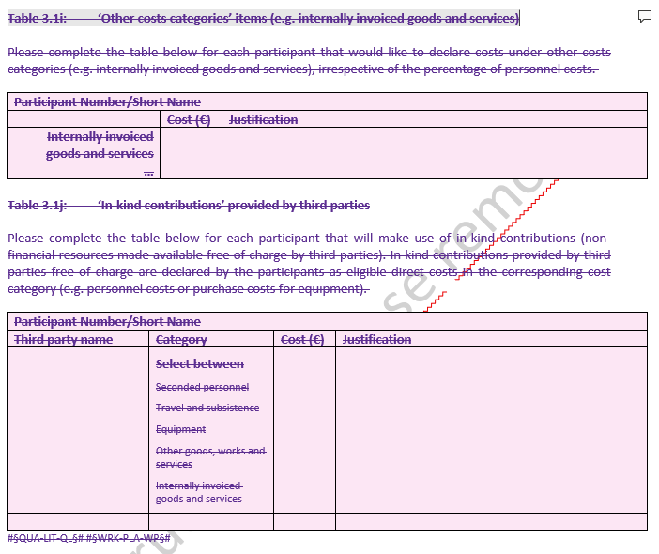
Simplification of proposal template
Implementation section
Table 3.1h ‘Purchase costs’: only details on large equipment costs are required
Removal of cost table 3.1i ‘Other cost categories’ and 3.1j ‘In kind-contributions provided by third parties’
The cost tables will be requested to only retained proposals during GAP
Attention: subject to final adoption of WP 22026-2027!

Slide 6
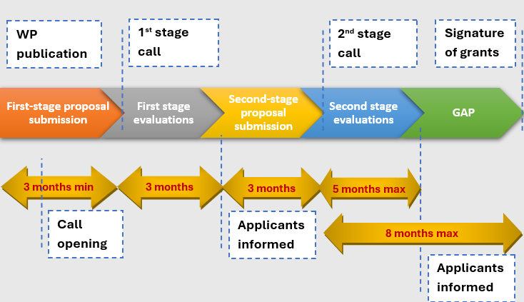
Reduction of overall TTG in two-stages calls
Current process for two-stage calls

Slide 7
Reduction of overall TTG in two-stages calls
Attention: subject to final adoption of WP 22026-2027!
Submission period for first stage calls when applicable: 2 months (3 months for calls opening at the time of publication of the WP)
Possibly simplified first-stage evaluation when applicable: no consensus phase, rejected applicants get a compilation of individual assessments
Reduced interval between stages when applicable: 2 months (instead of 3 months)
Faster evaluation of second stage: streamlined internal processes to save time
Overall TTG reduced by 3 months. From current 17 months to about 14 months.

Slide 8
Thank you!
# HorizonEU
http://ec.europa.eu/horizon-europe

