Slide 1

Widening Participation and Strengthening the European Research Area
12 January 2026
UK National Contact Point for WIDERA widera-uk@ukro.ac.u​​k

Slide 2

Agenda
General conditions
Focus on networking, training, capacity building, governance improvements, establishing synergies among regional and European funding sources, and creating cross-border and links between academia, businesses, governments and civil society
Proposed calls for 2026-27
Proposed new matrix structure for ERA calls
Resources
Upcoming Info Days and Brokerage Events

Slide 3
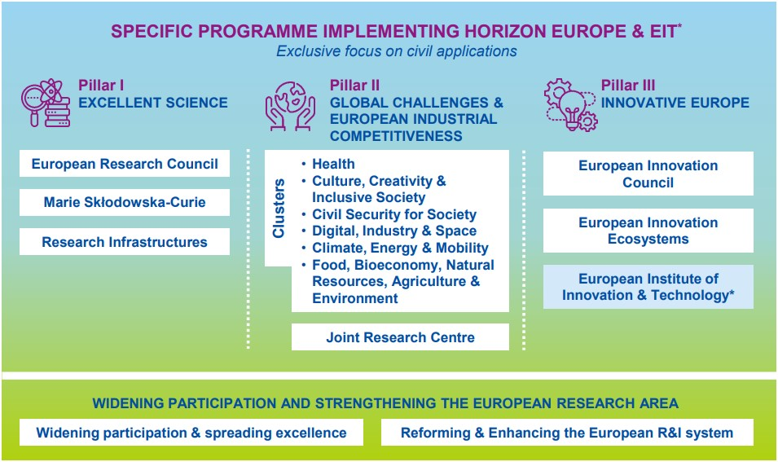
Horizon Europe structure

Slide 4
General conditions
Eligibility
Participation as coordinators to most calls is limited to legal entities established in Widening countries
Some calls might only be open to beneficiaries established in Widening countries (e.g., ERA Fellowships, EIC Pre-Accelerator)
Type of action
Most calls under the WIDERA Work Programme are Coordination and Support Actions (CSA)
Some Research and Innovation Actions (RIA) to be introduced under Destination “Reforming and enhancing the European Research and Innovation system”

Slide 5
2026-27 calls
Teaming Synergies: Fostering collaboration among Teaming Centres of Excellence
23 Apr 2026 – 24 Sep 2026
Twinning: Enhancing networking activities between research infrastructures in Widening countries by linking them with leading research institutions from advanced countries
08 Jan 2026 – 09 Apr 2026
Hop-On Facility: Allowing legal entities from Widening countries to join already funded Pillar II/EIC Pathfinder actions
13 Jan 2026 – 24 Sep 2026
Research Management Facility: Proving tailored support to Widening institutions that want to establish or upgrade their research management capacity
23 Apr 2026 – 24 Sep 2026
Widening

Slide 6
2026-27 calls
ERA Chairs: Attracting outstanding scientists and innovators to institutions based in Widening countries
06 Apr 2027 – 14 Sep 2027
ERA Research Managers: Attracting outstanding research managers to institutions based in Widening countries
06 Apr 2027 – 14 Sep 2027
Excellence Hubs: Fostering a regional innovation culture in Widening countries, e.g., by creating new international partnerships, institutional changes
02 Sep 2026 – 04 Mar 2027
Widening

Slide 7
2026-27 calls
Enhancing the European R&I Systems:
10 Dec 2025 – 12 Mar 2026 / 08 Dec 2026 – 11 Mar 2027
13 calls spread across four pillars
Selected expected outcomes:
Effective and sustainable structural institutional changes aligned with the ERA priorities
A more open, equitable and inclusive research and innovation ecosystem
Improved research careers and mobility, based on the European framework for research careers, fostering knowledge flows and career interoperability across sectors and countries
More resilient and future-proof R&I policies and long-term strategies with effectively integrated strategic intelligence and strengthened foresight communities
Systemic reform of research assessment through the recognition of the diverse outputs, practices, and activities which maximise the quality and impact of research;
ERA

Slide 8
2026-27 calls
Pillar I: Institutional changes for ERA | Pillar II: Ecosystems for ERA
Type: CSAs Focus: capacity building and support to foster adoption of ERA policies/practices within institutions Activity types: providing tools, resources, training, services, and policy advice | Type: CSAs Focus: building and reinforcing networks and partnerships to foster broad uptake of ERA policies/practices Activity types: exchanging knowledge and practice, networking and cooperative actions
Pillar III: Citizens and science in ERA | Pillar IV: New knowledge for ERA
Type: CSAs Focus: connecting R&I with citizens and other stakeholders Activity types: implementing and promoting participatory approaches, such as citizen engagement and citizen science | Type: RIAs Focus: creating new knowledge that supports design, implementation, monitoring and evaluation of policies and practices Activity types: conducting analyses, developing and testing new methods and practices
ERA

Slide 9
Resources, tips and tricks
Start early: Use NCP resources for guidance and scan the Draft Work Programme for upcoming opportunities
Get familiar with WIDERA: The ERA Platform showcases results from Horizon Europe-funded projects, making them available to a wide range of stakeholders to facilitate progress in ERA policy areas. Applicants are encouraged to consider these results as well as propose new tools, resources, and visual material that can be featured on the platform. Consult the ERA Actions and Structural Policies for more information on the relevant EU policies.
Choose the right call: Some calls might not be available to UK applicants. Check the Work Programme early or contact your NCP to check the eligibility criteria.
Attend Info Days & Brokerage Events and use partner search tools for networking.

Slide 10

Missed an Info Day?
ERA Info Day
11 December 2025
Recording available on the event page
Widening Info Day
22 January 2026
Recording available on the event page

Slide 11

Q&A
Contacts and resources:
Website: https://www.ukro.ac.uk/
LinkedIn: UK Research Office (UKRO)
UK National Contact Point (NCP) for WIDERA: widera-uk@ukro.ac.u​​k

