Slide 1


Pillar 3 Innovative Europe
Claire Griffin
UK National Contact Point (NCP) for EIC and EIE
NCP-EIC-Transition-Accelerator@iuk.ukri.org
Teresa Arumardi
UK NCP for the European Institute of Innovation & Technology (EIT)
ncp-eit@iuk.ukri.org
12th February 2026

Slide 2
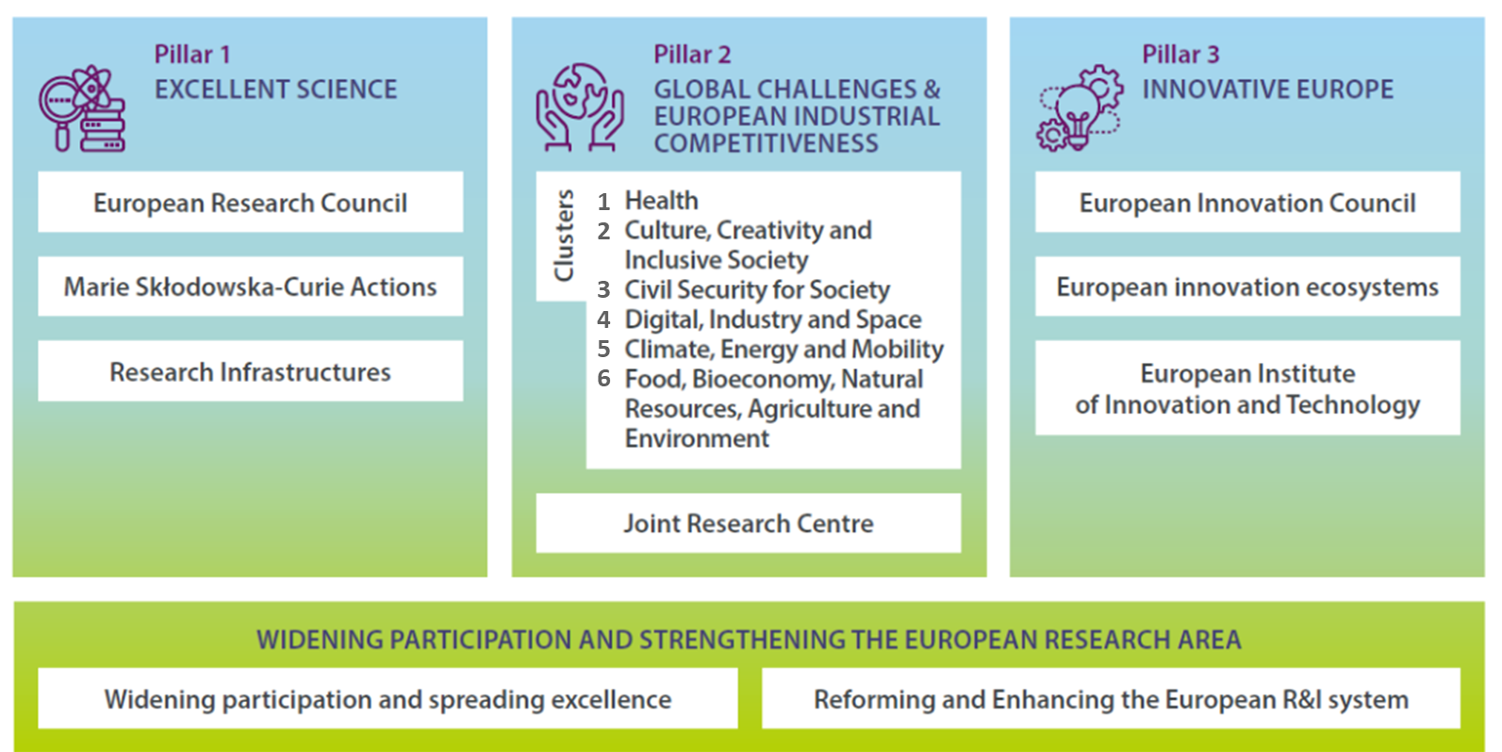


Slide 3

Pillar 3 - Innovative Europe
Supporting and Connecting Innovators Across Europe
Europe has solid research and industrial base
Yet it ‘could do better’ at strengthening the use of scientific excellence and industrial prowess to accelerate innovation and turn innovative SMEs into Technology Giants.
Focus on supporting the development of disruptive and market-creating innovations and on enhancing European Innovation Ecosystems

Slide 4
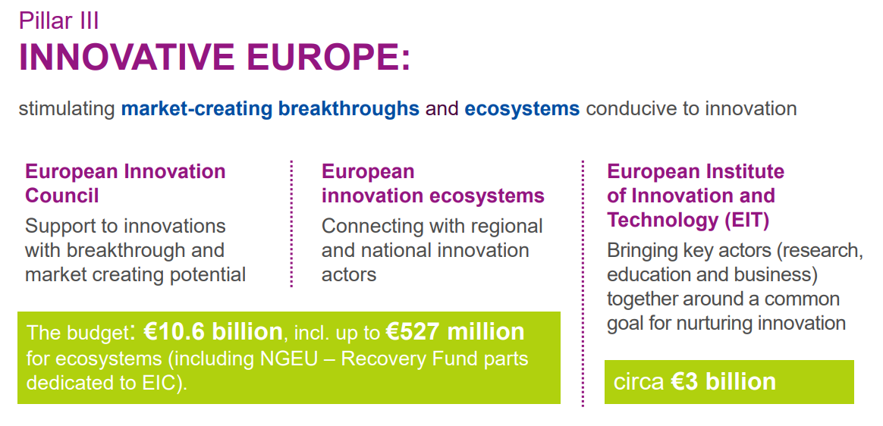

Copy only
Notes:
Pillar 3 features three distinctive and complementary instruments:
EIC –support for start-ups, SMEs and research teams developing high-risk, high-impact breakthrough innovation, with a particular focus on scaling-up game-changing innovations
EIE – building an interconnected, inclusive innovation ecosystem that encompasses European, National, regional and local initiatives as well as under-represented actors and territories, while also reinforcing the ecosystems’ innovation capacity.
and EIT – strengthens Europe’s innovation ability by powering solutions to pressing global challenges and by nurturing entrepreneurial talent

Slide 5
European Innovation Council
(EIC)

Slide 6
Six Strategic Goals for the EIC
To be investor of choice for those with visionary ideas
To crowd in €30-50 B investment into European Deep-tech
To pull through high-risk technologies in critical areas for society and open strategic autonomy
To increase the number of European Unicorns and Scale-Ups
To catalyse innovation impacts from European public research and innovation
To achieve operational excellence

Slide 7
What is deep-tech?
Technology that is based on cutting edge scientific advances and discoveries
Is characterised by the need to stay at the technological forefront by constant interaction with new ideas and results from the lab
NOT – High-tech which refers to R&D intensity
Unicorn – private company valued at over 1B€

Slide 8
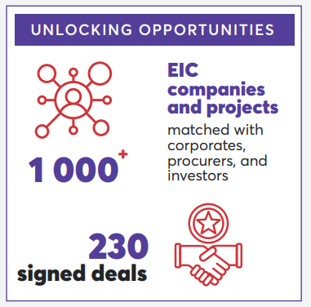
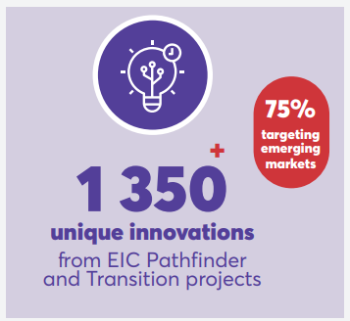
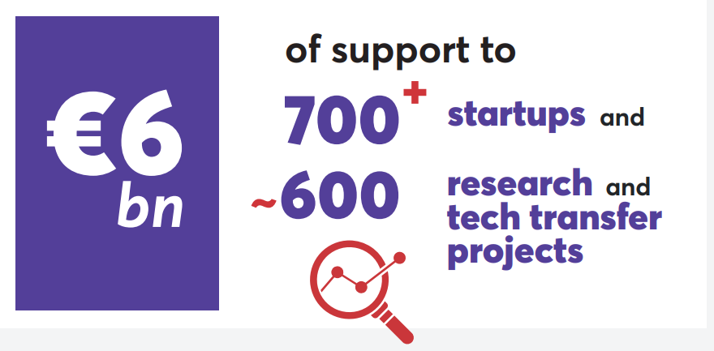
EIC Impact Report 2025
EIC Impact Report 2025
Generating new technologies from EU’s research base
  Translating research into market-ready innovations
EIC Pathfinder & EIC Transition projects have spawned over 1300 innovations and had led to the creation of more than 100 spinout companies
Includes ~100 projects that are commercialising results from ERC

Slide 9
Main Novelties in 2026
Increased grant size for EIC Pathfinder Open
  From €3M to €4M
  Pathfinder Open and Challenge now both 4M€
Broader eligibility of EIC Transition
  Research infrastructures
Advanced Innovation Challenges (AIC) pilot
  Staged funding to test multiple solutions to challenges
Reform to EIC Accelerator Full Proposal evaluation:
  Shorter form, more frequent deadlines, faster time to grant

Slide 10
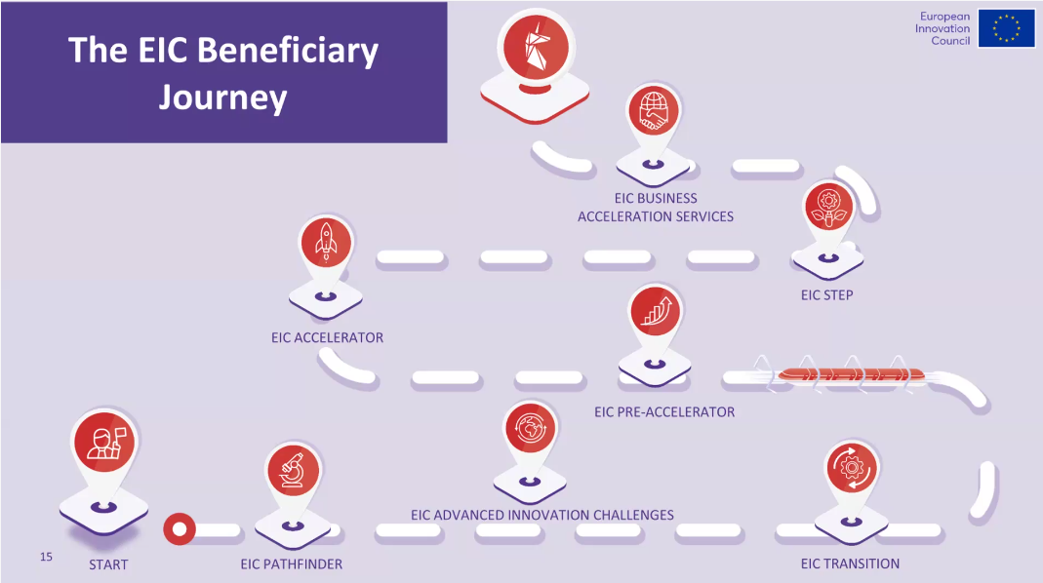

Slide 11

UK exclusions in EIC
As set out in the UK's Trade and Cooperation Agreement which sets out the details of the UK’s association to Horizon Europe, UK entities shall not participate in the European Innovation Council (‘EIC’) Fund established under Horizon Europe. (TCA, Protocol 1, Article 6)
The EIC confirmed that UK entities are not eligible for the equity part of the EIC Accelerator or the EIC Step Scale Up call which is equity only. (Details: EIC 2025 Info day, time stamp 5:32:00)

Slide 12


Slide 13

EIC 2026 WP: Budget overview
Total budget €1.424 Billion (~equal to 2025 budget)
  New deadlines & new budget for each call
EIC Advanced Innovation Challenges: €6M in 2026 + €25M in’27
  Deadline 26/02/2026 Stage 1 & 18/06/2027 Stage 2
EIC Pathfinder: €262 M (=2025)
  Pathfinder Open: €166 M (+24M€) Deadline 12/05/2026
  Pathfinder Challenge: €96 M (-24M€) Deadline 28/10/2026
EIC Transition: €100 million (+2M€ from 2025) Deadline 16/09/2026
EIC Accelerator: €634 M(=2025) Deadline - Various
  Accelerator Open €414 M (+30M€)
  Accelerator challenges: €220m (-€30M)

Slide 14
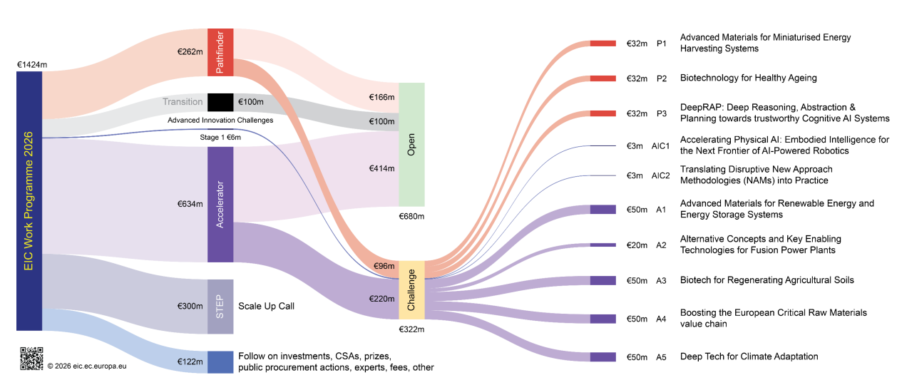
EIC Work Programme Budget 2026

Slide 15
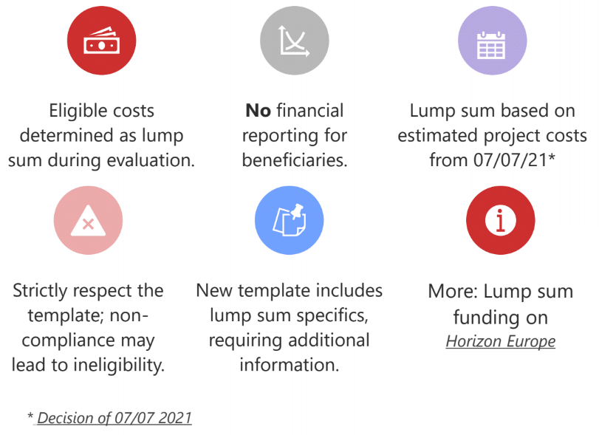
EIC – New 2026 - all Lump Sum
EU Funding & Tenders Portal

Slide 16
EIC Open vs Challenge Calls
EIC Open – to support projects in any field of science, technology or application without predefined thematic priorities (bottom-up)
EIC Challenges – to support projects within predefined thematic areas with the aim of achieving specific objectives for each challenge (top-down)
Notes:
.

Slide 17
EIC Programme Manager
Follow on LinkedIn and listen to their ‘Tech Talks’
Establishes a common roadmap
Proactively steers the selected projects as a portfolio towards the goal of each challenge
Projects are expected to:
  Interact and exchange
  Remain flexible & reactive
  Progress together toward goals
EIC Programme Managers - European Commission (europa.eu)
Notes:
Pillar 3 features three distinctive and complementary instruments:
EIC –support for start-ups, SMEs and research teams developing high-risk, high-impact breakthrough innovation, with a particular focus on scaling-up game-changing innovations
EIE – building an interconnected, inclusive innovation ecosystem that encompasses European, National, regional and local initiatives as well as under-represented actors and territories, while also reinforcing the ecosystems’ innovation capacity.
and EIT – strengthens Europe’s innovation ability by powering solutions to pressing global challenges and by nurturing entrepreneurial talent.

Slide 18
What is the EIC Pathfinder?
2026

Slide 19
Why Apply
Realise an ambitious vision for radically new technology, with potential to create new markets and/or to address global challenges
Early-stage development of future technologies – Low TRLs
Based on high-risk/ high-gain science-towards-technology breakthrough research (including deep-tech)
Research must provide the foundations of the technology you are envisioning

Slide 20
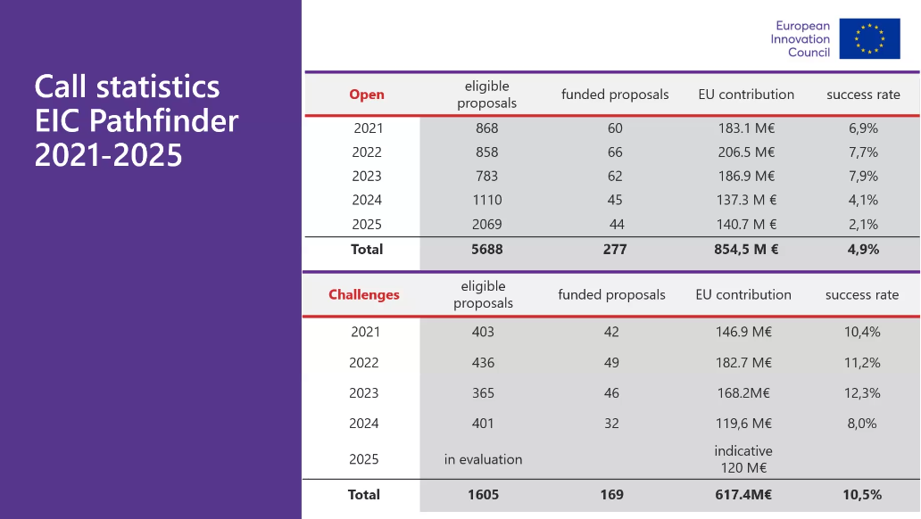
~30 @ 4M but
667 submitted
~4.5%

Slide 21
EIC Pathfinder 2026 – Open & Challenges
CHALLENGE
Deadline: 28 October 2026
Single entities
Consortia of two
Consortia of three or more
100% grant up to 4M€
Info day TBC ~ March 2026
OPEN
Deadline: 12 May 2026
Only Consortia
100% grant up to €4M
Info day 13th November
Online Info Day - EIC Work Programme 2026 - European Innovation Council

Slide 22
EIC Pathfinder Open: Gatekeepers
Collaborative, interdisciplinary research which meets:
  Convincing, long-term vision of a radically new technology that has the potential to have a transformative positive effect to our economy & society
  Concrete, novel and ambition science-towards-technology breakthrough providing advancement towards the envisioned technology
  High-risk & high-gain research approach & methodology with concrete & plausible objectives

Slide 23
Consortium Composition - Open
Submitted by the Co-Ordinator on behalf of a consortium
  Lump Sum
  New Part B – 22 A4 pages max.
At least three legal entities, independent from each other and established in a different country
  At least one in a MS
  At least two other independent legal entities, each established in different MS or AC
Legal entities may be universities, research organisations, SMEs, start-ups, industrial partners or natural persons

Slide 24
EIC Pathfinder Open – Ranking criteria
Proposals with the same scoring will be untied in the following order:
Higher score under criterion Excellence
Higher score under criterion Impact
Gender balance among the work package leaders as identified in the proposal
Number of applicants that are SMEs
Number of MS & AC in the consortium
If needed, other factors determined by the evaluation committee

Slide 25
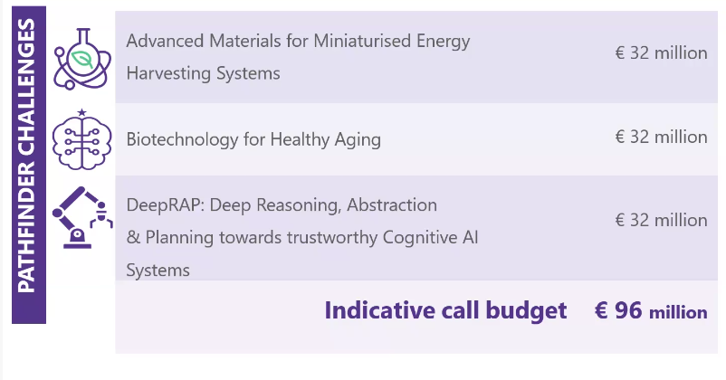
EIC Pathfinder Challenges 2026
New
Info day planned for Spring 2026

Slide 26
EIC Pathfinder Challenges
Build on cutting edge directions in science and technology
Disrupt a market or create a new opportunities by realising innovative technological solutions grounded in high-risk/high-gain research and development
Establish a portfolio of projects for each Challenge that explore different perspectives, competing approaches or complementary aspects
Proactively steered by Programme Managers

Slide 27
EIC Pathfinder 2026 Challenges Guide
New
Will provide more info about:
Objectives of the Challenge
Technical information underpinning the objectives
Portfolio Considerations used for the final selection of proposals to be funded.
Read in conjunction with EIC 2026 Work Programme!
EIC Pathfinder Challenges 2026 - European Innovation Council

Slide 28
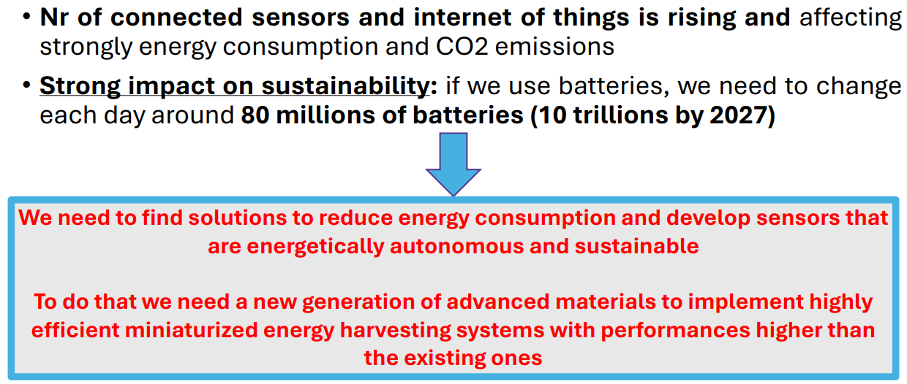
Advanced Materials for miniaturised Energy Harvesting Systems

Slide 29
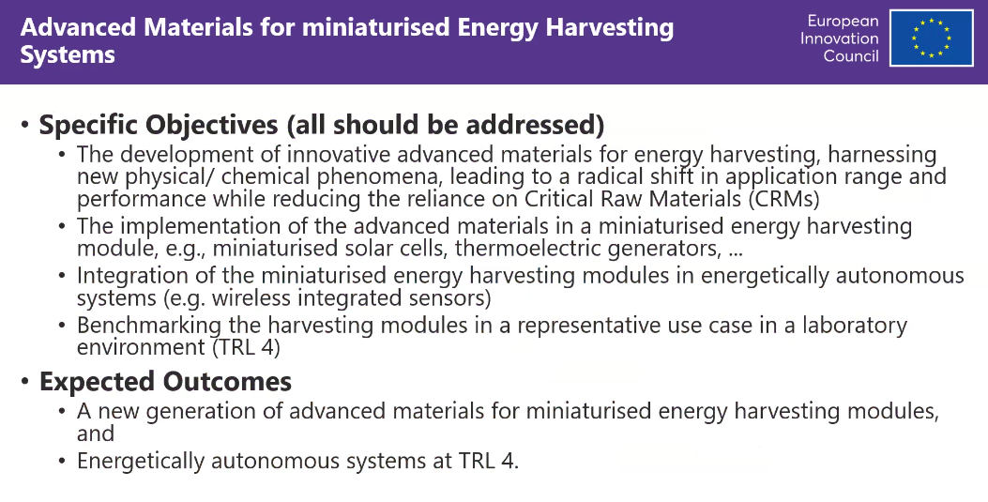
Advanced Materials for miniaturised Energy Harvesting Systems

Slide 30
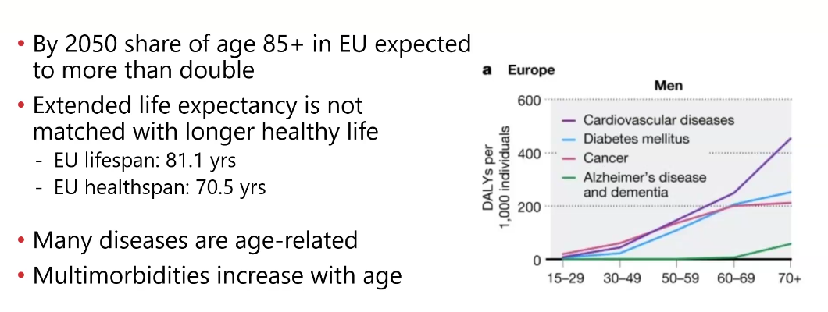
Biotechnology for Healthy Ageing

Slide 31
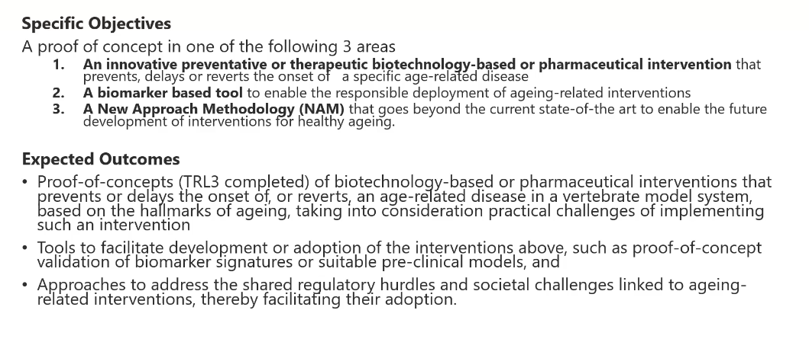
Biotechnology for Healthy Ageing

Slide 32
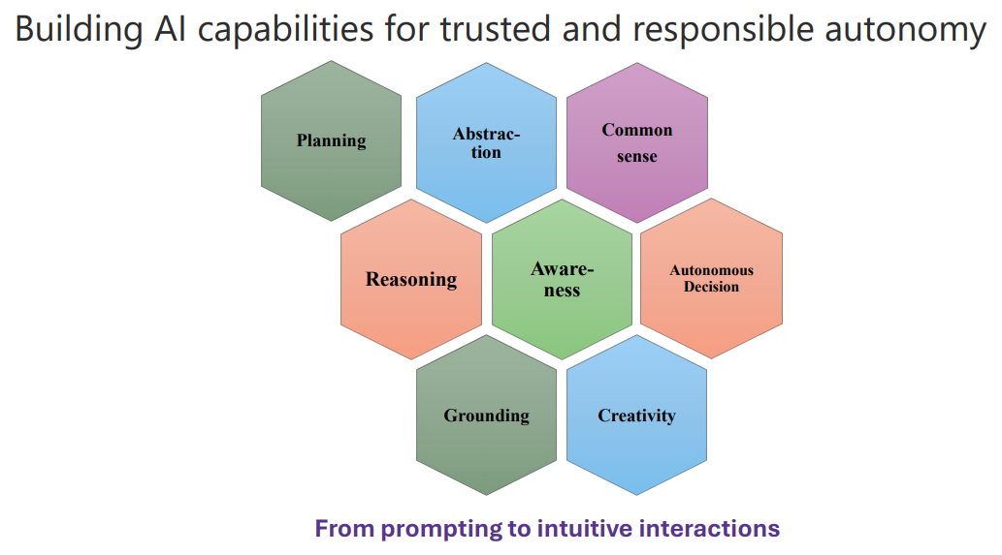
DeepRAP: Deep Reasoning, Abstraction & planning towards trustworthy Cognitive AI systems

Slide 33
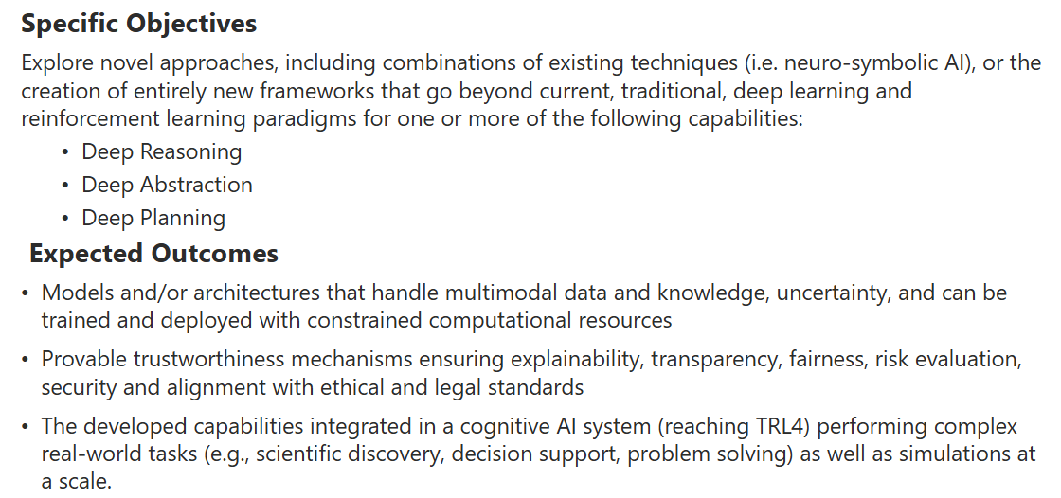
DeepRAP: Deep Reasoning, Abstraction & planning towards trustworthy Cognitive AI systems

Slide 34
EIC Pathfinder - Expected outcomes
As defined in the respective challenge
Top-level scientific publications
Adequate formal protection of the generated IP, as well as an assessment of relevant aspects related to regulations, certification and standardization
Projects are encouraged to involve and empower key actors that have potential to become future leaders
Female researchers and achieve gender balance among work package leaders

Slide 35
What is the EIC Transition?
2026

Slide 36
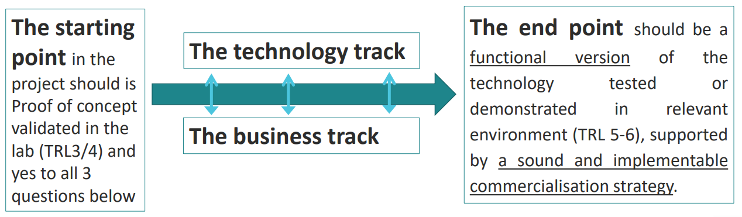
EIC Transition
Have you identified EU-funded project with promising commercial potential
Do you have a novel technology, with proof of concept
Have you conducted early market / competition explorations
Do you have a motivated and diverse team to take forward to the next steps

Slide 37
Restricted application – Who can apply
EIC Pathfinder & H2020 FET
ERC PoC – 1 proposal only
Research Infrastructures
H2020 Societal Challenges & LEIT + Horizon Europe Pillar 2
JUs except FSTP grants
EDF (PADR)
See – Innovation Radar - Innovation Radar > EIC Transition
NOT Eligible – ERA-nets, Co-funded Partnerships, EIT KICs
New

Slide 38
EIC Transition – eligibility criteria
Validated in the ‘lab’ & ready for next steps towards maturation and validation
Moving the boundaries of technological possibilities
Min TRL3 – TRL4 preferred
Consortium mono-beneficiary or max. 5 entities - very specific
Who can apply – previously funded projects .
Performed early market / competition collaborations
Team motivated for commercialisation

Slide 39
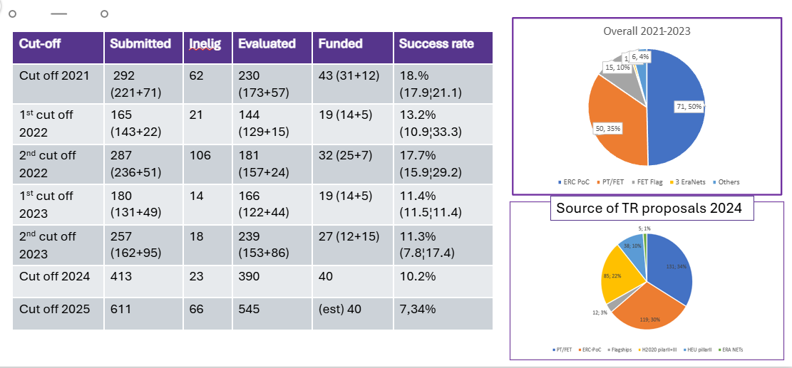
EIC Transition 2021-2025

Slide 40
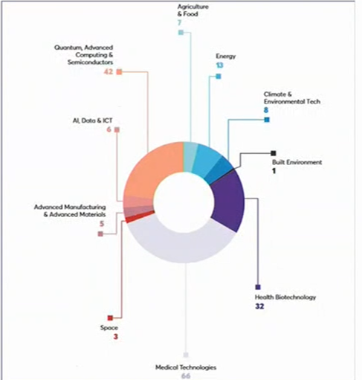
EIC Transition 2021-2024
183 projects & 445M€ in grants
33% SMEs beneficiaries
50% from ERC PoC
35% from Pathfinder / FET
53.5% Medical & Health Biotech

Slide 41
EIC Transition – new in 2026
Deadline 16 Sept 2026 @ 17:00 – UK time 16:00
Hard limit of 2.5M€
Duration of 1-3 years will be deemed appropriate
18 months from start of previous project
Within 24 months of end of previous project
Pay attention to consortium composition – 5 max.
  Is the number of partners well justified?
  Main partners responsible for bringing technology to market must be involved in the research
Operational capacity to execute project well
BAS Coaching is Compulsory – Tech to Market Programme
ERC PoC cannot submit more than one project

Slide 42
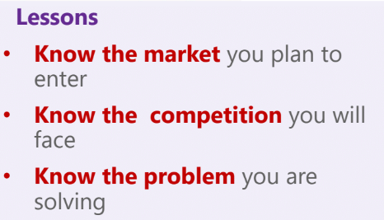
Lessons learnt from 2021-2025
Need for higher impact & Commercial potential
  Need to identify a promising market
  Not specific, small market with limited potential
Business model and Market Analysis
  Prelim Business Model and Market analysis – included
  Business model validation & refinement of Market analysis
  Not only technology maturation
Technology Readiness Level
  TRL3 is the min – TRL4 is preferred
  TRL5 or 6 is too high
IPR issues – commitment needs to be solid

Slide 43
EIC Advanced Innovation Challenges (AIC) 2026
New
PILOT

Slide 44
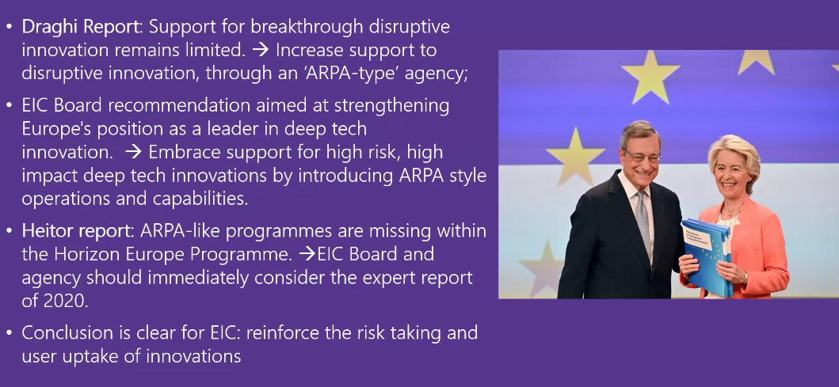
Why Advanced Innovation Challenges

Slide 45
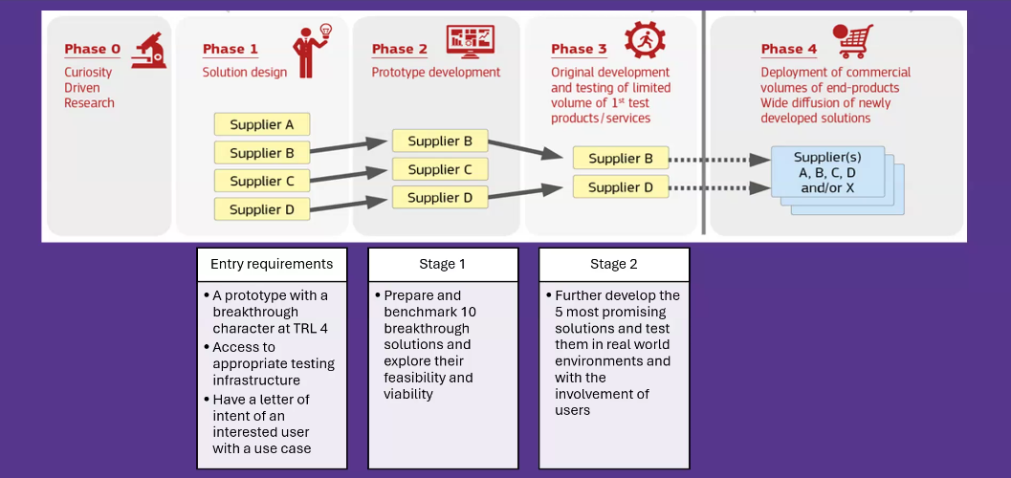
Typical Staged funding vs EIC AIC

Slide 46
Key features of the EIC AIC – 2026 & 2027
Two-stage, gate funding
  Stage 1 - €300k lump sum for up to 9 months (Q4 2026 – end Q2 2027) to prepare & benchmark PLUS explore their feasibility & viability
  Stage 2 – up to €2.5M for 2.5 years to develop most promising solutions & test in real world with users
Demand side integration
  Commercial users (e.g. industry or public sector) or end-users
  Regulatory bodies or other major stakeholders
Single entity or small consortia
  Mono-beneficiary for Stage 1
Proactive portfolio management
  Overseen by PM ensure coherent portfolio development
Lump Sum Funding – Type 1

Slide 47
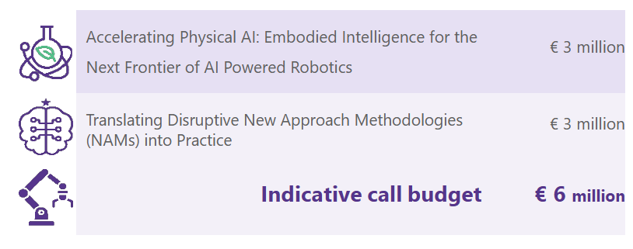
EIC Advanced Innovation Challenges 2026
New

Slide 48
Accelerating Physical AI: Embodied Intelligence for the Next frontier of AI-Powered Robotics
Aims to accelerate the development towards integration deployment & commercialisation of breakthrough Physical AI solutions
Addresses the critical gap AI’s digital capabilities & real world requirements
Why is a deep tech approach needed
  Current AI systems are primarily designed for controlled digital environments
This challenges requires fundamental breakthroughs in embodied intelligence, integrating advanced in robotics, materials science, and sensor technology to create autonomous PHYSICAL AI systems

Slide 49
Accelerating Physical AI: Embodied Intelligence for the Next frontier of AI-Powered Robotics
Proposals must address at least two of these technical aspects
  Intelligent Perception and Cognition
  Adaptive Learning and optimisation
  Autonomous Decision-Making & collective Intelligence
  Human-AI Collaboration & Interaction
  Physical Integration & Innovation
3 Application domains
  Disaster response & Civil Security
  Autonomous Labs for Scientific Discovery
  Personal or professional robot assistants

Slide 50
Translating Disruptive New Approach Methodologies (NAMs) into Practice
Vision – to move from lab-based proof-of-concept to clinical and industrial adoption
  To accelerate the uptake of disruptive NAMs in biomedical research, safety, efficacy and quality testing – enabling human-relevant, ethical and faster innovation in health.
Scope – applicants should propose the further development of innovative and disruptive NAMs addressing one or both areas:
  Preclinical biomedical research
  Testing of medicinal products or medical technologies for safety, efficacy or quality.

Slide 51
EIC AIC – Stage1
Opening mid Dec 2025 & Closing 26th Feb 2026 @17:00
Existing prototype or existing results at least TRL4
Expected to demonstrate feasibility of solution
Benchmark against state-of-the-art
Proposal 11 pages for sections 1-3
Workshop with other Stage 1 projects, experts & users
EIC PMs will provide strategic guidance & support
Encourage collaboration & learning across projects & stakeholders
Allocate at least 1 person month for portfolio activities

Slide 52
EIC AIC – Stage 2
Closing 18th June 2027
Goal – further develop to TRL6/7 – the most promising solutions from Stage 1 and test them in real world & users
Proposal – 22 pages
Mono-beneficiary & small consortia <= 3
Live pitch in front of Jury Chaired by PM
Results from Stage 1 taken into consideration
Access to BAS
Evaluation will access readiness for real world deployment, and the potential for scale-up and market up-take.
Results - 6 weeks after 2nd Stage call closure.

Slide 53
What is the EIC Accelerator?
2026

Slide 54
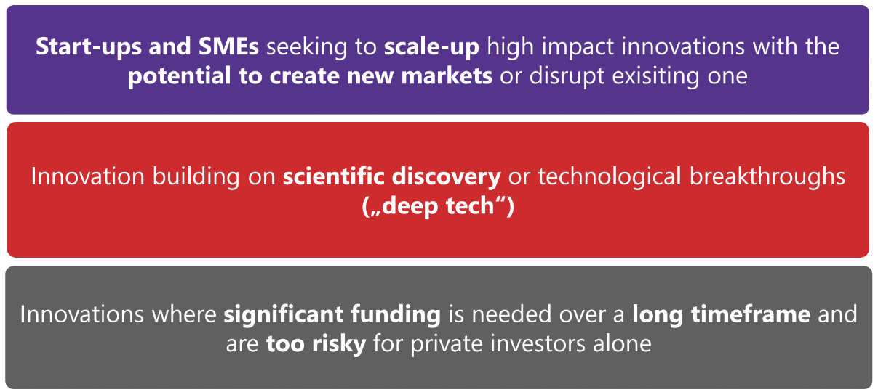
What is the EIC looking for?
Min TRL6 is required

Slide 55
Who can apply?
Single Companies – mono-beneficiary
  NO Universities, NO Research organisations, NO Consortia
  Subcontracting & affiliated entities are possible
Natural person(s) or legal entity:
  From MS or AC intending to est an SME in MS or AC by contract
  From non-associated third country intending to est SME prior to FULL
SME according to EU Definition
  <250 employees, <50M€ turnover or <43 M€ total balance
    Linked or partner enterprises will be taken into consideration
Small mid-caps (up to 499 employees) for equity only
SME Self-assessment tool

Slide 56
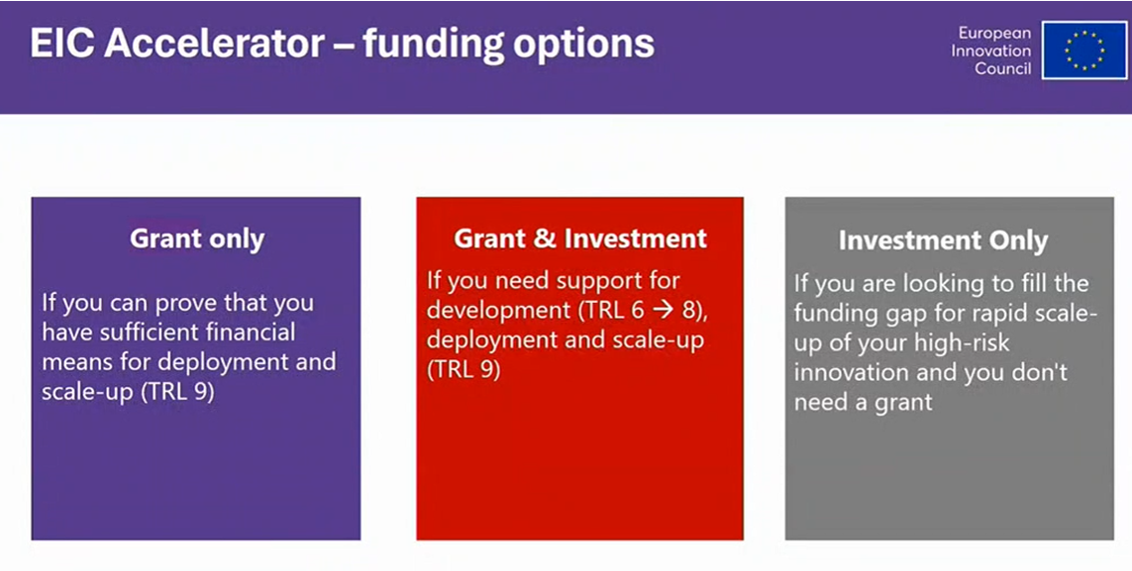

Slide 58
EIC Accelerator novelties in 2026
Major simplification and shortening of the evaluation process
More frequent batching of proposals for evaluation
Due diligence at the application stage to enable fast investment decisions
Increase in budget for Open call from 384 to 414M€
New Challenges
New Part A submission forms AND simplified Part B submission template

Slide 59
Main Changes to evaluation process
Short proposal – updated submission template with simplified set of questions and improved evaluation criteria
Full Proposal
  6 batches annually – first Wednesday / odd numbered months
  3 interview sessions – dates TBC
  Simplified set of questions – 20 pages max
  Technology expert in-depth assessment PLUS remote interview
    Inputs to evaluation panel of three experts who decide final score / interview invite
Jury Interviews
  Fewer proposals going to interview = higher success rate

Slide 60
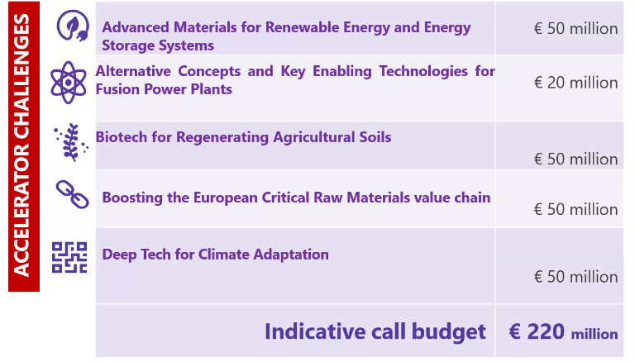
EIC Accelerator Challenges 2026

Slide 61
Advanced Materials for renewable Energy & energy Storage Systems
Context
  We need to develop a new generation of advanced materials with added functions that act as alternatives to Critical Raw Materials (CRMs)
Objective
  Start-ups & SMEs with added functionalities & improved performance for energy storage or energy generation / harvesting systems
  Targeted systems address Renewable Energy Systems, mid/long term energy storage or energy generation/harvesting systems

Slide 62
Advanced Materials for renewable Energy & Energy Storage Systems
Scope
  Development of advanced materials for renewable energy or energy storage systems, encompassing the design, synthesis, characterisation, up-scaling & production
Expected outcomes & impacts
  Develop along value chain
  More diversified and digitally driven value chain
  Accelerate market uptake
  Strengthening the EU Value chain of advanced materials for the energy sector

Slide 63
Alternative Concepts & Key Enabling Technologies for Fusion Power Plants
Context
  Fusion Energy holds the potential to revolutionise energy production but faces many technological, materials and economic barriers
Objective
  Applicants must focus on one or more elements of the fusion value chain including:
    Alternative concepts
    Advanced materials
    Sustainable & stable fuel production
    New laser technologies
    New components / systems for Plasma
    Magnets
    Advanced digital technologies; targets for inertial confinement fusion
    Others Key enabling technologies will also be considered

Slide 64
Alternative Concepts & Key Enabling Technologies for Fusion Power Plants
N.B. – EIC Accelerator but applicants can be at TRL4-6 at point of application
Regardless of area addressed demonstrate how TRL is advanced in one or more critical bottlenecks. Including cost-effectiveness, design, construction and operation of commercially viable fusion power plants.
Scope
  Advancing new fusion reactor concepts and key enabling technologies for fusion power plants.
Outcomes
  By developing and scaling up breakthrough innovations for fusion energy; expected to:
    Keep technology leadership & build value chain
    Enhance competitiveness attract new deep tech start-ups etc etc etc

Slide 65
Biotech for regenerating Agricultural Soils
Context
  EU Soils are under increasing pressure from various sources, including contamination by microplastics, heavy metals, persistent organic pollutants as well as the inappropriate use of fertilisers,
Objective - Reinforcing soil-based agricultural production, encompassing food, feed and biomass through biotech deep tech driven solutions that will:
  Improve soil health and enhance quality of agricultural products
  Address soil pollution to restore, enhance and protect soil
  Reduce dependency on hazardous chemicals, enhance soil fertility and health while minimising environmental impacts

Slide 66
Biotech for regenerating Agricultural Soils
Scope – one or more of the following areas
  Bioremediation technologies
  Soil and Soil microbiome management technologies
  Renewable fertilisers and bio stimulants
Outcomes
  Scale deep-tech solutions that will improve soil health and the sustainability, efficiency and resilience of the European Agricultural Sector, which spans food, feed and biomas.
  Will also support challenges linked to climat echange and environment stresses

Slide 67
Boosting the European Critical Raw Materials (CRM) value chain
Context
  Secure access to CRMs will reduce Europe’s dependence on unreliable suppliers, introducing circularity and make the most of EU’s limited resources
Objective – in one or more of the following areas:
  Exploration of critical and strategic raw materials
  Extraction, processing and metallurgy refining for the supply of primary critical and strategic raw materials
  Recycling from end-of-life products for the supply of secondary critical and strategic raw materials
N.B. life cycle analysis (LCA) required

Slide 68
Boosting the European Critical Raw Materials (CRM) value chain
Scope
  Deep-sea mining does not fall within the scope of this call
  Strengthening the supply of primary critical and strategic raw materials in the EU
  Increasing the recovery rate of critical and strategic raw materials as set out in the CRMA
Outcomes
  Expected to contribute to the secure supply of sustainability produce primary and secondary critical and strategic raw materials for EU industrial Chains
  Help strengthen the EU mining value chain

Slide 69
Deep tech for Climate Adaptation
Context
  Europe is warming faster than any other continent
  4 key risks for Europe
    Mortality and morbidity of people and changes in the Ecosystem due to heat
    Heat and drought stress on crops
    Water scarcity, and
    Flooding and sea level rise
Objectives
  To improve Europe’s Climate resilience by scaling up companies and solutions and connect them to the Mission’s regions and local authorities

Slide 70
Deep tech for Climate Adaptation
Scope
  One of the following priorities
  Combating extreme heat in urban environments
  Climate Smart agriculture
  Combatting water scarcity
  Flood & coastal protection
Outcomes
  Develop and commercially scale timely solutions needed across Europe to adapt to key climate risks.

Slide 71



UK Participation in
the European Institute of
Innovation & Technology (EIT)
Teresa Arumardi
UK National Contact Point (NCP) for EIT
28/1/2026
Notes:
The abstract pattern can be removed or repositioned if required. Be careful to ‘Send to Back’ so that it does not obscure any important information.

Slide 72





Objectives
EIT in Horizon Europe
EIT
Activities
Knowledge & Innovation Communities (KICs)
Opportunities

Slide 73



EIT in Horizon Europe
€95.5bn funding agreed for 2021-2027
Pillar I
Pillar II
Pillar III
Excellent Science
Global Challenges
Innovative Europe
European Research Council
Health
Culture, Creativity and Inclusive Society
Civil Security for Society
Digital, Industry and Space
Climate, Energy and Mobility
Food, Bioeconomy, Natural Resources, Agriculture and Environment
European Innovation Council (EIC)
Marie Sklodowska-Curie Actions
European Innovation Ecosystems (EIE)
Clusters
Research Infrastructures
European Institute of
Innovation & Technology (EIT)
€24.9bn
€13.4bn
Joint Research Centre
€53.8bn
Widening Participation and Strengthening the European Research Area
Widening participation and spreading excellence
Reforming and enhancing the European R&I system
N.B. Budgets shown are for 2021-2027. Budgets will be higher than above once the UK and other Associated Country contributions are included.
Key
Open to all research and innovation fields
Challenge driven – must solve the problem posed – not bottom-up idea driven

Slide 74




EIT – Europe’s Largest Innovation Network
1,400
Companies Including SMEs
What is the EIT?
The European Institute of Innovation and Technology (EIT) drives innovation in Europe by supporting entrepreneurs, innovators and students across Europe to turn their best ideas into reality.
How does the EIT work?
2,400+
Partners Across Europe
Companies
500
Higher Education Institutions
350
Research Centres
EIT
Innovation Community
Universities
Research Centres
Trains a new generation of entrepreneurs
Develops innovative products & services
Powers
start-ups & scale-ups
250
Cities, Regions and NGOS

Slide 75

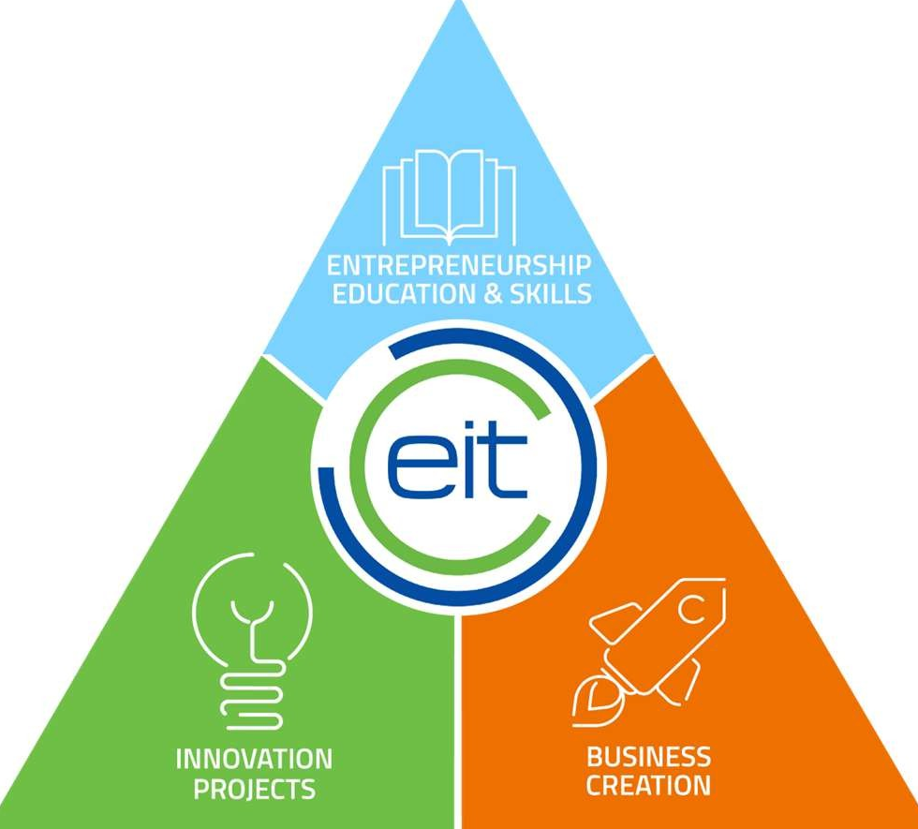


EIT Activities
EDUCATION & SKILLS
Creating future innovators:
Deliver entrepreneurs and provide business and industry with a skilled workforce
WATCH VIDEO
INNOVATION
Breaking down the barriers for collaboration:
Innovation projects between universities, research organisations and business that helps to turn research into commercial products and services
WATCH VIDEO
BUSINESS CREATION
Turning ideas into businesses.
Help start-ups and ventures to start and accelerate the growth of their business.
WATCH VIDEO

Slide 76

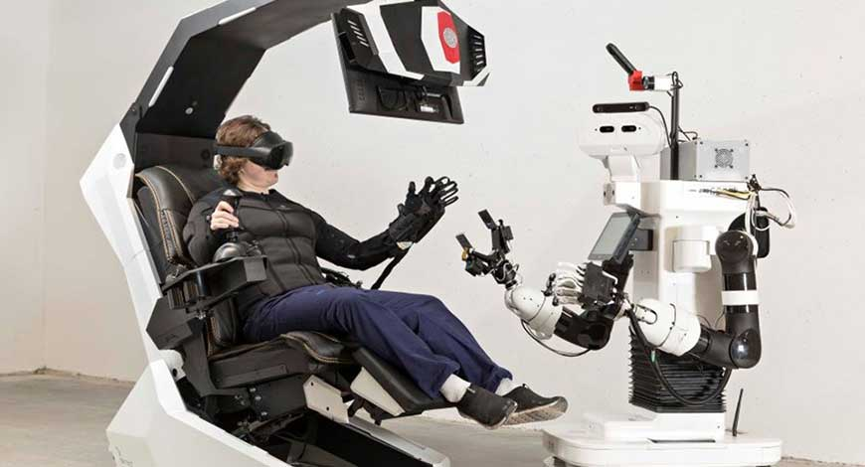
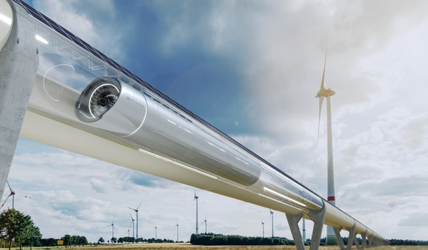






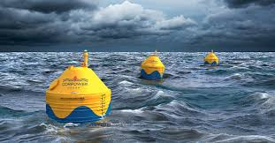
EIT Knowledge & Innovation Communities (KICs)
EIT CLIMATE
EIT DIGITAL
EIT INNOENERGY
EIT HEALTH
Accelerating the transition to a zero-carbon economy
Drive Europe’s digital transformation
Achieve a sustainable energy future for Europe
Healthier lives for EU Citizens
EIT RAW MATERIALS
EIT FOOD
EIT MANUFACTURING
EIT URBAN MOBILITY
Develop raw materials into a major strength for Europe
Lead a global revolution in food production & innovation
Increase Europe’s manufacturing competitiveness
Smart, green & integrated transport
The EIT KICs and their partners make up the
EIT Community
EIT CULTURE & CREATIVITY
EIT WATER
Unite Europe’s creatives
Launched in 2025
Notes:
As an EU body we have a very special mandate – to direct innovation to solve global challenges. How do we solve global challenges? How do we focus our support? We create communities that are thematic – in areas that need innovation the most. This is central, as we mobilize thematic experts ( so we don’t just bring together universities, business and research centers, but for example, we bring together, university faculties specializing in Food, with research centres working on agriculture with businesses and industry partners selling food products or goods). Our KICs are then able to channel their partners’ expertise to power innovations, support start-up and budding entrepreneurs growing the sustainability and future of their sectors.
Our 9 KICs (soon to be 10 with the inclusion of EIT Water) are referred to as the EIT Community

Slide 77



EIT Opportunities
EIT Opportunities
EIT KIC websites

Slide 78
Highlighted Opportunities
EIT Higher Education Initiative (HEI)
EIT Urban Mobility
28 Digital

Slide 79
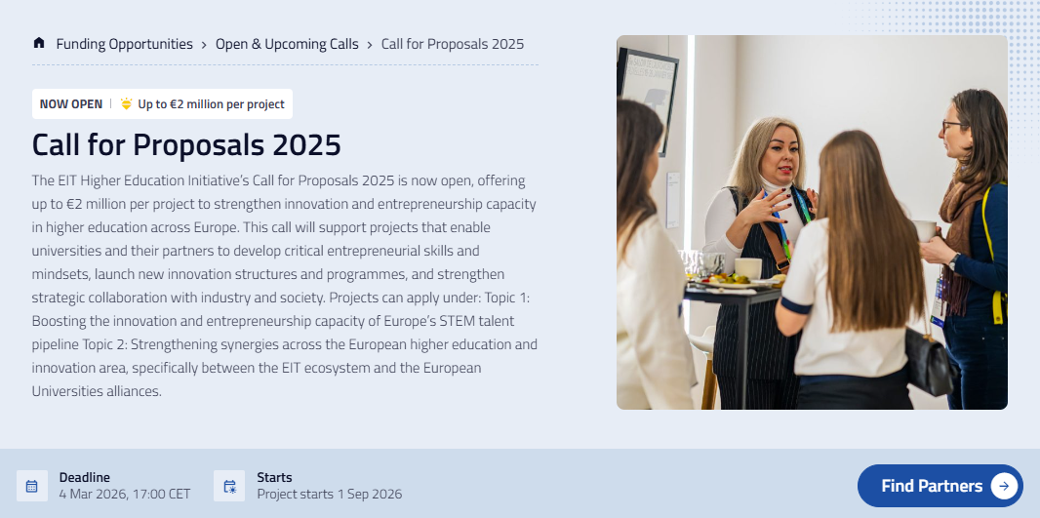

EIT Higher Education Initiative (HEI)
Call for Proposals 2025
This call will support projects that enable universities and their partners to develop critical entrepreneurial skills and mindsets, launch new innovation structures and programmes, and strengthen strategic collaboration with industry and society.
This call offers up to €2 million per project.
Deadline:
  4 March 2026
Contact:
  HEI@eitrawmaterials.eu
  Feel free to cc me ncp-eit@iuk.ukri.org

Slide 80


EIT Urban Mobility
Urban Mobility Explained (UMX) Open Call 2
This call is designed to accelerate the development and delivery of high-quality, sustainable professional training and support services that close the urban mobility knowledge gap.
This call offers up to €700,000 per project.
Upcoming cut-off dates:
  29 September 2026
  Additional cut-off dates 2027-2028 TBA
Contact:
  AcademyCall@eiturbanmobility.eu
  Feel free to cc me ncp-eit@iuk.ukri.org

Slide 81


28Digital
SPIN: Rise 2026 Call for Proposals
The call invites proposals for the design and delivery of a 7-week hybrid programme in 2026, combining online training and mentoring with an in-person bootcamp.
This maximum EIT funding amount is €85,000 per SPIN: Rise programme designed for mandatory minimum of 20 participants.
Deadline:
  17 March 2026
Upcoming info session:
  5 February 2026

Slide 82
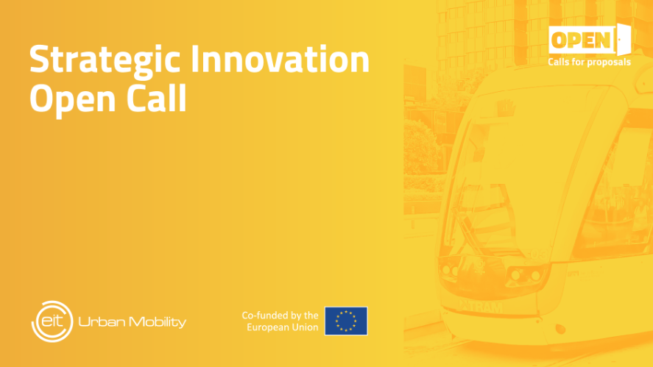

EIT Urban Mobility
Strategic Innovation Open Call
The call aims to accelerate the deployment of impactful solutions that address the most pressing challenges in urban mobility.
Sectors in focus:
  Public Transport - Urban Logistics - Electrification of transport and alternative fuels - Mobility data management - Health and mobility
Upcoming cut-off dates:
  12 February 2026
  18 June 2026, February 2027, June 2027
Contact:
  innovationcall@eiturbanmobility.eu
  Feel free to cc me ncp-eit@iuk.ukri.org

Slide 83



Get in Touch
Claire Griffin
UK NCP for EIC and EIE
NCP-EIC-Transition-Accelerator@iuk.ukri.org
Teresa Arumardi
UK NCP for EIT
ncp-eit@iuk.ukri.org
UK NCP Newsletter
Notes:
Change to over 100M

Slide 84
Thank you
LinkedIn:
Innovate UK
YouTube:
Innovate UK

