Slide 1



Horizon Europe: What’s new
in Pillar II
Perry Guess
Horizon Europe National Contact Point, Cross-Cutting
Innovate UK
NCP-CrossCutting@iuk.ukri.org
Notes:
I’m Perry Guess, one of the 24 Horizon Europe National Contact working in UKRI
I sit within Innovate UK and have a cross-cutting remit.
Essentially this means I know a little about a lot, right across Horizon Europe, whereas most of my NCP colleagues know a lot about a little bit of Horizon Europe as they are focused on specific aspects – but more on that later.

Slide 2



Structure of Horizon Europe
Pillar I
Pillar II
Pillar III
Excellent Science
Global Challenges European Industrial Competitiveness
Innovative Europe
European Research Council
Health
Culture, Creativity and Inclusive Society
Civil Security for Society
Digital, Industry and Space
Climate, Energy and Mobility
Food, Bioeconomy, Natural Resources, Agriculture and Environment
European Innovation Council
Marie Skłodowska-Curie Actions
European Innovation Ecosystems
Clusters
Research Infrastructures
European Institute of Innovation & Technology
Joint Research Centre
€24.9bn
€53.8bn
€13.4bn
Widening Participation and Strengthening the European Research Area
Widening participation and spreading excellence
Reforming and enhancing the European R&I system
N.B. Budgets shown are for 2021-2027. Budgets are higher than above when the UK and other Associated Country contributions are included.
Key
Open to all research and innovation fields
Challenge driven – must solve the problem posed – not bottom-up idea driven
Notes:
Don’t forget to mentioned EIT:
new EIT Water KIC has just been launched last month, no confirmation of opportunities yet, but UK audience can ‘keep an eye out’.
EIT Higher Education Initiative 2025 has just been launched this week: Call for Proposals 2025 - EIT Higher Education Initiative, closing 4/3/2026. This opportunity could be highly relevant to this audience and so signposting to it would be helpful.
The EIT Higher Education Initiative’s Call for Proposals 2025 is now open, offering up to €2 million per project to strengthen innovation and entrepreneurship capacity in higher education across Europe.
This call will support projects that enable universities and their partners to develop critical entrepreneurial skills and mindsets, launch new innovation structures and programmes, and strengthen strategic collaboration with industry and society.
Projects can apply under:
Topic 1: Boosting the innovation and entrepreneurship capacity of Europe’s STEM talent pipeline
Topic 2: Strengthening synergies across the European higher education and innovation area, specifically between the EIT ecosystem and the European Universities alliances.
Deadline
4 Mar 2026, 17:00 CET
Starts
Project starts 1 Sep 2026

Slide 3
Horizon Europe - Work Programmes 2026/27
Pillar II Clusters Total = €7,027m over 413 Call Topics*
€3,782m
€2,578m
€202m
€223m
€20m
€76m
The values are what is included in the Horizon Europe 2026/27 Work Programme for each Cluster. Further funding for thematic areas is available in Missions, Joint Undertakings, KICs etc.
€1,248.3m
€1,950.6m
€1501m
€388.5m
€693.5m
€1,245.3m
*
Notes:
Obviously, the first ‘what’s new’, is there’s a completely new set of WPs for 2026/27. These contain some €7,027m opportunities across 413 call topics. In the usual way, many build upon previous call topics, so be sure to read the details and use CORDIS to review and, where appropriate, reach out to past relevant projects, particularly where IAs build on RIAs, for example. It’s worth noting , some of the WPs include some call topics from Partnerships, particularly Cluster 5 and 6, but not all do. There are some 50 Partnership and many are refreshing their work programme, which will come out in time.
Pre‑Commercial Procurement (PCP)
PCP is a public demand-driven R&D procurement used when no close-to-market solution exists.
Public Procurement of Innovative Solutions (PPI)
PPI uses the public sector’s purchasing power as an early adopter for innovative solutions already near-market or in limited supply.

Slide 4
Horizon Europe - Work Programmes 2026/27
3
3
5
8
DISTRIBTION (€m & #Topics)
4
15
The values are what is included in the Horizon Europe 2026/27 Work Programme for each Cluster. Further funding for thematic areas is available in Missions, Joint Undertakings, KICs etc.
DESTINATIONS (%total)
*

Slide 5
Horizon Europe - Work Programmes 2026/27
DISTRIBTION (€m & #Topics)
The values are what is included in the Horizon Europe 2026/27 Work Programme for each Cluster. Further funding for thematic areas is available in Missions, Joint Undertakings, KICs etc.
DESTINATIONS (%total)
*

Slide 6

Horizon Europe - Work Programmes 2026/27
Cluster 1: Health
[Feb26→Ap26] [Feb27→Ap27] [Feb27→Ap27→Sept27] [June27→Sept27]
Cluster 2: Culture, Creativity and Inclusive Society
[May26→Sept26] [May27→Sept27] [Mar27→May27→Sept27]
Cluster 3: Civil Security For Society
[Mar26→Sept26] [May26→Nov26] [Mar27→Sept27] [May27→Nov27]
Cluster 4: Digital, Industry and Space
Industry: [Jan26→Ap26] [Dec25→Mar26→Oct26] [Sept26→Feb27] [Sept26→Feb27→Sept27]
Space: [Mar26→Sept 26] [Mar27→Sept27]
Digital: [Jan 26→Ap26] [Nov26→Mar27]
Cluster 5: Climate, Energy and Mobility
[Dec25→Mar&Ap26] [Dec25→Mar/&Ap26→Oct26]
[May26→Sept26] [June26→Oct26] [Aug26→Dec26]
[Nov/Dec26→Mar27] [Dec26→Ap27] [Dec26→Ap27→Oct27]
[May27→Sept27] [June27→Oct27] [Aug27→Dec27]
Cluster 6: Food, Bioeconomy Natural Resources, Agriculture and Environment
[Ap26→Sept26] [Jan26→Ap26] [Aug26→Nov26] [Feb26→Ap26→Sept26]
[Ap27→Sept27] [Feb27→May27] [Feb27→Ap27→Sept27]
All Pillar II Work Programmes
Notes:
I’m please to say that the 2026/07 Work Programmes were published before Christmas by the Commission and can be accessed using the links on the slide.
The Funding and Tenders Portal has also been updated to show these – with the exception of some of the Missions
I’ve highlighted the opening and closing dates in this slide to give you a feel of the timelines.

Slide 7
Horizon Europe - Work Programmes 2026/27
EU Missions
Climate Mission: [Feb26→Sept26] [Feb27→Sept27]
Cancer Mission: [Feb26→Sept26] [Feb27→Sept27]
Oceans & Water Mission: [Feb26→Sept26] [Feb27→Sept27]
Climate-Neutral Smart Cities: [Feb26→Oct26] [Feb27→Oct27]
Soil: [Feb26→Sept26] [Feb26→Ap26→Sept26] [Feb27→Sept27] [Feb27→Ap27→Sept27]
City + NEB Joint Call: [Feb26→Oct26]
Climate + Cities + NEB Joint Call: [Feb26→Sept26]
Soil + Climate Joint Call: [Feb26→Sept26] [Feb27→Sept27]
Soil + Cancer Joint Call: [Feb27→Sept27]
Climate + Cities Joint Call: [Feb27→Sept27]
New European Bauhaus Facility and Horizontal Activities
NEB: [May26→Dec26] [May27→Dec27]
Soil Mission + NEB Joint Call: [May27→Sept7]
Widening participation and strengthening the European Research Area
[Dec26→Mar26][Jan26→Apr26] [Apr26→Sept26] [Jan26→Sept26] [Sept26→Mar27]
[Dec26→Mar27] [May27→Nov27] [Ap27→Sept27]
See ‘Widening participation and spreading excellence’
All Pillar II Work Programmes
Notes:
As for the Clusters in Pillar 2, the Work Programmes for Missions and NEB were published just before Christmas. I’ve also added a link to the WIDERA work programme, that was published then too.

Slide 8
Key Novelties – General Introduction
Less prescriptive topic descriptions
Less prescriptive topic descriptions
Shorter topic descriptions
Less prescriptive – increasing flexibility
More open topics* in Pillar II
Shorter Work Programmes (33% shorter than WP2023-24)
*Open topics are topics for which the expected outcomes or impacts are clearly defined, but the pathways and methods to achieve them remain open-ended.
Fewer topics
Fewer topics
35% reduction compared with WP2023-24
Greater focus on fewer but larger topics – increasing impact
50% decrease in topics funding only one project and increase in number of project funded per topic
Increased use of lump-sum
50% of call budget
Especially grants below €10m
Increased use of lump-sum
Work Programme 2026-2027 – 1. General Introduction

Slide 9
Key Novelties – General Introduction
‘Newcomer’ & SME-friendly topics
‘Newcomer’ & SME-friendly topics
Includes topics specifically designed to encourage SMEs, start-ups and scale-ups, civil society organisations and small public administrations participation
More topics allowing financial support to third parties^
^Grants with financial support to third parties
(‘FSTP’ or ‘cascade funding’) are EU grants which include a budget window that can be used by the beneficiaries to publish calls for recipients downstream, in cascade mode. They are allowed if the call conditions of the EU call/topic provide for it
Use of two-stage calls
Use of two-stage calls
41 call topics with two-stage evaluation
Mostly blind evaluation of short proposals – to overcome risk of bias
Shorter time to grant - through shorter first stage submission period and simplification of evaluation process (from 17m to 14m)
Reduces complexity of proposal template
Reduces complexity of proposal template
Simplification of requirements for the impact and implementation sections
Reduction in overall page limit
Work Programme 2026-2027 – 1. General Introduction
Notes:
TWO STAGE CALLS
Time reduction by shortening the First-stage and Second-stage submission windows each by one month
Given this impacts applicants, it will only be implemented where it’s seen as viable
IMPACT simplification:
The "likely scale and significance of the contributions from the project" is no longer part of the evaluation of impact.
Updates Application form part B – Impact
Impact criterion Section 2.1
No longer need to explain the general scientific, economic and societal expected impacts as they are already taken into account in the topic expected impact.
IMPACT TABLE
Whilst now optional, the inclusion of the Impact Table is still encouraged as evaluators find it helpful
IMPLEMENTATON Simplification
Removed time consuming elements in the cost table in the proposal as they don’t impact the assessment of a proposal….including:
Purchase Costs simplified
Other costs and in-kind removed
But…these will be asked for at the Grant Agreement Preparation stage
ONLY APPPLICABLE FOR 2026/27 WP CALL TOPICS – ANY 2025 CALL TOPICS IN 2026 STAY AS THEY WERE

Slide 10
Key Novelties – General Annexes
Page Limits
Page Limits
Full application reduced
40 from 45 pages for RIAs & IAs (Lump Sum 45 from 50)
25 from 30 for CSAs (Lump Sum 28 from 33)
65 form 70 for CoFund
First-stage remains 10 pages
Eligibility Rules
Eligibility Rules
China excluded from IA and most RIAs (except for specific destinations e.g., Cluster 2, parts of Cluster 5 & 6, Missions, Widening)
Chinese universities linked to MIIT barred from all actions
Entities controlled by China cannot join IAs in AI, semiconductors, quantum, biotech.
Associated Countries
Associated Countries
Republic of Korea (Pillar II) & Switzerland (entire Programme form 2025)
Egypt (entire Programme form 2025) & Japan (Pillar II from 2026)
Work Programme 2026-2027 - 15. General Annex
Notes:
CHINA
The restrictions target Chinese entities not Chinese Citizens, and so they do not apply to Chinese citizens working in non-Chinese owned entities
JAPAN
If not associated by the time of the Grant Agreement, organisations in Japan will have to fund via National Funding, and will be Associated Partners not Beneficiaries

Slide 11
Key Novelties – General Annexes
Gender Equality Plans
Gender Equality Plans
As in 2025 – applies to all public bodies, ROs or HEIs
(inc. private owned) legal entities in MS/AS but:
Now applies retroactive to grants awarded under calls with deadlines in 2022 onwards
Requires data collection and monitoring to be reported at least every two years based on indicators, as opposed to annually
Two-Stage Evaluation Threshold
Two-Stage Evaluation Threshold
Increased oversubscription target for stage 2 via changes
to stage 1 assessment%:
2025: Budget target = 1.5–2× available budget
2026–2027: Budget target = 2–3× available budget
% ‘Excellence’ and ‘Impact’ remain the assessment criteria at stage 1 - threshold is expected to normally be set at 8 or 8.5
Work Programme 2026-2027 - 15. General Annex

Slide 12
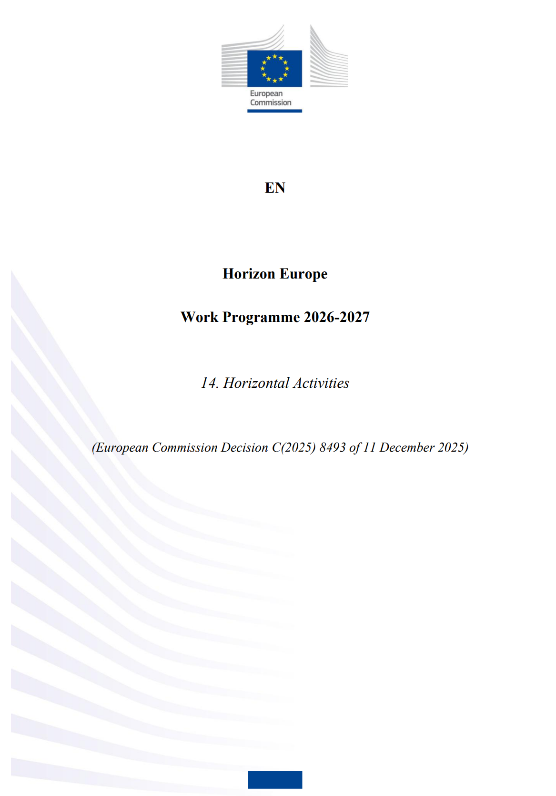
Key Novelties – Other
Horizontal Activities
Horizontal Activities
Groups the horizontal calls
Aims to create critical mass and avoid duplication of budget
Horizontal call - R&I in Support of the Clean Industrial Deal
HORIZON-CID-2026-01: €275m - 2xIA Call Topics - 16 projects - 15 Sept 2026
HORIZON-CID-2027-01: €265m - 2xIA Call Topics - 16 projects - 15 Sept 2027
Horizontal call - AI in science
HORIZON-RAISE-2026-01: €27.8m - 2xRIA Call Topics - 2 projects - 21 April 2026
HORIZON-RAISE-2027-01: €32m - 2xRIA Call Topics - 4 projects - 02 Feb 2027
Horizontal call - RAISE Doctoral Networks for AI in Science
HORIZON-RAISE-2026-01-MSCA: €30m - TMA Doctoral Networks - 24 Nov 2026
See also: Horizon Implementation day – Novelties in the 2026-2027 Horizon Europe work programme (20 January 2026)

Slide 13

UK NCP Info Days/Training
Forthcoming events:
Horizon Europe Reapply Masterclass 2026
4 Feb - Bristol; 11 Feb - Edinburgh; 4 Mar - Manchester; 18 Mar - London
Recent events:
Unlocking Horizon Europe Cluster 5 Opportunities: Climate, Energy & Mobility (2026–2027) - 11th Nov 2025
Horizon Europe: Adaptation to Climate Change and 100 Climate-Neutral & Smart Cities - 13th Nov 2025
2026 ERC Proof of Concept Grant - 11th Dec 2025
EIC Pathfinder - DeepRAP: Deep Reasoning, abstraction & planning towards trustworthy Cognitive AI Systems – 11 Dec 2025
EIC Pathfinder Challenges – 2nd / 4th / 11th Dec 2025
EIC Advanced Innovation Challenges (pilot) – 4th Dec 2025
Regularly check: past events & forthcoming events

Slide 14
European Commission Info Days
Cluster 1: Health – 10 Feb
Cluster 2: Culture, creativity and inclusive society – 26 Mar
Cluster 3: Civil security for society – 4 Mar
Cluster 4: Digital, Industry and Space – 29-30 Jan
Cluster 5: Climate, Energy and Mobility – 15 Jan
Cluster 6: Food security, Bioeconomy, Natural Resources, Agriculture and Environment – 22-23 Jan
WIDERA Widening – 22 Jan
EU Missions – 20/21 Jan
Research Infrastructures – 18 Mar
EIC Info Day recording – Nov 2025
Find out more here: Upcoming info days

Slide 15

Thank you
NCP-CrossCutting@iuk.ukri.org

