Slide 1




New European Bauhaus in Horizon Europe
Hazel Dalgård, UK NCP NEB, UKRI
NCP-bauhaus@ukro.ac.uk

Slide 2
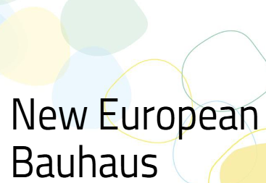
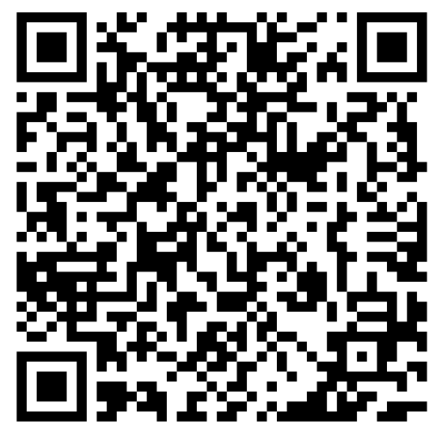
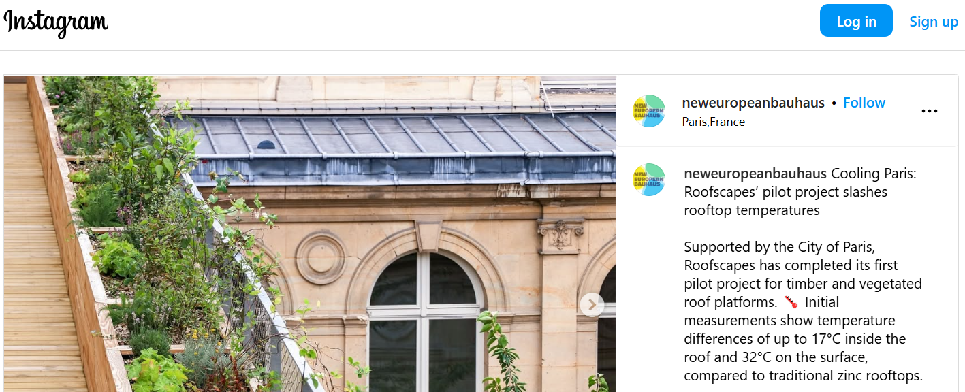
Sustainable, inclusive, and beautiful neighbourhood transformation
UK NEB site
If the European Green Deal has a soul, then it is the New European Bauhaus which has led to an explosion of creativity across our Union. Ursula von der Leyen, President of the European Commission
City of Paris Rooftop cooling

Slide 3
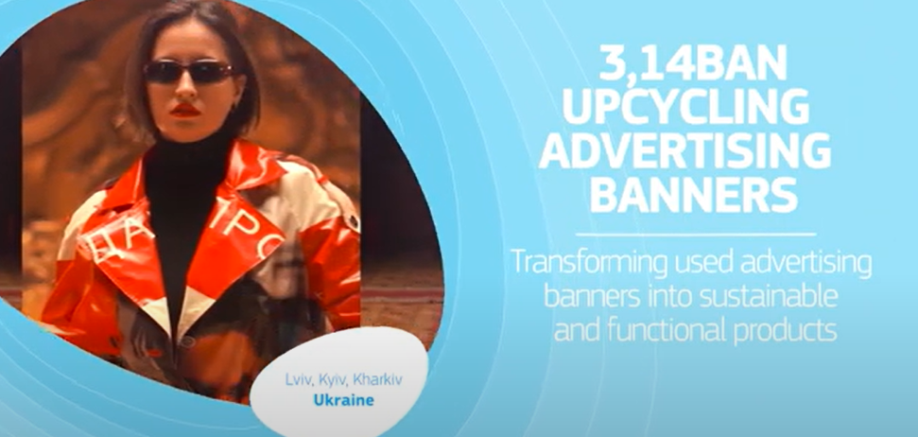
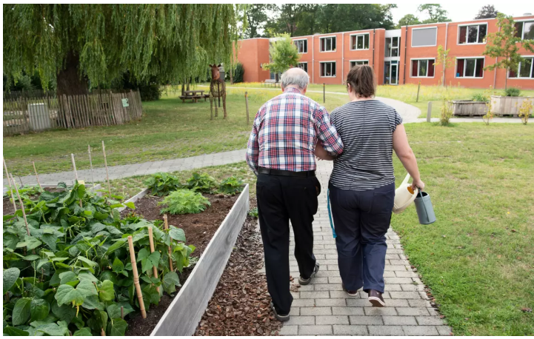
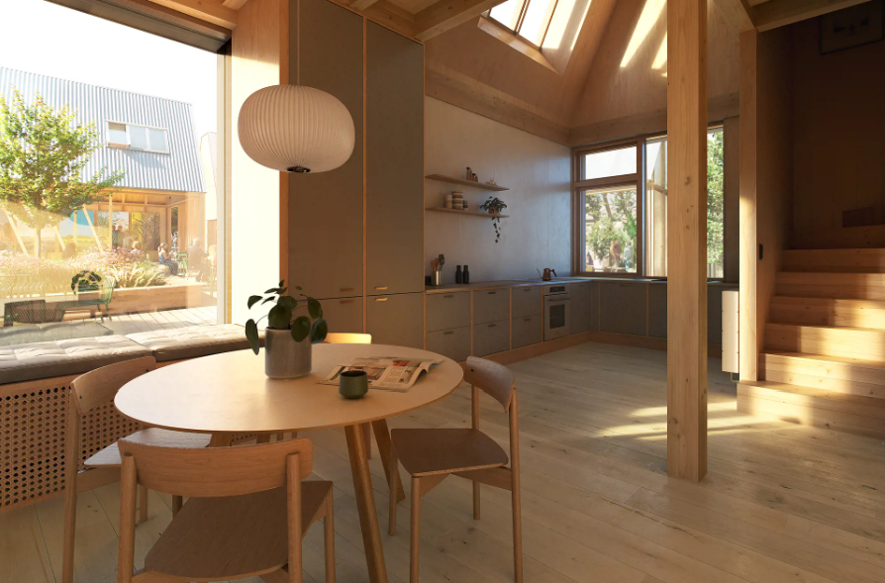
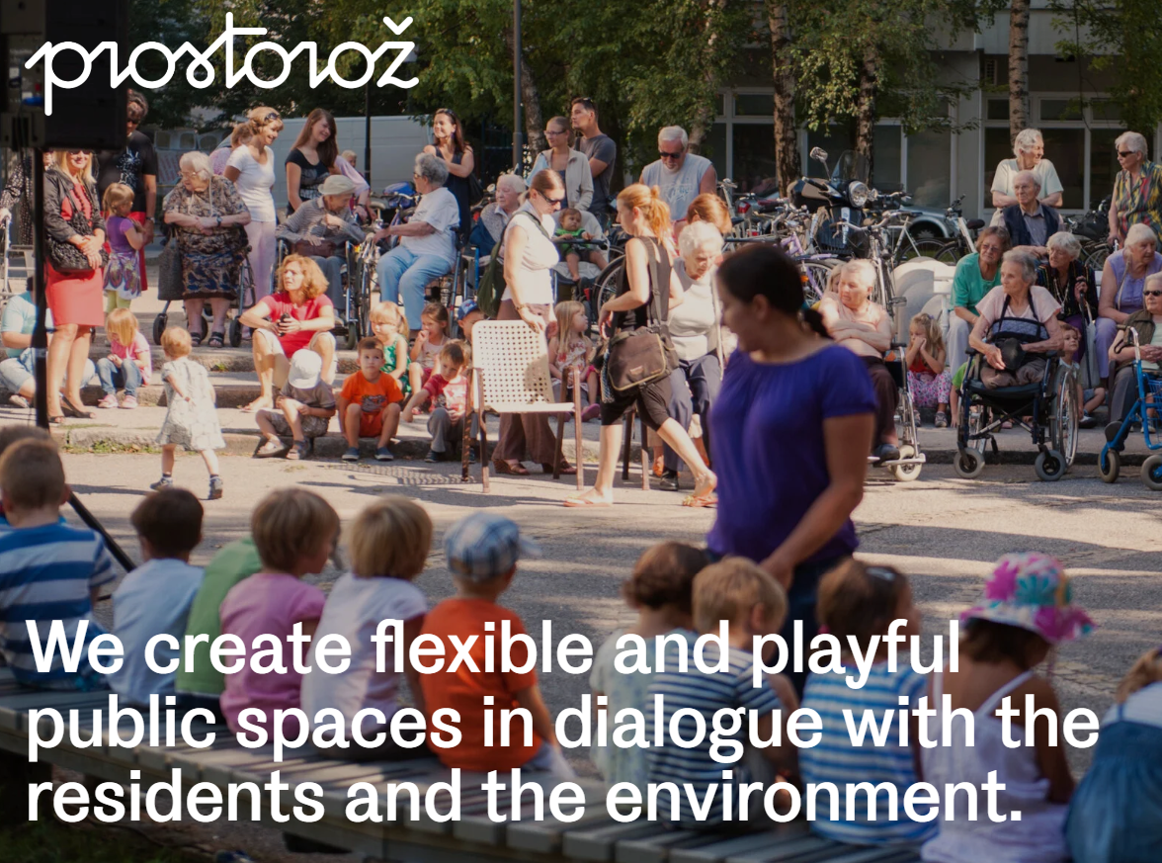
NEB is for change makers!
Selection of NEB 2025 Prizes and runners up – Full details:
https://prizes.new-european-bauhaus.europa.eu/winners-prizes

Slide 4
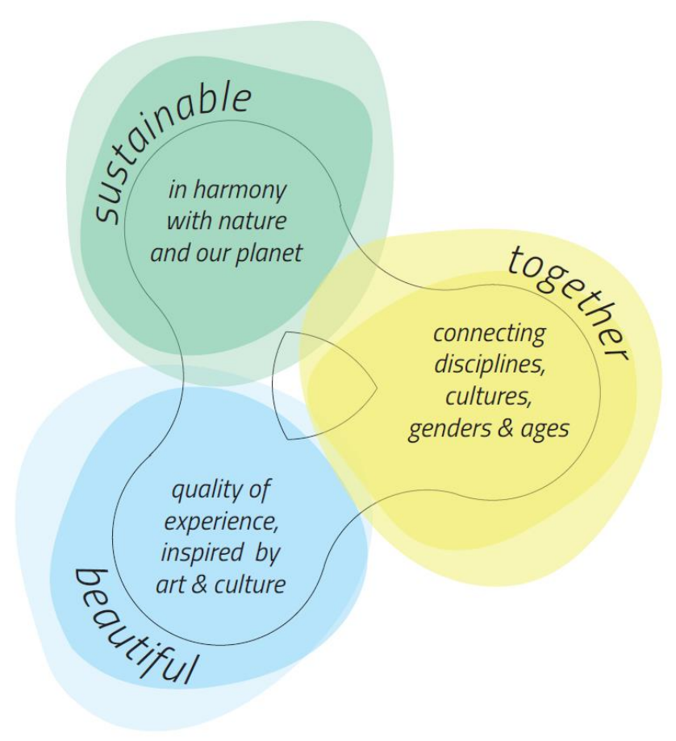
Horizon Europe NEB Destinations
Three R&I destinations (broad topics): (starting points – NEB is wholistic!)
1. Connecting the green transformation, social inclusion and local democracy
2. Circular and regenerative approaches for the built environment
3. Innovative funding and new business models for the transformation of neighbourhoods
NEB expanded compass values

Slide 5
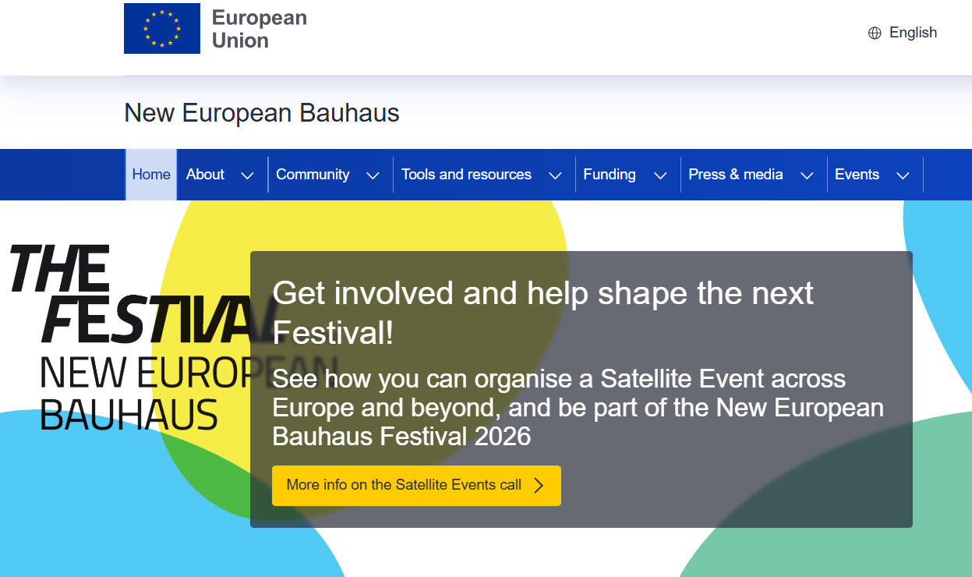
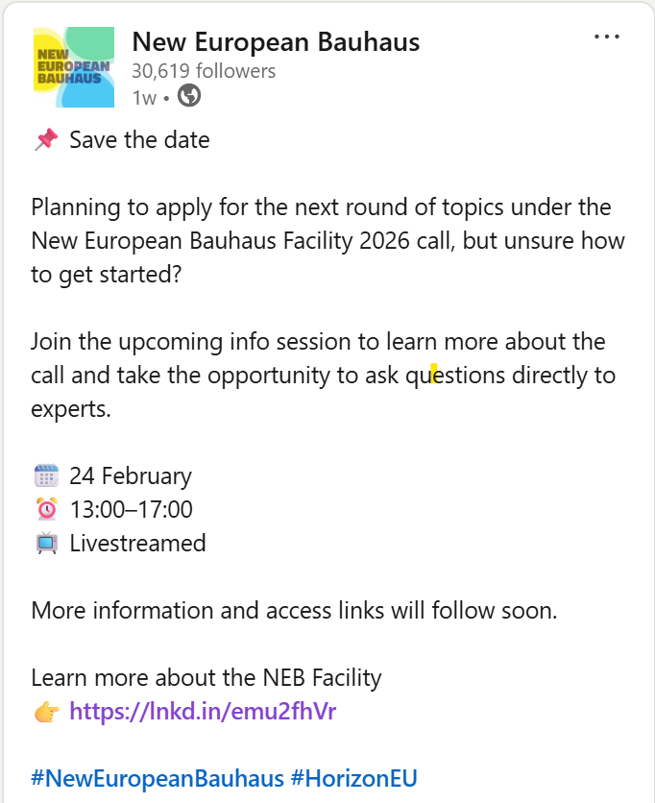
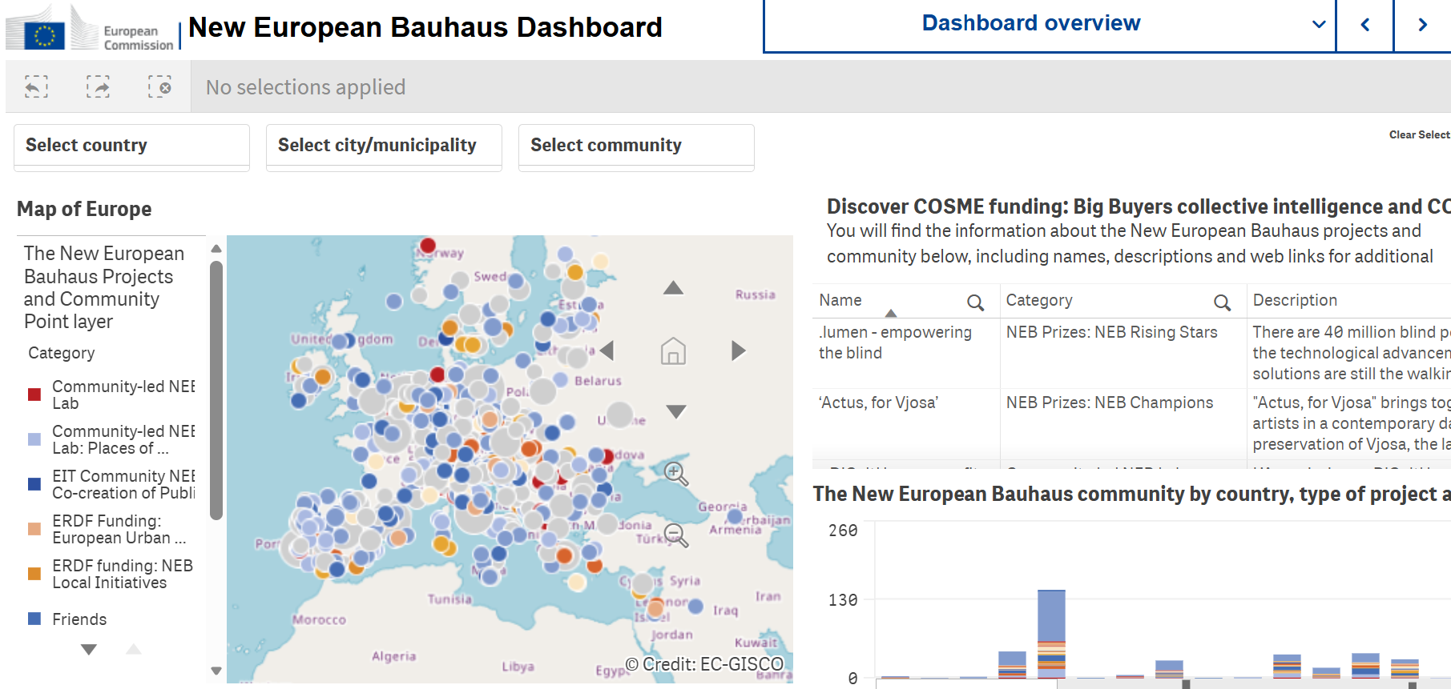
NEB - EC website– contact building, resources, events
Consortia building and project design tools.
NEB Info Days (Horizon Europe) 2026– essential viewing! Online, date tbc.
NEB Festival 9-13 June, Brussels, and satellite events in other countries.
NEB Facility webinar – 24 02 26 (overarching – UK is only eligible for Horizon Europe Calls, not Roll out calls.)
https://new-european-bauhaus.europa.eu/index_en

