Slide 1


MSCA Novelties
Raquel Meco Melguizo
MSCA National Contact Point (UK)
12 February 2026

Slide 2


Agenda
1 Quiz
2 Setting the scene
MSCA in Horizon Europe
3 MSCA
Principles and Actions
4 Novelties
MSCA Work Programme 2026-2027
5 Questions

Slide 3
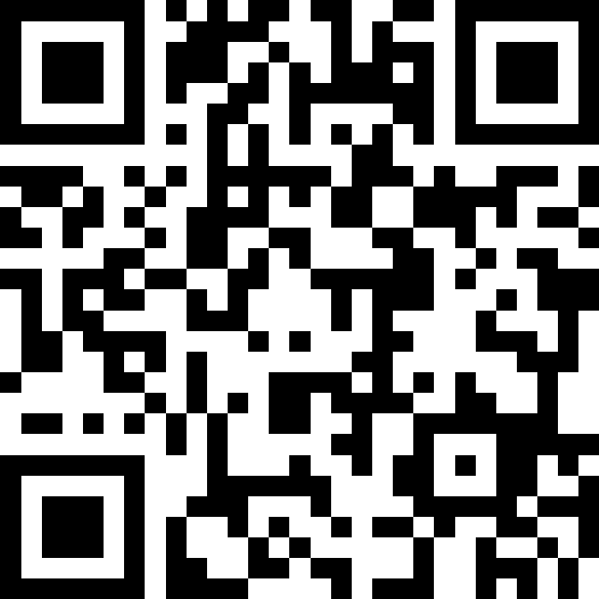
MSCA Quiz
Join at slido.com
#2917 4996

Slide 4
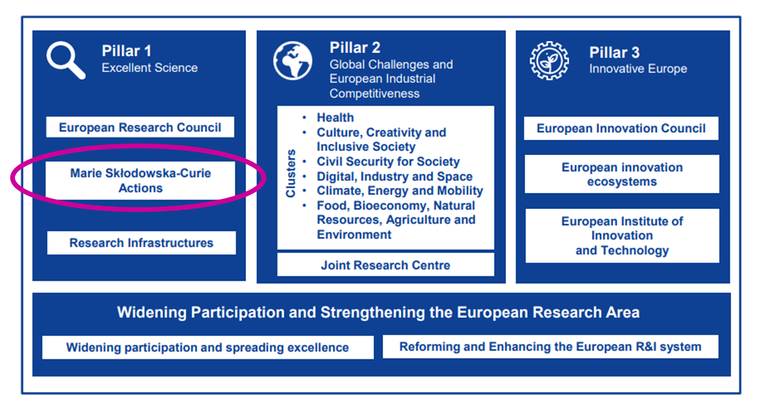
MSCA in Horizon Europe
The EU’s reference programme for doctoral education and postdoctoral training
Equipping researchers
with new knowledge
and skills through mobility
and training
Budget = €6.6billion
Notes:
Horizon Europe is the EU’s key funding programme for research and innovation. It lasts for 7 years (2021-2027), and it has a budget of EUR 93.5 billion, of which 7% goes to MSCA actions.
Since their launch in 1996, MSCA has become the EU’s reference programme for doctoral education and postdoctoral training.
To put this into context, in Horizon 2020, the previous framework programme for R&I, that run from 2014 to 2020, the MSCA supported 65 000 researchers in Europe and beyond and funded over 1 000 excellent international doctoral networks.

Slide 5
MSCA Principles
Excellence
Recruitment and working conditions
Open Science and Responsible Research and Innovation
Mobility
Bottom-up and open to the world
Supervision
European Green Deal
Notes:
Excellence: MSCA focuses not only on the excellence of the individual fellows, but also the collaboration fostered, the research conducted as well as the training, supervision and career guidance provided.
Mobility: physical mobility across countries, sectors and disciplines is central.
Bottom-up and open to the world: MSCA are open to all research domains, without any prescribed priorities. International cooperation is key to set-up collaborations worldwide and attract foreign talents to Europe.
Inclusiveness and working conditions: MSCA embeds the European Charter for Researchers principles—open recruitment, fair working conditions, and support for researchers at risk and underrepresented groups.
Supervision: supervision is one of the crucial elements of successful research. Guiding, supporting, directing, advising and mentoring are key factors for a researcher to pursue their career path.
Open Science and Responsible Research and Innovation: MSCA endorses Open Science and Responsible Research and Innovation (RRI) through engaging society at large, integrating the gender and ethical dimensions, promoting Open Science practices through targeted training activities.
European Green Deal: MSCA supports the EC’s commitment to tackling climate and environmental-related challenges. All MSCA projects are encouraged to address the principles of the MSCA Green Charter and implement measures to minimise the environmental footprint of their activities

Slide 6
MSCA Actions
Doctoral Networks (DN)
Doctoral programmes in and outside academia, inc. joint & industrial doctorates
Total budget 2026: €593.03 million
Opening call: 28/05/2026
Deadline: 24/11/2026
Postdoctoral Fellowships (PF)
Support to excellent postdoctoral researchers
Total budget 2026: €399.05 million
Opening call: 09/04/2026
Deadline: 09/09/2026
Staff Exchanges (SE)
Support for research and innovation staff exchanges
Total budget 2026: €97.92 million
Opening call: 16/12/2025
Deadline: 16/04/2026
COFUND
Co-funding doctoral and postdoctoral programmes
Total budget 2026: €105.46 million
Opening call: 16/12/2025
Deadline: 08/04/2026
MSCA and Citizens
Public outreach events aiming to bring research and researchers closer to the public
There will not be a call in 2026
Choose Europe for Science (CEfS)
Co-funding postdoctoral programmes
There will not be a call in 2026
Notes:
DN: Supports doctoral programmes developed by universities, research institutions and research infrastructures, businesses including SMEs, and other socio-economic actors from different countries across Europe and beyond.
PF: Enhances the creative and innovative potential of researchers holding a PhD.
SE: Promotes innovative international, inter-sectoral and interdisciplinary collaboration in research and innovation.
COFUND: Co-finances new or existing national, regional or international doctoral programmes and postdoctoral fellowship schemes.
MSCA & Citizens: Aims to bring research and researchers closer to the public at large, to increase awareness of research and innovation activities and to boost public recognition of science and research education.
There will not be a call in 2026, but in 2027 Choose Europe for Science will replace the MSCA COFUND-Postdoctoral. Max EUR 5M per beneficiary (as opposed to EUR 3.5M), PF contribution model for the EU-funded phase (including CCCs); flexibility regarding the order of the two phases.
Slightly lower budget for all the actions in 2026, and likely to have higher submission numbers as we’ve seen in the last rounds of MSCA PF and DN
MSCA PF expected to open nearly a month earlier (from May to April)

Slide 7
Novelties – All Actions
Introducing a minimum score threshold of 3 on all evaluation criteria (‘Excellence’, ‘Impact’ and ‘Quality and efficiency of the implementation’)
Including AI in the list of transferrable skills
Reference to restrictions on participation of certain Chinese universities
Increasing 2026-2027 living/top-up allowances
Increasing the maximum duration of secondments from 1/3 to half of the fellowship duration
Notes:
Introducing a minimum score threshold of 3 on all evaluation criteria (‘Excellence’ (50%), ‘Impact’ (30%) and ‘Quality and efficiency of the implementation’ (20%))
AI will be included in the list of transferrable skills
Restriction on participation of Chinese universities linked to the Ministry of Industry and Information (MIIT)
Increase 2026-2027 living/top-up allowances to cope with inflation
Increasing max duration of secondments from 1/3 to half of fellowship duration. For MSCA Global PF this applies to the outgoing phase

Slide 8
Novelties – Particular Actions
For DN and PF only, increasing the UK’s Country Correction Coefficients (CCC) that applies to the living allowance from 141,7% to 143,5%
For PF only, increasing re-submission score to 80% to align with DN
For DN, relaxing the enrolment rule in doctoral programmes for beneficiaries from non-associated Third Countries
For SE, relaxing eligibility conditions to allow same-sector secondments, inc. dropping the 1/3 rule on interdisciplinarity
For SE, removing the 1-month employment prior to the secondment rule
Notes:
For DN and PF, the UK’s Country Correction Coefficients (CCC) that applies to the living allowance has increased from 141,7% to 143,5%
For PF only, increasing re-submission score from 70% to 80% to align with DN re-submission restrictions
For DN, researchers recruited by beneficiaries established in non-associated third countries, their enrolment may take place solely in a doctoral programme offered in the country of the beneficiary by way of exception.
For SE, former rule: up to 1/3 of the total secondments funded by the EU can be secondments between different Member States/Associated Countries within the same sector (academic or non-academic) if the proposal is considered as interdisciplinary by the evaluators. This rule has dropped; however, same sector secondments are strongly encouraged to be interdisciplinary.
For SE, former rule: Supported staff members must be actively engaged in or linked to R&I activities for at least one month (full-time equivalent) at the sending institution before the first period of secondment. This rule has dropped to give more flexibility to participants to the scheme.

Slide 9
Resources/ Upcoming MSCA sessions
Resources | MSCA Information webinars
EU Funding & Tenders Portal MSCA 2026-2027 Work Programme MSCA Financial Guide MSCA Guidelines on Supervision Our MSCA Factsheets RADIANCE project | MSCA COFUND 2026 Call Information webinar, 5 February, 10:00-12:00. Recording will be available soon! MSCA Staff Exchanges 2026 Call Information webinar, 24 February, 10:00-12:00 MSCA Doctoral Networks, 25 June, 10:00-12:00. Registration details will follow soon.
Notes:
RADIANCE provides guide to applicants through a FAQ, Handbooks for each scheme, and the new MSCA matchmaking platform that brings together Academic Organizations, companies, NGOs, supervisors, etc. This is a unique opportunity to generate new contacts and future successful collaborations in the actual and upcoming MSCA calls.

Slide 10

Nothing in life is to be feared, it is only to be understood. Now is the time to understand more, so that we may fear less.
Marie Skłodowska-Curie
mariecurie-uk@ukro.ac.uk

