Slide 1


Horizon Europe – Lump Sum Funding an overview
Chris Young
Horizon Europe UK Legal and Financial National Contact Point
christopher.young@iuk.ukri.org
9th December 2025

Slide 2
Basic principles
Lump sum evaluation and grant agreement follow the standard approach with the same:
Evaluation criteria
Pre-financing and payment scheme
Reporting periods and technical reporting - focusing on completion of work packages
One lump sum share is fixed in the grant agreement for each work package:
Work package completed payment
Payments do not depend on a successful outcome, but on the completion of activities.
Work packages can be modified through amendments (eg. new scientific developments)
Judgement of performance of grant same as any other grant.

Slide 3
Writing a lump sum proposal
To write a lump sum proposal, you:
Use the standard application form;
Present objectives and methodology; address the expected outcomes and impacts as in any HE proposal
Describe in detail the activities covered by each work package
Detailed budget table - define and justify the lump sum - cost estimations (approximation of actual costs + costs eligibility criteria).
Detailed budget table - Excel file - download from the online submission system, complete and submit as an Annex to Part B of your application form.

Slide 4

Project design – Work packages
Work packages distribution:
As many as needed but no more than what is manageable
Work package (WP) - major sub-division of the work plan of your project (number of tasks).
NOT
a single activity
a single task
a % of progress (e.g. 50 % of the tests)
a lapse of time is generally not a WP (e.g. activities of year 1)
WP - long duration - split along the reporting periods (eg. project management) - paid at the end of the reporting period.

Slide 5
Splitting work packages - example
Single long-duration work package
WP no | WP name | YEAR 1 |  |  |  |  |  |  |  |  |  |  |  | YEAR 2 |  |  |  |  |  |  |  |  |  |  |  | YEAR 3 |  |  |  |  |  |  |  |  |  |  |  | YEAR 4
 |  | Reporting Period (RP) 1 |  |  |  |  |  |  |  |  |  |  |  |  |  |  |  |  |  | Reporting Period (RP) 2 |  |  |  |  |  |  |  |  |  |  |  |  |  |  |  |  |  | Reporting Period (RP) 3
 |  | 1 | 2 | 3 | 4 | 5 | 6 | 7 | 8 | 9 | 10 | 11 | 12 | 13 | 14 | 15 | 16 | 17 | 18 | 19 | 20 | 21 | 22 | 23 | 24 | 25 | 26 | 27 | 28 | 29 | 30 | 31 | 32 | 33 | 34 | 35 | 36 | 37 | 38 | 39 | 40 | 41 | 42 | 43 | 44 | 45 | 46 | 47 | 48
WP1 | Management
Split work packages, same content
Splitting *
WP no | WP name | YEAR 1 |  |  |  |  |  |  |  |  |  |  |  | YEAR 2 |  |  |  |  |  |  |  |  |  |  |  | YEAR 3 |  |  |  |  |  |  |  |  |  |  |  | YEAR 4
 |  | Reporting Period (RP) 1 |  |  |  |  |  |  |  |  |  |  |  |  |  |  |  |  |  | Reporting Period (RP) 2 |  |  |  |  |  |  |  |  |  |  |  |  |  |  |  |  |  | Reporting Period (RP) 3
 |  | 1 | 2 | 3 | 4 | 5 | 6 | 7 | 8 | 9 | 10 | 11 | 12 | 13 | 14 | 15 | 16 | 17 | 18 | 19 | 20 | 21 | 22 | 23 | 24 | 25 | 26 | 27 | 28 | 29 | 30 | 31 | 32 | 33 | 34 | 35 | 36 | 37 | 38 | 39 | 40 | 41 | 42 | 43 | 44 | 45 | 46 | 47 | 48
WP1 | Management (RP1)
WP2 | Management (RP2)
WP3 | Management (RP3)
* WPs split – align with RP - allows reimbursed at intermediate periods.
* WPs contain the same tasks (e.g. project management) - no need to repeat the same description for each split WP in the proposal (part B, table 3.1b).

Slide 6
Evaluation of a lump sum proposal
Proposal evaluated by independent experts - standard evaluation criteria: excellence, impact, and implementation.
The cost estimations assessed against proposed activities – implementation criterion.
Experts:
ensure cost estimations are reasonable and non-excessive
evaluate if proposed resources and the the lump sum split allow completing the activities described in the proposal.
If overestimated costs - concrete recommendations - recorded in the ESR - reflected in modified lump sum amount in grant agreement - score will not be decreased.
Serious problems with lump sum budget (eg. budget unfit for purpose, excessive costs) - decreased score (implementation).

Slide 7
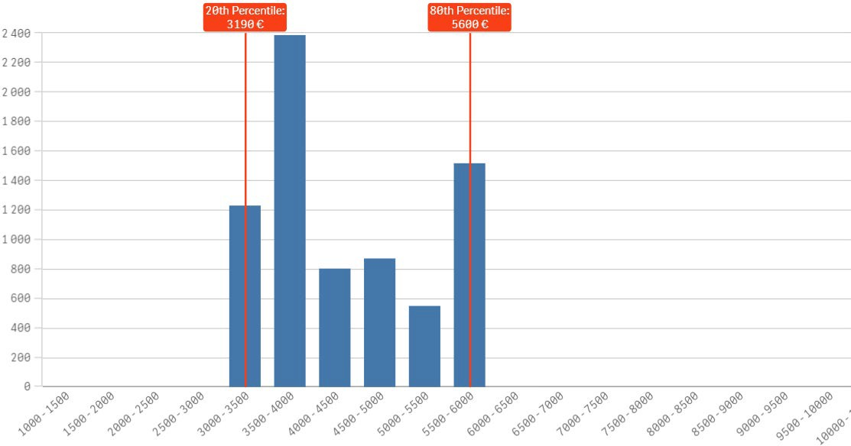
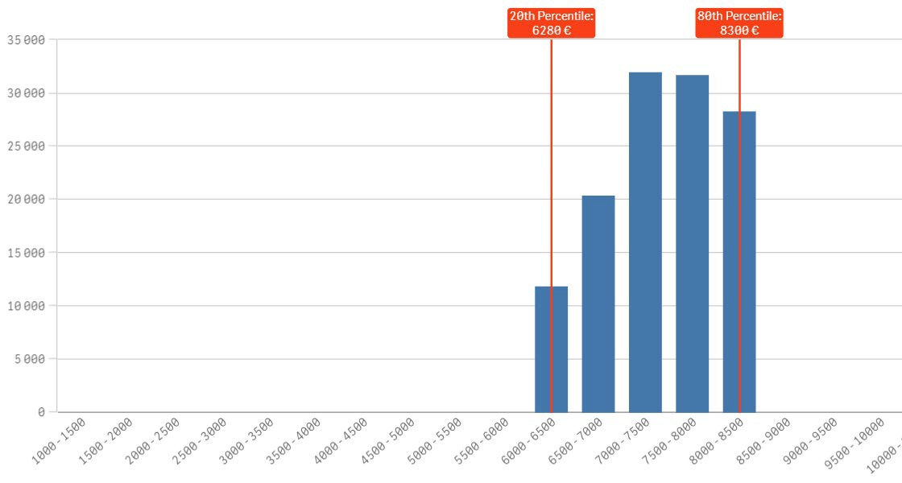
Horizon dashboard for lump sum evaluations
Experts MUST use the dashboard - ensure personnel costs are reasonable.
Personnel costs for Research Organisations in Romania
Personnel costs for Research Organisations in Romania
For each country and organisation type - dashboard displays distribution of personnel costs between the 20th and the 80th percentile.
Based on data from grants signed in Horizon Europe
Personnel costs for Research Organisations in Germany
Justify high personnel costs in the ‘Any comments’ tab of the Excel budget table - especially if above the values shown in the dashboard.
Personnel costs for Research Organisations in Germany
Average personnel costs (per month per person)

Slide 8
Grant preparation
Standard process followed to prepare the grant agreement.
The grant agreement based on the Model Grant Agreement for lump sum grants.
The ‘no negotiation’ principle applies – GA prepared on basis of the proposal submitted - some changes may be necessary:
correcting obvious errors and inconsistencies
other changes necessary to comply with applicable rules
adjustment of the lump sum to amount specified in the ESR
Breakdown of lump sum shares per beneficiary and per work package - GA Annex 2 (proposal lump sum budget table not part of the lump sum GA).
Once fixed in GA - budget not questioned (eg prices change subsequently)

Slide 9

Budget allocation
Art 5.4 lump sum MGA
Budget allocation (Annex 2 GA)
 |  | WP1 |  | WP2 |  | WP3 |  | WP4 | WP5 | WP6 | WP7 | WP8 | Total
Beneficiary A |  | 250.000 |  |  |  |  |  | 50.000 | 300.000 | 250.000 |  | 300.000 | 1.150.000
Beneficiary B |  |  |  | 250.000 |  | 350.000 |  | 50.000 |  |  | 100.000 | 150.000 | 900.000
Beneficiary C |  | 100.000 |  | 100.000 |  |  |  | 50.000 |  | 280.000 |  |  | 530.000
Beneficiary D |  |  |  | 120.000 |  |  |  | 50.000 |  |  | 100.000 | 150.000 | 420.000
Total |  | 350.000 |  | 470.000 |  | 350.000 |  | 200.000 | 300.000 | 530.000 | 200.000 | 600.000 | 3.000.000
Shares of the lump sum per beneficiary
Lump sum
=
Maximum grant amount
Shares of the lump sum per WP

Slide 10


Budget flexibility
Art 5.5 lump sum MGA
Use the budget as you see fit - as long as project is implemented in GA - actual distribution of lump sum is invisible to Commission
Budget transfers – amendment - if to be reflect in the GA (Annex I).
 | WP1 | WP2 | WP3 | WP4 | WP5 | WP6 | WP7 | WP8 | Total
Beneficiary A | 250.000 |  |  | 50.000 | 300.000 | 250.000 |  | 300.000 | 1.150.000
Beneficiary B |  | 250.000 | 350.000 | 50.000 |  |  | 100.000 | 150.000 | 900.000
Beneficiary C | 100.000 | 100.000 |  | 50.000 |  | 280.000 |  |  | 530.000
Beneficiary D |  | 120.000 |  | 50.000 |  |  | 100.000 | 150.000 | 420.000
Total | 350.000 | 470.000 | 350.000 | 200.000 | 300.000 | 530.000 | 200.000 | 600.000 | 3.000.000
Transfer between Work Packages possible if:
Work Packages concerned NOT completed (and declared in a financial statement)
Justified by the technical and scientific implementation of the action

Slide 11




Consortium
Costs actually incurred are not relevant.
Who does the work still is!
Costs actually incurred are not relevant.
Sub-contractors
Who does the work still is!
Associated partners
Who does what and when (see bubbles to the right).
Organisations and activities are specified in the GA. This includes:
BENEFICIARIES
Beneficiaries
Affiliated entities (if any)
Associated partners (if any)
Subcontractors (if any)*
Affiliated entities
* Subcontracted activities must be in the grant agreement, but the subcontractor may or may not be named.

Slide 12




Payment schedule
Art 22 lump sum MGA
Types of payments:
Pre-financing payment
Same function and same rules as for other grants
Interim payment(s)
One or more
Payment of the balance
Closes the financial aspects of the grant
Payment of shares of the LS (Annex 2) for WPs completed & approved in the RP
Coordinator distributes the amount according to consortium agreement
Partial payment for partially completed WPs possible
Releases the amount retained for the Mutual Insurance Mechanism

Slide 13
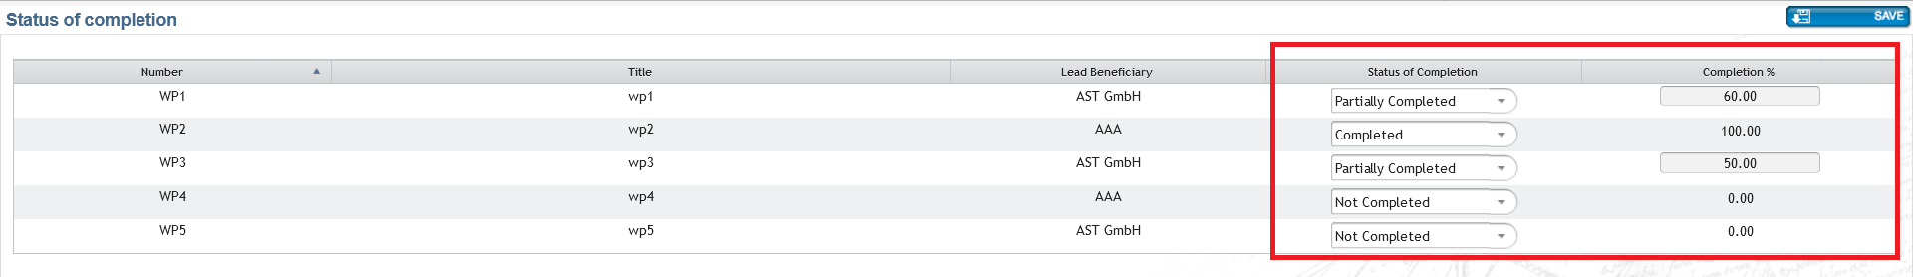
Reporting and payment (1)
Standard reporting template
Coordinator declares WPs Completed or Not Completed - justified by the technical periodic report.
Incomplete work package can be completed and paid in a subsequent reporting period.
Final RP – can declare partially completed WPs – enter % completed
The completion of WPs = completion of activities (described in Annex I) NOT successful outcome.

Slide 14


Reporting and payment (2)
The financial report is simplified and (mainly) automated.
The financial statement for all beneficiaries is automatically generated (based on the accepted work packages and the corresponding lump sum shares).
WP1 WP2 WP3 WP4 WP5
Interim payments: pay the lump sum shares for completed work packages.
Final payments: can also pay partially completed work packages.
Beneficiary A | 250.000 |  |  | 50.000 | 300.000
Beneficiary B |  | 250.000 350.000 |  | 50.000
Beneficiary C | 100.000 | 100.000 |  | 50.000
Beneficiary D |  | 120.000 |  | 50.000
Total | 350.000 | 470.000 | 350.000 | 200.000 | 300.000
✗
✗
Payment = 350 000 +
0 + 350 000 +
0 = 700 000 €

Slide 15
Acceptance of work packages
WPs accepted if the activities have been carried out OR all essential tasks completed OR when equivalent tasks have been carried out OR when deviations have been justified.
Lump sum projects can be amended according to scientific-technical needs (or deviations justified in the reports) - use mechanisms to make completion of work packages feasible.
Before a lump sum WP (declared completed) is rejected as incomplete, partner invited to respond to the observations of the project officer.
If the rejection is upheld - lump sum share concerned is not paid at that time - complete the work package later and declare it at the end of any subsequent reporting period.
If WP not completed by the end of the project (e.g., for technical reasons) - lump sum is paid partially in line with the degree of completion - decision for partial payment taken on a case-by-case basis – can provide observations.

Slide 16


Ex-post controls
Art 25 lump sum MGA
Checks, reviews and audits for:
☹ Proper implementation of the action (e.g. technical review)
☹
Compliance with the other non-financial obligations of the grant:
〉
〉
〉
〉
〉
IPR obligations Ethics and integrity Open science Dissemination
Etc.
No financial checks, reviews and audits by the European Commission

Slide 17
Keeping records
You need (e.g.)
You don't need*
Technical documents
Publications, prototypes, deliverables
Documentation required for good research practices eg. Lab books
… any document proving that the work was done as detailed in Annex I
Time-sheets
Pay-slips or contracts
Depreciation policy
Invoices
…any document proving the actual costs incurred
*You still need to comply with any financial record keeping obligations outside the grant agreement (e.g., under national law or internal procedures)
Same as all HE grants

Slide 18
Summary
Keep in mind when working with lump sums:
No reporting of actual costs, no financial checks and audits
Following the evaluation of the proposal, lump sum shares are defined per beneficiary and per work package and are fixed in the Grant Agreement
Pre-financing as usual
Payments upon completion of work packages at the end of reporting periods

Slide 19
Questions (submitted)
Proposal stage
How many work packages do you recommend for a lump sum project?
Is it necessary/acceptable to split longer WPs eg. management and coordination, in order to align with reporting periods?
Do we need to adhere to the personnel rates given in the dashboard for lump sum grants? If a project uses high grade staff and the rate is much higher than that on the dashboard is that acceptable?
Do I still need to complete the financial tables in Part A, section 3.1(g-j)?
Where do I enter information on in-kind contributions from third parties?
How do I deal with own resources in a lump sum proposal
Project implementation
What is the process to decide on full, partial or non completion of work packages?
How will the amount of funding each partner receives be calculated?
What is the timeline for payments to be finalised after the above decisions have been made?
Do we have any sense of how often the EC are not paying out fully on work packages?

Slide 20
Questions (submitted)
Project implementation and post completion
What will European Commission audits on lump sums look like?
Best practice in terms of setting up lump sum grants on internal university costing tool e.g. Worktribe
Best practice/recommendation of how to capture spending against Work Package completion
More information on reporting requirements and audit - we know that is % of completion and no audit unless randomly selected. If there is an audit, is it an external expert who would evaluate the action % of completion?

Slide 21

Thank you!
Q&A
Emails: ncp-rules@iuk.ukri.org
Newsletter Subscription: https://eufunding.ukri.org/subscribe

