Slide 1

Research Managers Event – Supporting participation in Horizon Europe
Wednesday 28th January 2026
Notes:
The abstract pattern can be removed or repositioned if required. Be careful to ‘Send to Back’ so that it does not obscure any important information.

Slide 2
Purpose of today
To deliver targeted, practical and collaborative training that empowers UK research support professionals to maximise engagement with Horizon Europe and prepare for FP10
The build on and strengthen relationships between UK research staff

Slide 3
Agenda
Welcome & policy context – UKRI, University of Leicester and DSIT updates, including FP10 and the Spending Review
Horizon Europe pillars – Key novelties and updates across Pillar I (MSCA), Pillar II, and Pillar III (EIC & EIT)
Networking & collaboration – Structured networking with peers and UKRI Brussels
Cross-cutting opportunities – COST developments and wider Horizon Europe insights
Grant preparation support – Practical sessions on preparing applications, AI in proposal writing, and lump sum funding
Looking ahead – Sector challenges, lobbying for Horizon Europe, and next steps as we enter the final two years

Slide 4
Housekeeping
Tea/Coffee and refreshments will be provided throughout the day, please help yourself
Restroom facilities are located on the lower ground floor and ground floor, both next to the lifts.
No fire alarms are expected – if an alarm does sound, please make your way outside the Imperial College Main Entrance (back through the registration area).
We encourage constructive dialogue, inclusive behaviour and respect for speakers and other attendees
UKRI staff will be taking photos throughout the day
Wi-Fi is available via eduroam or The Cloud
There will be live Q&A during each session. We appreciate there may be lots of questions, if we do not get around to answering all questions, please approach us throughout the day or drop your questions to ukro@ukro.ac.uk

Slide 5
Research Managers Event – Supporting participation in Horizon Europe
Emily Clarke
Associate Director of European Funding Wednesday 28th January 2026
Notes:
The abstract pattern can be removed or repositioned if required. Be careful to ‘Send to Back’ so that it does not obscure any important information.

Slide 6
UKRI support for UK participation in Horizon Europe
Operational changes to the delivery of support for Horizon Europe engagement
Opportunity to work towards a more sustainable and coherent support structure
Integrating different teams - the Horizon Guarantee, the National Contact Points, and UKRI Brussels

Slide 7
UKRI support for UK participation in Horizon Europe
Associate Director EU
UKRI Brussels
National Contact Points and wider support
Horizon Europe Guarantee
Europe policy monitoring and influence
UKRO Portal Horizon Hub
Enquiry Services
Webinars and training
Brokerage and missions
UKRI Guarantee grant delivery

Slide 8
Horizon Europe Guarantee
Final calls closed on 27 November 2025
In case of late applications – please contact the team directly at eugrantsfunding@ukri.org as soon as possible
Will have awarded £2.19bn
Thank you for all your support in making this work

Slide 9

UKRI Brussels
All stakeholders – including HEI sector – emphasised the importance of Brussels presence
Establishing a UKRI Brussels overseas office in Spring 2026, co-located at UK Mission to the EU
Will operate in a similar fashion to UKRI other overseas offices in Washington DC, Ottawa, New Delhi and Beijing

Slide 10
UK National Contact Point Services
Delivered by UKRI on behalf of the Department for Science, Innovation and Technology
New team structure brings together UKRO with wider NCPs across UKRI
NCP resources include a range of activities to support the entire horizon Europe journey
UKRO portal and the Horizon Hub
Enquiry Services and signposting covering all 3 Pillars and cross-cutting schemes
Online webinars, trainings, brokerage events, overseas missions
Contact details for all UK NCPs on UK gov website

Slide 11
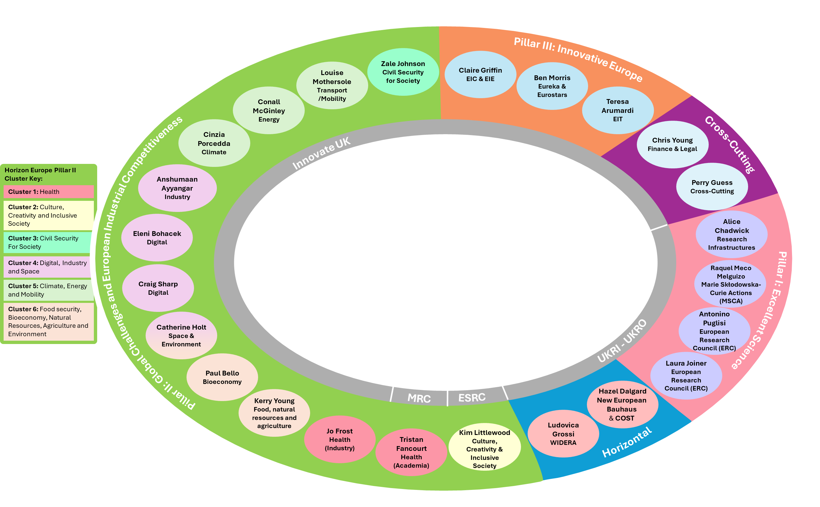






For external use
What support is available?
Horizon Europe
National Contact Points
Raise awareness
increase participation
Assistance, guidance and training
help simplify the process and
enhance the quality of applications
Signposting and cooperation
help connectivity and
consortium development
European NCP counterparts

Slide 12
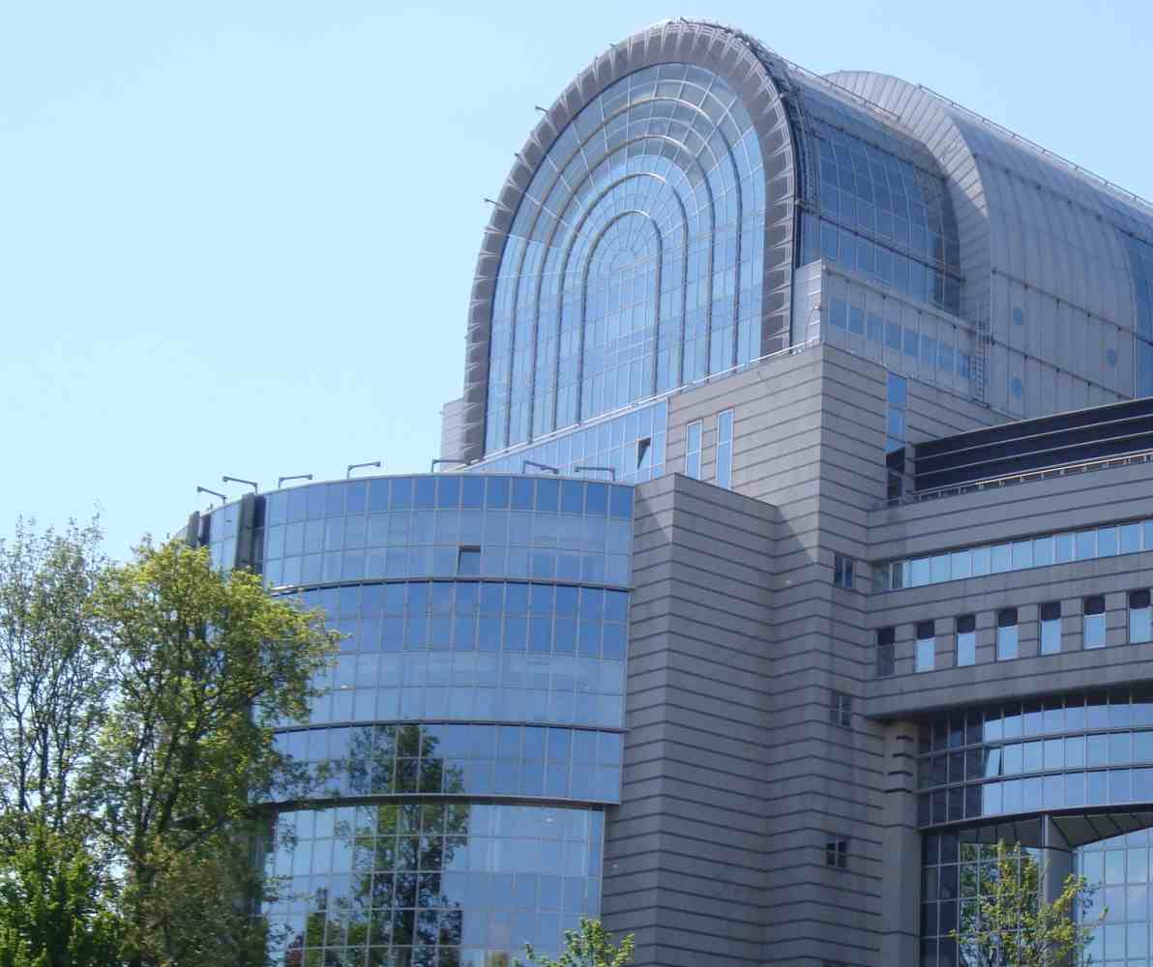
Forward look
Focus on boosting UK participation during remainder of Horizon Europe - this is key
Continuing to deliver high quality support for European engagement, and develop this to better need the needs of all sectors
For example, improved website and online resources
Looking to FP10 - understanding and influencing in line with overall UK position

Slide 13
Thank you
Stay updated on Horizon Europe:
Sign up to the NCP newsletters
Check the UKRO portal and the Horizon Hub
Follow UKRO and the NCPs on LinkedIn
Contact details for all UK NCPs on UK gov website
LinkedIn: UK Research and Innovation
YouTube: UK Research and Innovation
Notes:
The abstract pattern can be removed or repositioned if required. Be careful to ‘Send to Back’ so that it does not obscure any important information.

