Slide 1

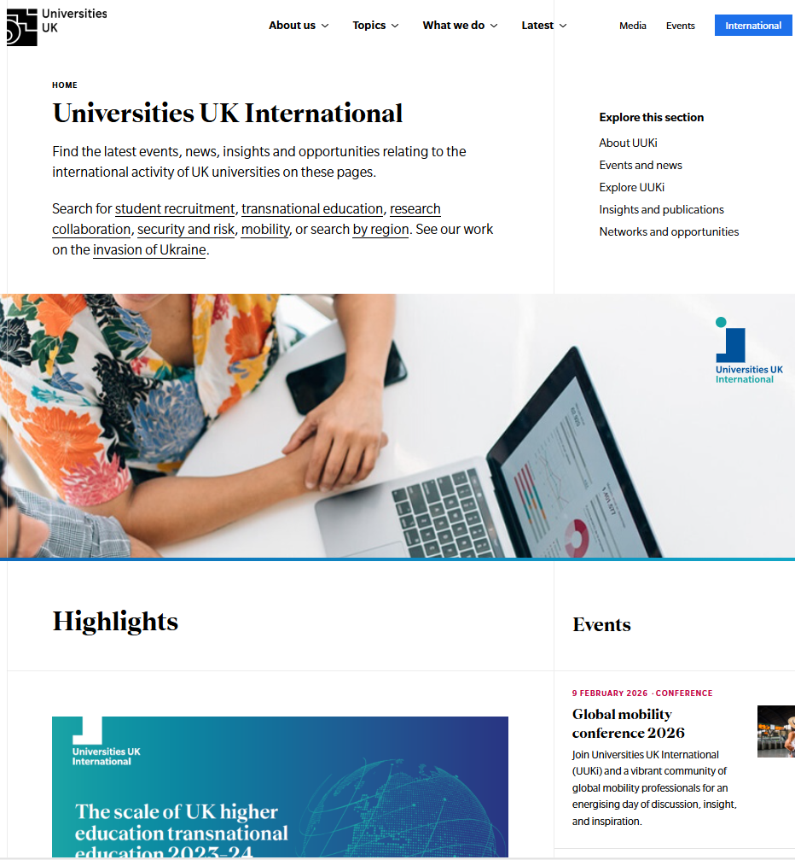
Horizon Europe
Research Manager Event
Two years to go - what do we do next?
Dajana Dzanovic
Head of Global Research and Innovation Policy
dajana.dzanovic@international.ac.uk
London, 9 December 2025

Slide 2


About UUK: our strategy & priorities
Universities UK is the collective voice of 142 universities across the UK. Our mission is to help UK universities be the best in the world, through their research and teaching, and the positive impact they have locally, nationally and globally.
UUK International policy priorities:
Securing a sustainable, competitive environment for int’l staff and student recruitment
Enhancing the scale, scope and impact of the UK’s global R&I activities
Delivering growth in and effective regulation of Transnational Education
Maximising international experiences for UK-based students
Managing & mitigating the risks of international engagement
Notes:
A little about my organisation, Universities UK International.
Universities UK is the collective voice of 141 universities across the UK.
Our mission is to help UK universities be the best in the world, through their research and teaching, and the positive impact they have locally, nationally and globally.
As UUKi, we represent UK universities on the international stage. In the UK and abroad, we connect higher education leaders, share insights, influence policy and create opportunities.
And while we work across all aspects of international collaboration, fostering new collaborations in research and innovation – especially through Horizon Europe – is a core priority for our team.

Slide 3

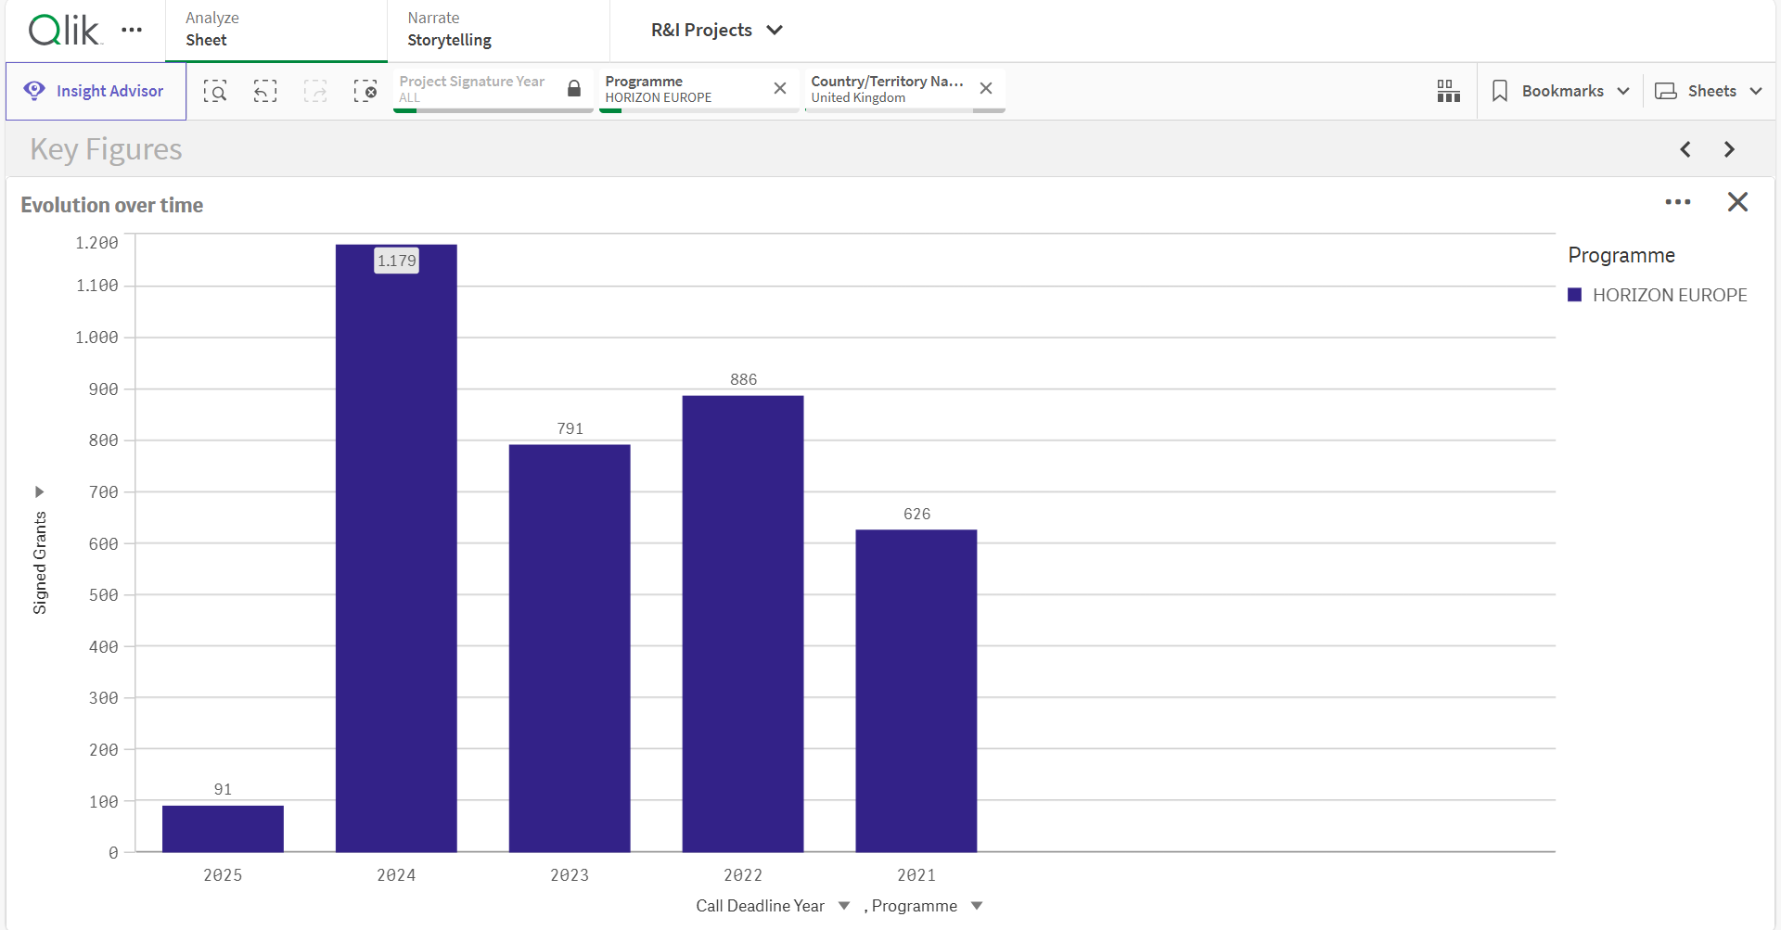
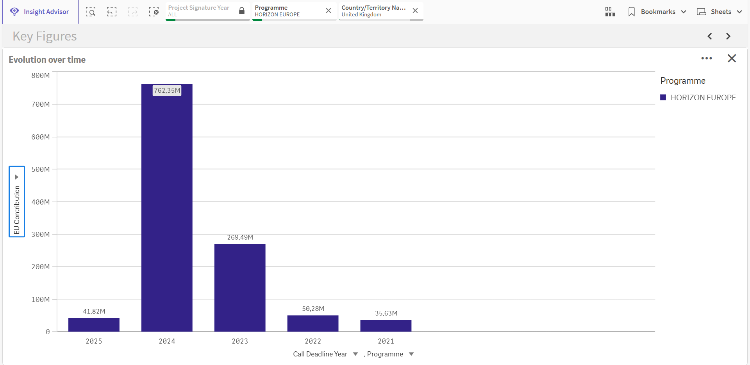
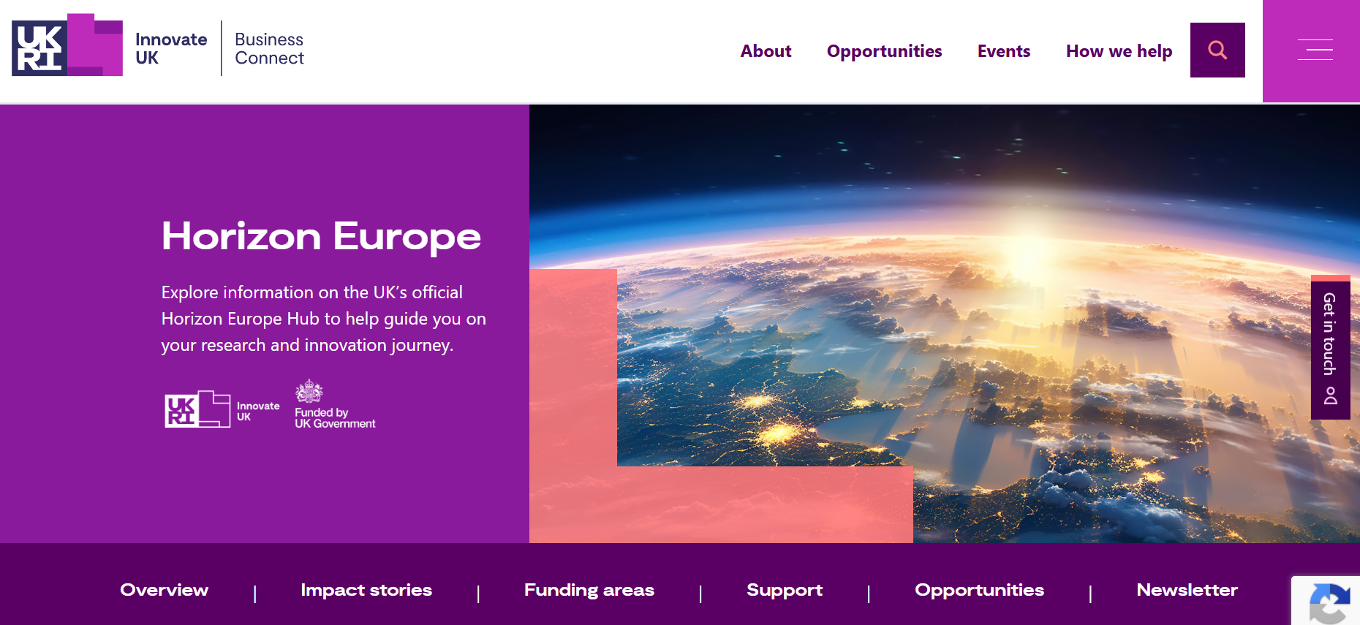

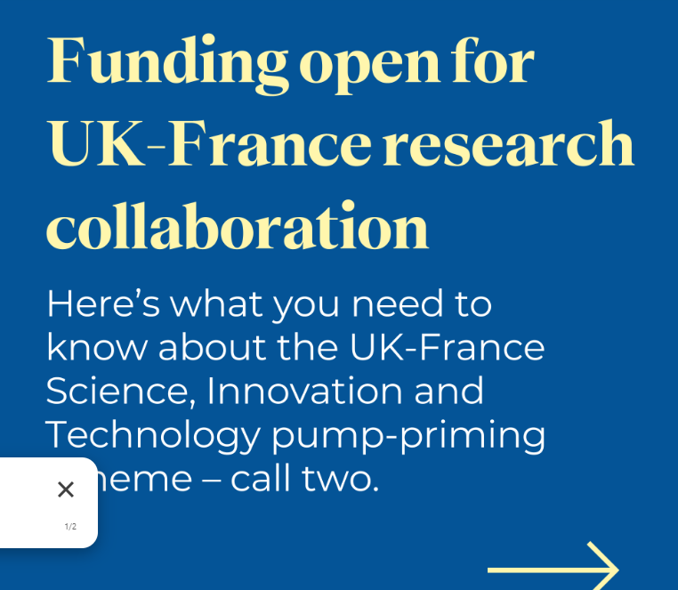
Horizon Europe
Participation/successes 2024-2025:
      Pillar 1: bounced back strongly (ERC & MSCA)
      Pillar 2: bounced back less strongly
      Pillar 3: notable UK engagement in the EIC (esp Pathfinder, but scheme success rates are low), other schemes are lacking
      Indication that 80% of UK participation is HEIs

Slide 4

Two years to go - what do we do next?
Horizon Europe 2026/27
Boost participation - lots of opportunities still!
Maximise successes by championing areas where we do particularly well (pillar 1)
Continue driving pillar 2 (and pillar 3) even though it’s getting tougher
Share best practice/capacity build (events like today ☺)
Continue proactive engagement: EU MS, associate countries, LMICs, Brussels

Slide 5
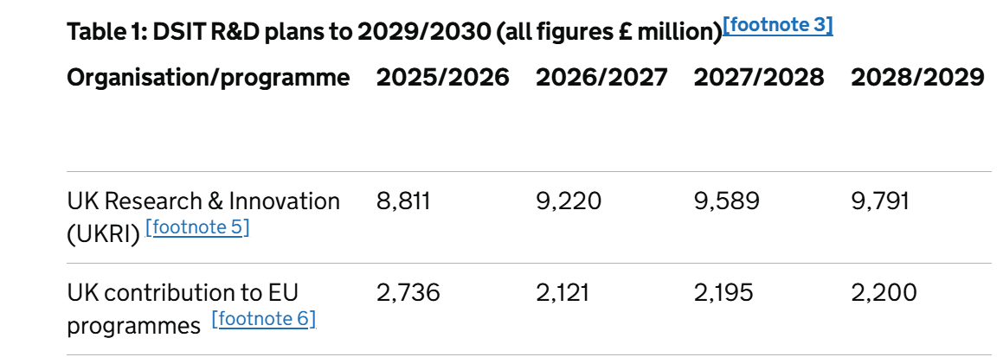
Two years to go - what do we do next?
FP10/Horizon Europe and European Competitiveness Fund
Draft MFF 2028-2034
EU/DSIT budgets: good news/bad news
Like-minded trusted countries
Proactive associated country voice: meeting with EC reps on 4 Dec, MEP session in collab with EUA on 14 Jan

Slide 6
Two years to go - what do we do next?
Harnessing a joint UK approach
      DSIT recently specifically focussed on Germany and Spain: brokerage events in specific research fields incl. open to universities
      UUKi EU MS and associated country delegations, UK-France funding, Brussels engagement
      Better connectivity across the system NCPs, NDs, feedback mechanism, draft WPs
      Addressing gaps (incl. industry participation)
      Thinking strategically and long-term

Slide 7

Thank you!
Dajana Dzanovic, Head of Global R&I Policy dajana.dzanovic@international.ac.uk
Find us online https://www.universitiesuk.ac.uk/universities-uk-international
Notes:
Thank you

