Slide 1
Supporting Applications in Horizon Europe
Thursday 12th February 2026

Slide 2
Before we start….
Why listen to me?
This is not the paradigm!
I will focus on:
How we support EU applications and awards
How it has changed post-association
How we (plan to) balance resource vs increased demand
But first – let’s see how much resource we have in the room

Slide 3



Do not edit How to change the design
How much fte supporting EU proposals do you have?
The Slido app must be installed on every computer you’re presenting from

Slide 4
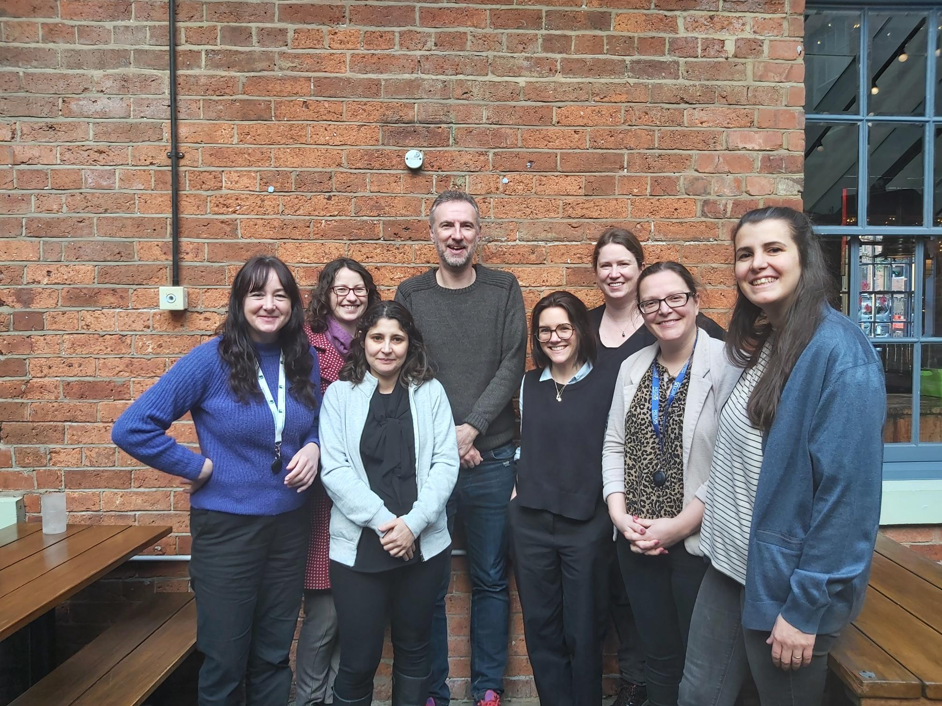
Text hierarchy and formatting information slide
Ben Williams
Head of EU Funding
B.A.Williams@leeds.ac.uk
Su Laithwaite
S.A.Laithwaite@leeds.ac.uk
Sophia Verhaeghe (on mat leave)
S.Verhaeghe@leeds.ac.uk
Jess Clarke
j.clarke2@leeds.ac.uk
Keri Dunning
K.L.Dunning@leeds.ac.uk
Pre-award
Post-award
8 people
6.8fte
Cigdem Tasci Tochniti
C.TasciTochniti@leeds.ac.uk
Kelly Armstrong
K.M.Armstrong@leeds.ac.uk
Martika Cawley
M.Cawley1@leeds.ac.uk
Our support reflects this resource

Slide 5

Do not edit How to change the design
What one aspect of proposal support is of most importance / interest to you?
The Slido app must be installed on every computer you’re presenting from

Slide 6
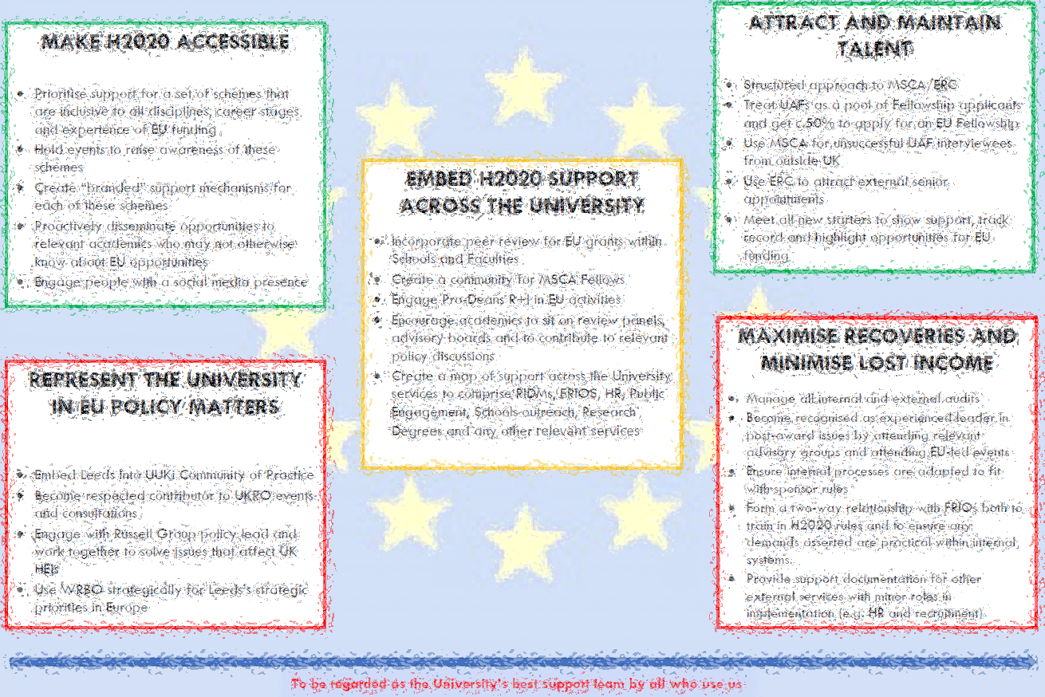


Re-engaging our academics
Need to adapt strategy to be more than ‘business as usual’
+ Re-engagement with Horizon Europe
Research and Innovation Service
Under-represented schemes
ECRs and First-time applicants
Wider spread of activity
External Networks and engagement
Celebrate Success
Remove Barriers
Brussels Office

Slide 7
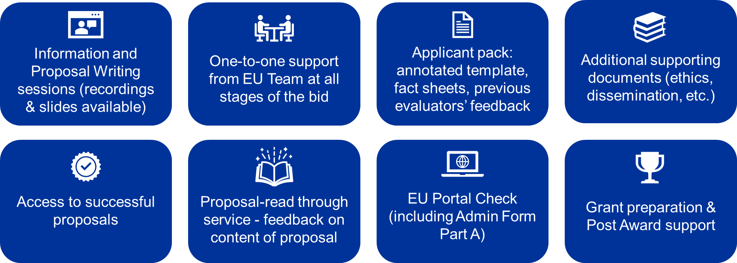
Horizon Europe – Info and Support

Slide 8
What we do (by phase)
New starters / FTA – EU Team Brochure
Presentations – bespoke for Schools/groups/faculties, scheme specific..
Comms – Newsletter, Social Media, Intranet, Events calendar
Matching opportunities – proactive as well as reactive
TEAMS site for collaboration / sharing – e.g. info forms for costings and admin data
Pump-priming
Proposal review – guide for local review, EU Team review of all Leeds-coordinated proposals
Portal admin – Parts A for Leeds and partners
Successful examples
Mock interviews
Grant Prep Tracker
Signatories
SyGMA data
Agreements – managing process for Consortium Agreements etc.
Evidence for and submission of Claims and audits,
External audit management.
Internal process compliance e.g. COST, facilities, student fees, VISAs
Legal and financial management – amendments, justifying activities, problem projects
MSCA Fellows Forum
Database – performance stats
External networking – ERLY (Regional Network), National Network, Post-Award network, ARMA SIG

Slide 9
Joining Up Support
Library
FRIO
HR
RIDMs
EU TEAM
Comms
Secretariat
Contracts
CrowdHelix
School Admin
Trusted Research
Doctoral College

Slide 10
Reviewing Proposals
Make the first draft as good as it can be before you look at it! (annotated template, recorded presentations, successful example, mentor)
Checklist (based on evaluation criteria) – can it be improved enough?
Focus on “Tier 2” – this is where you can make a difference
Appropriate peer review – Scientific / Research Excellence by researchers BUT make sure they know what they are reviewing. EU Team for whether the proposal is saying what reviewers are looking for. Impact and Implementation – more EU Team focus. CHX for Impact.
Talk to successful applicants about how they did it. Talk to those who have evaluated.
ESR analysis and past feedback

Slide 11
Refining Support
Front-loaded effort to save time going forward – support docs and intranet can cut-off the “easy” queries
Once support structure is in place, much easier and more efficient to maintain and tweak
However, level of activity over last 18 months has meant we are just fire-fighting
So….need to refine support

Slide 12
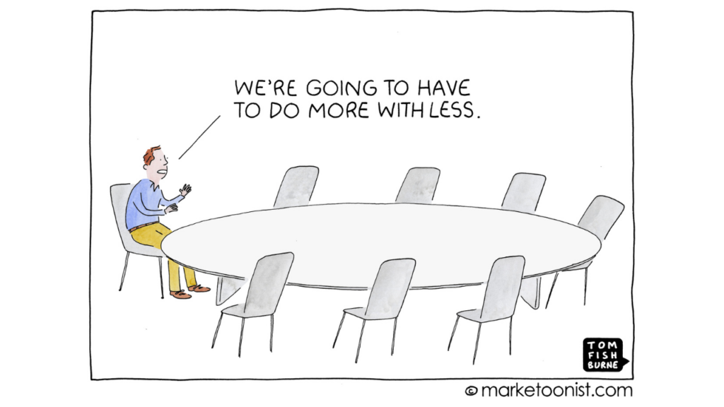
Doing More with Less Resource
EU Team Away Day to refine and re-focus support

Slide 13
Final Thoughts
EU Support is institutional
Don’t do what you don’t do – save time
Developing quick fixes saves time in the long run
Get feedback on what you do and what people want
Embrace AI – it won’t be taking your job, it will be freeing you to be less procedural and more innovative
Identify opportunities, review proposals, create comms and guides, analyse ESRs
Network – share ideas and best practice

Slide 14
Group Discussion
What one realistic action would you introduce to your support if you had a free choice?
Why would you choose this?
What are the barriers? How could you overcome them?
e.g. is there existing activity in the same area but for different funders? (e.g. peer review mechanism), other services, refining or reducing tasks
What outputs would you create? What overall outcome would you be hoping for?

