Slide 1




Novelties in the ERC funding opportunities
Horizon Europe Research Manager Event
Leeds,12 February 2026
Dr Antonino Puglisi | UK National Contact Point for the ERC
Notes:
The abstract pattern can be removed or repositioned if required. Be careful to ‘Send to Back’ so that it does not obscure any important information.

Slide 2


Agenda
1 ERC Plus
2 Changes in the proposal structure
3 Additional fundings
4 Eligibility windows in 2027
Notes:
To replace with a photo of your own: 1) Send the geometric shape overlay to the back – Right-Click > Send to Back > Send to Back. 2) Replace image – use the guides provided to correctly position it. 3) Send your image to the back so that the geometric overlay re-appears over the image.

Slide 3


ERC Plus
Notes:
The abstract pattern can be removed or repositioned if required. Be careful to ‘Send to Back’ so that it does not obscure any important information.

Slide 4





ERC | Frontier Grants Opportunities
Starting
1.5M€ | 5 yrs
Consolidator
2M€ | 5 yrs
Advanced
2.5M€ | 5 yrs
ERC Plus
7M€ | 7 yrs
Synergy
10M€ | 6 yrs
Notes:
Please replace photo of presenter with a portrait of your own. 1) Send the geometric shape overlay to the back – Right-Click > Send to Back > Send to Back. 2) Replace image – use the guides provided to correctly position it. 3) Send your portrait to the back so that the geometric overlay re-appears over the portrait.

Slide 5
ERC Plus
Support outstanding PIs to address major scientific challenge
In
a
nut
shell
Projects cannot be carried out with regular ERC grant
Application includes vision statement that explains how project goes beyond regular ERC

Slide 6

ERC Plus Grant | Grant size & duration
Up to EUR 7 million for up to 7 years
2026 call budget = € 210 million, that is, only 30 ERC Plus grants for 2026
Lump sum funding
No additional funding

Slide 7


ERC Plus Grant | Candidates
PIs with an outstanding record of scientific achievement at the forefront of their field
Open to all career stages
Open to all nationalities, both residing in EU/AC & outside at time of submission

Slide 8

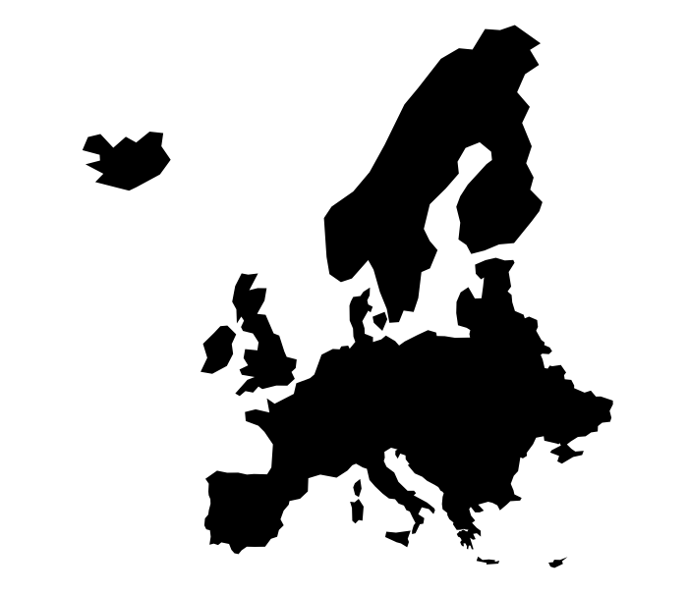
Principal Investigator | Time Commitment
Min. of working time on grant
Min. of working time in EU’s MS or AC
30% | Advanced, Synergy and ERC Plus
40% | Consolidator
50% | Starting
50%

Slide 9



ERC Plus Grant | More info
Excellence as only evaluation criterion | two-step evaluation
Statement of Vision | one half to two pages
Researcher can have the grant only once in their career

Slide 10
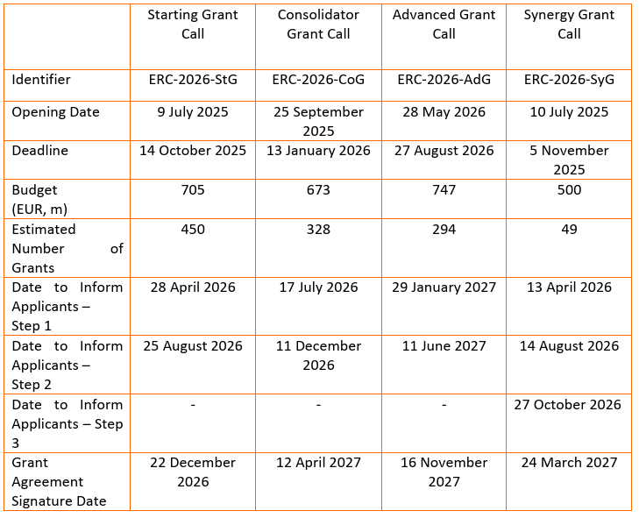


ERC | 2026 WP Calls Calendar
ERC Plus
ERC-2026-Plus
2 June 2026
2 September 2026
210
30
16 Feb 2027
15 June 2027
-
13 Oct 2027

Slide 11
Changes in the proposal structure
Notes:
The abstract pattern can be removed or repositioned if required. Be careful to ‘Send to Back’ so that it does not obscure any important information.

Slide 12
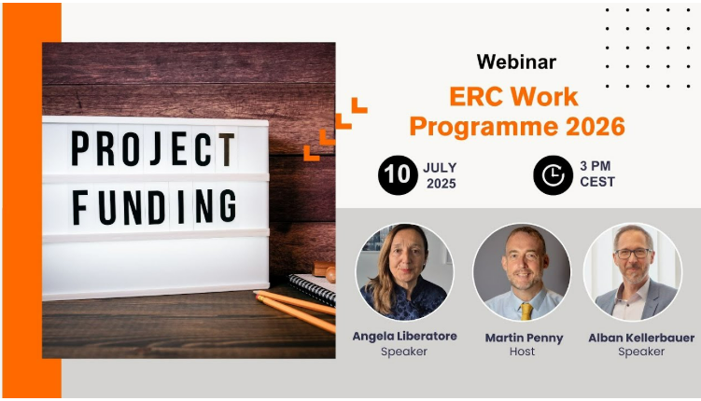
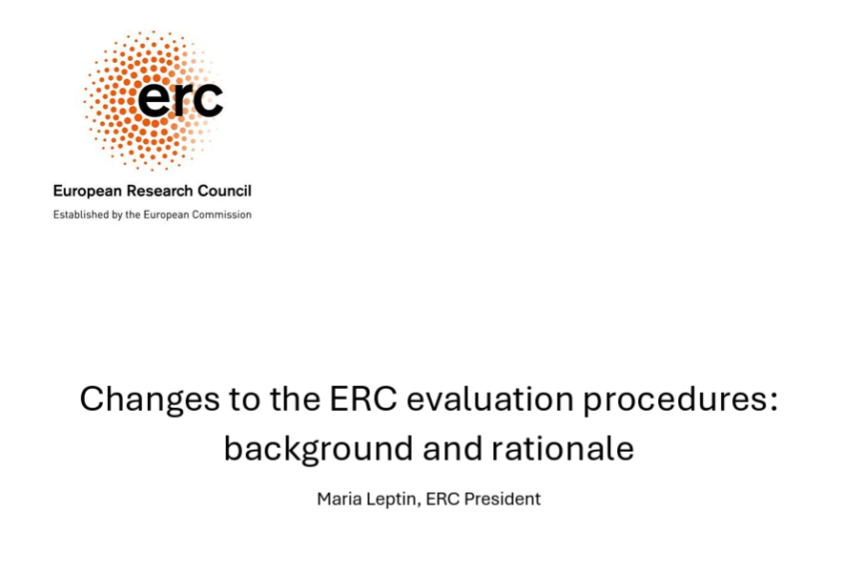
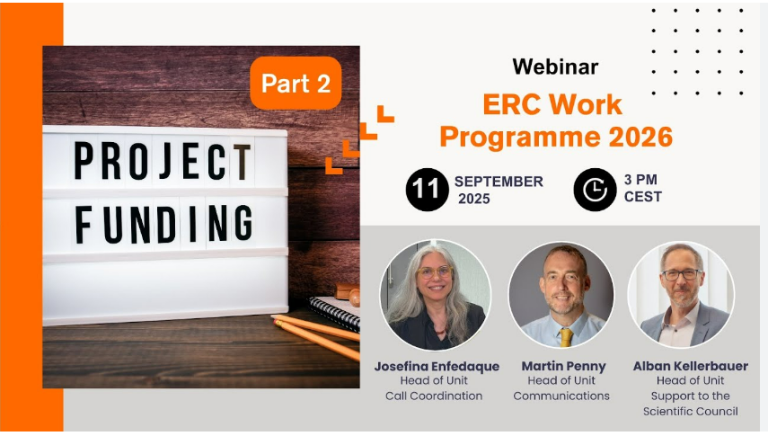

2026 Work Programme Changes
Notes:
Feel free to replace the image with your own.

Slide 13



A
ERC Application – Your building blocks
B2
B1
Part A
Administrative Forms
B1
Part I
+
CV & Track Record
B2
Part II
7 pages StG, CoG, AdG
(5 + 4 pages)
10 pages SyG
online
Annexes
Host Institution Letter, Ethics, Eligibility Documents
Notes:
Feel free to replace the image with your own.

Slide 14

ERC Application – Your scientific proposal
Can that idea be pursued realistically, and if so, in the manner and with the approach that the applicant proposes?
Part I
Is this a great idea that would be worth pursuing?
Part II
Notes:
Feel free to replace the image with your own.

Slide 15




Part I | Your envisaged research
Present the overall approach or research strategy to reach the goals of the project
5 pages max
Part I
Explain the scientific question & the objectives of the project
Lay out the current state of knowledge
Notes:
Feel free to replace the image with your own.

Slide 16




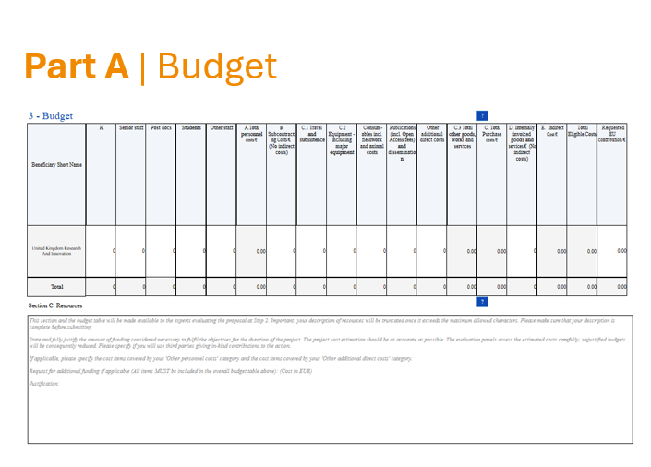

Your scientific proposal | Part II
Describe the implementation
7 pages max
StG, CoG and AdG and ERC +
10 pages max
SyG
Part1
Methodology
Part II
Part2
Work plan
Part II cannot deviate from the resources section (Part A | Budget)
However, you can include additional justification where necessary, that is, some budget aspects can be included in Part II (but there is no obligation to do so)
Risk assessment
Notes:
Feel free to replace the image with your own.

Slide 17
Additional fundings
Notes:
The abstract pattern can be removed or repositioned if required. Be careful to ‘Send to Back’ so that it does not obscure any important information.

Slide 18


Funding rates
StG 1.5M€
Up to 1M euros
For grantees already working in the EU’s MS or AC
Up to 2M euros
For grantees moving to EU’s MS or AC
CoG 2M€
5 yrs
AdG 2.5M€
Base amount
Can be request for any purpose Including personnel costs!
Additional funding
ERC plus 7M€
No additional funding
7 yrs
SyG 10M€
Up to 4M euros
6 yrs
Notes:
Feel free to replace the image with your own.

Slide 19
Eligibility windows in 2027
Notes:
The abstract pattern can be removed or repositioned if required. Be careful to ‘Send to Back’ so that it does not obscure any important information.

Slide 20
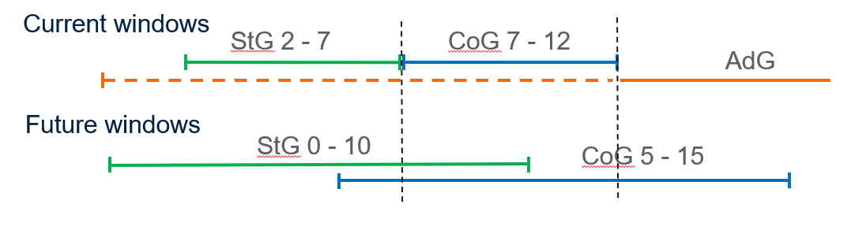
ERC 2027 WP
Extension of eligibility windows
Widening responds to evolution in career paths across all fields of research
Only one StG per career and only one CoG per career
Current policies for extension of eligibility periods remain in force
Notes:
Feel free to replace the image with your own.

Slide 21


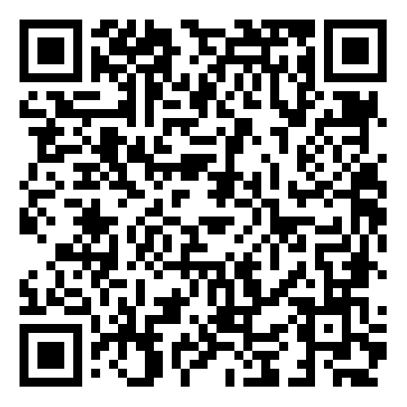


erc-uk@ukro.ac.uk
UK Research
and Innovation
UKRIforResearchers
Notes:
The abstract pattern can be removed or repositioned if required. Be careful to ‘Send to Back’ so that it does not obscure any important information.

Slide 22


Notes:
The abstract pattern can be removed or repositioned if required. Be careful to ‘Send to Back’ so that it does not obscure any important information.

