Slide 1
Preparing Horizon Europe Applications
Marie Adams University of Leicester marie.adams@leicester.ac.uk

Slide 2

Leicester’s Horizon Europe support
Small team, diverse workload, high-volume
Embedded in the central Research and Enterprise Division
Part of a wider research support ecosystem
Provide…
Specialist funder knowledge
Advice and signposting
Costing and contracting support
Post-award financial support
News and events
Training

Slide 3
University of Leicester: a sense of scale...
In 2024/25 the University Horizon Europe applications increased by over 55% in number and 70% in value.
In 2025/2026 we passed 2024/25 application numbers and values in Q1!
Problem!
Large multi-national, multi-sector consortia.
Top down - policy alignment key.
Competitive with diverse criteria for success.
Limited resource.

Slide 4
Solutions:
Horizon Europe – a plan for (sustainable) growth.
One to one when necessary, one to many preferred.
Internal resources; online ‘toolkit’, templates, successful bids.
Leveraging additional support – academic champions, mentors.
Utilise existing infrastructure – research institutes, seminar series, research committees.
Notes:
Red bar logo / crest The red bar logo is inspired by floating navigation bars on websites and digital platforms. Our logo is the most important part of our identity and its application should always be consistent to ensure recognition of our brand. The red bar logo must always be in front of imagery/content and should be used on title and final slides. The square crest logo should be used on other slides in between to allow more space for content, and should not be used on any other printed or digital materials unless approved by the External Relations Department.
Engaging headlines Our headlines should be inspiring, inclusive, unexpected and confident.
Interaction and bleeding off By bleeding images off the page, interacting elements and allowing white space we create a sense of layering and constant movement.
White space Allowing lots of white/blank space gives a sense of confidence throughout our brand and gives a sense of modernity

Slide 5
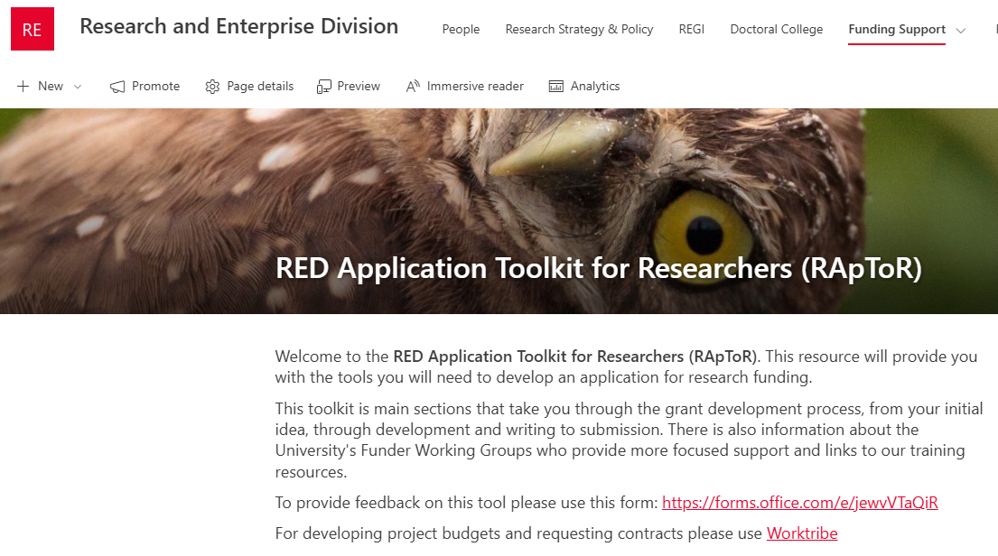
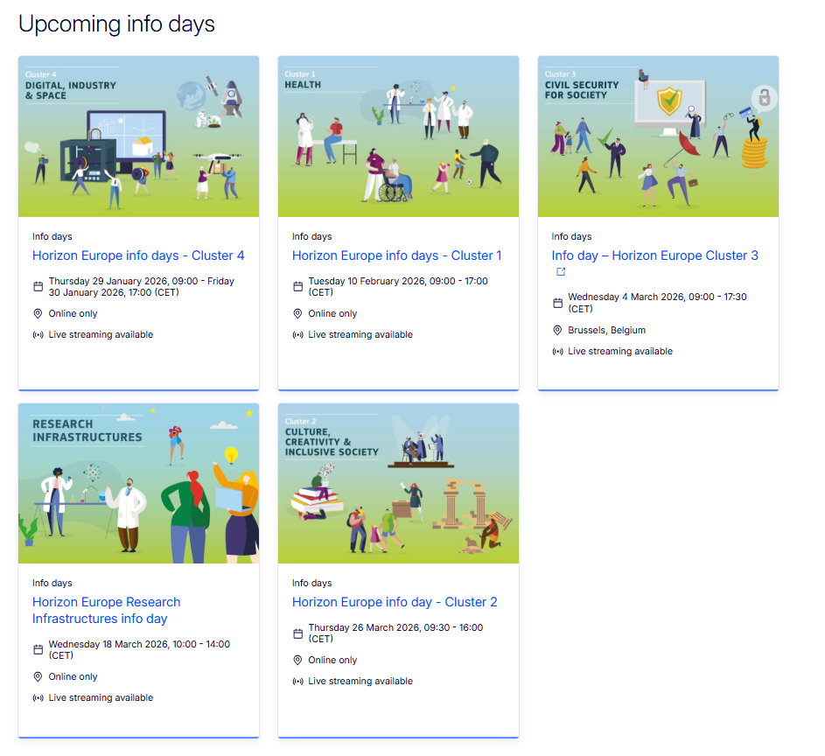

Collaborative proposal development
Our role in preparing applications & facilitating collaboration
Start early (now!) - target opportunities in areas of strategic importance, highlight events and Info Days. Establish research leadership.
Evaluate opportunity for a cohort approach.
Assist in navigating internal rules and processes;
Engage other teams early e.g. pre-award, research governance etc.
Establish roles, timelines and boundaries.
Help applicants understand the call text and individual call requirements/nuances.

Slide 6

Potential obstacles
…not an exhaustive list!
Budget redistribution and caps.
Waivers of internal policies and costs (e.g. tuition fees, overheads).
IP protection required.
Clinical trials and ethical issues.
Enhanced due diligence requirements.
Up front agreements e.g. NDA’s, LoI’s.
Additional requirements at proposal stage (novelties, lump sum, unfamiliar application process).
Cultural, organisational and disciplinary differences.

Slide 7


Slide 8


Slide 9


MSCA PF 2026 CALL DEADLINE

Slide 10


MSCA PF 2026 CALL DEADLINE
NCP INFO EVENT

Slide 11
MSCA PF 2026 CALL DEADLINE
INFO EMAIL
NCP INFO EVENT

Slide 12
DIY CONCEPT REVIEW
MSCA PF 2026 CALL DEADLINE
INFO EMAIL
NCP INFO EVENT

Slide 13

DIY SUMMER SCHOOL
DIY CONCEPT REVIEW
MSCA PF 2026 CALL DEADLINE
INFO EMAIL
NCP INFO EVENT

Slide 14
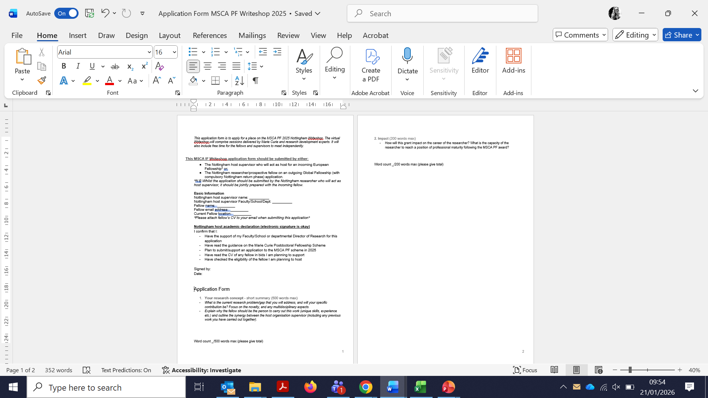
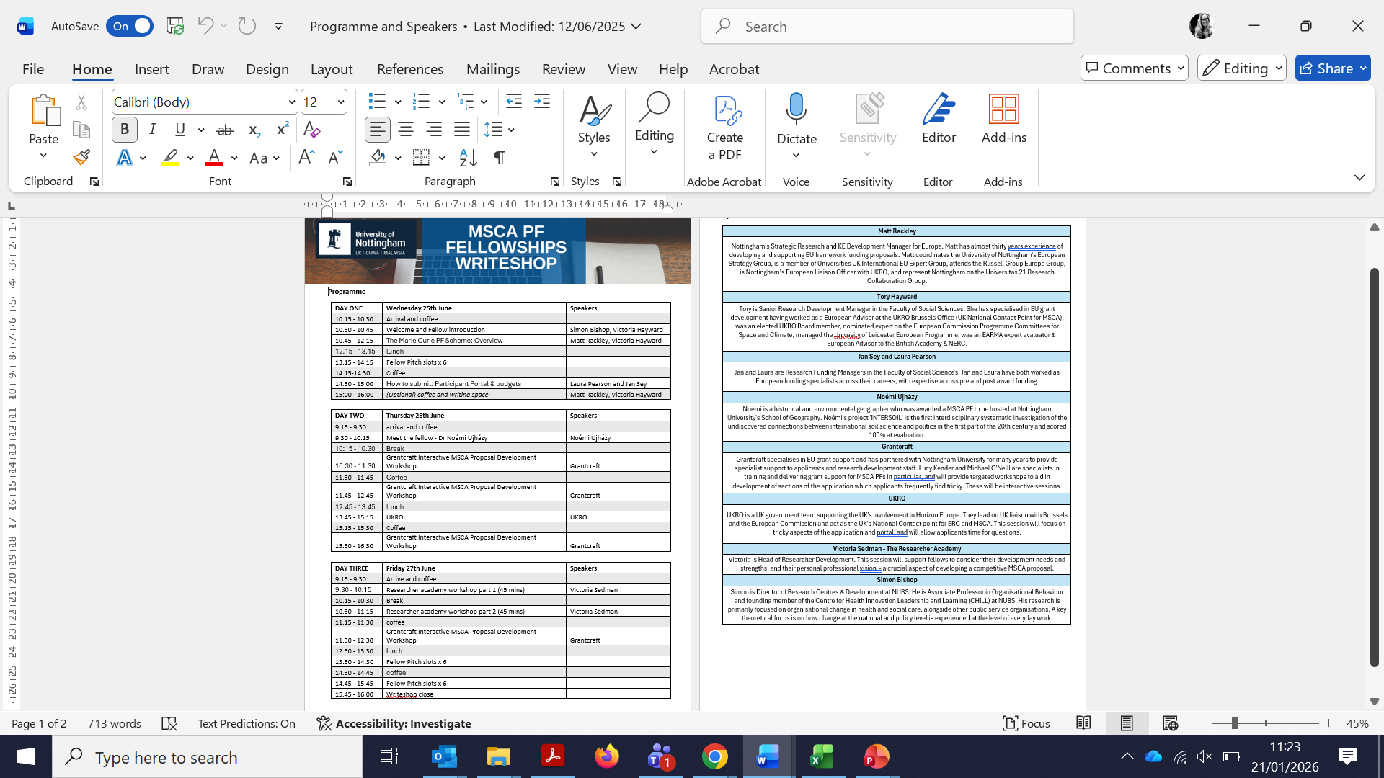
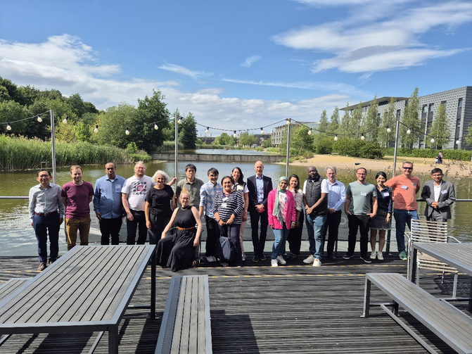
DIY SUMMER SCHOOL
DIY CONCEPT REVIEW
MSCA PF 2026 CALL DEADLINE
INFO EMAIL
NCP INFO EVENT

Slide 15


Slide 16
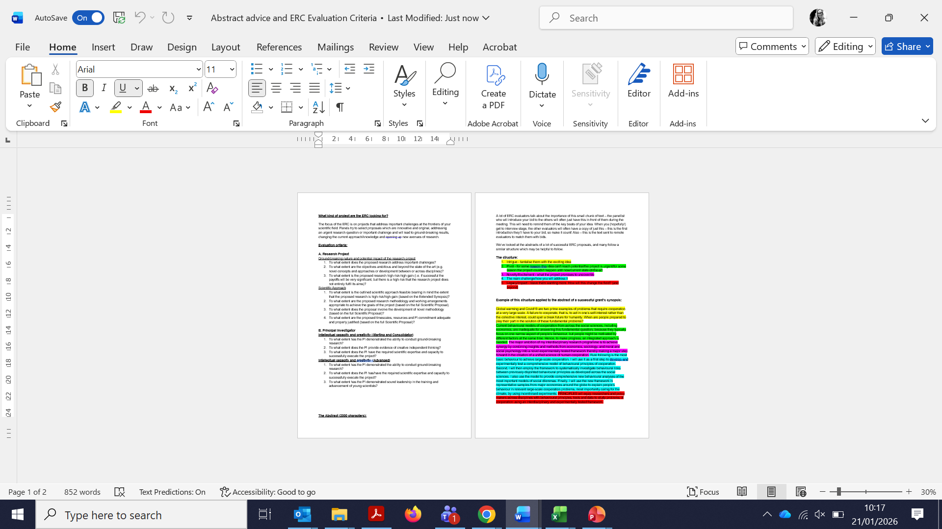
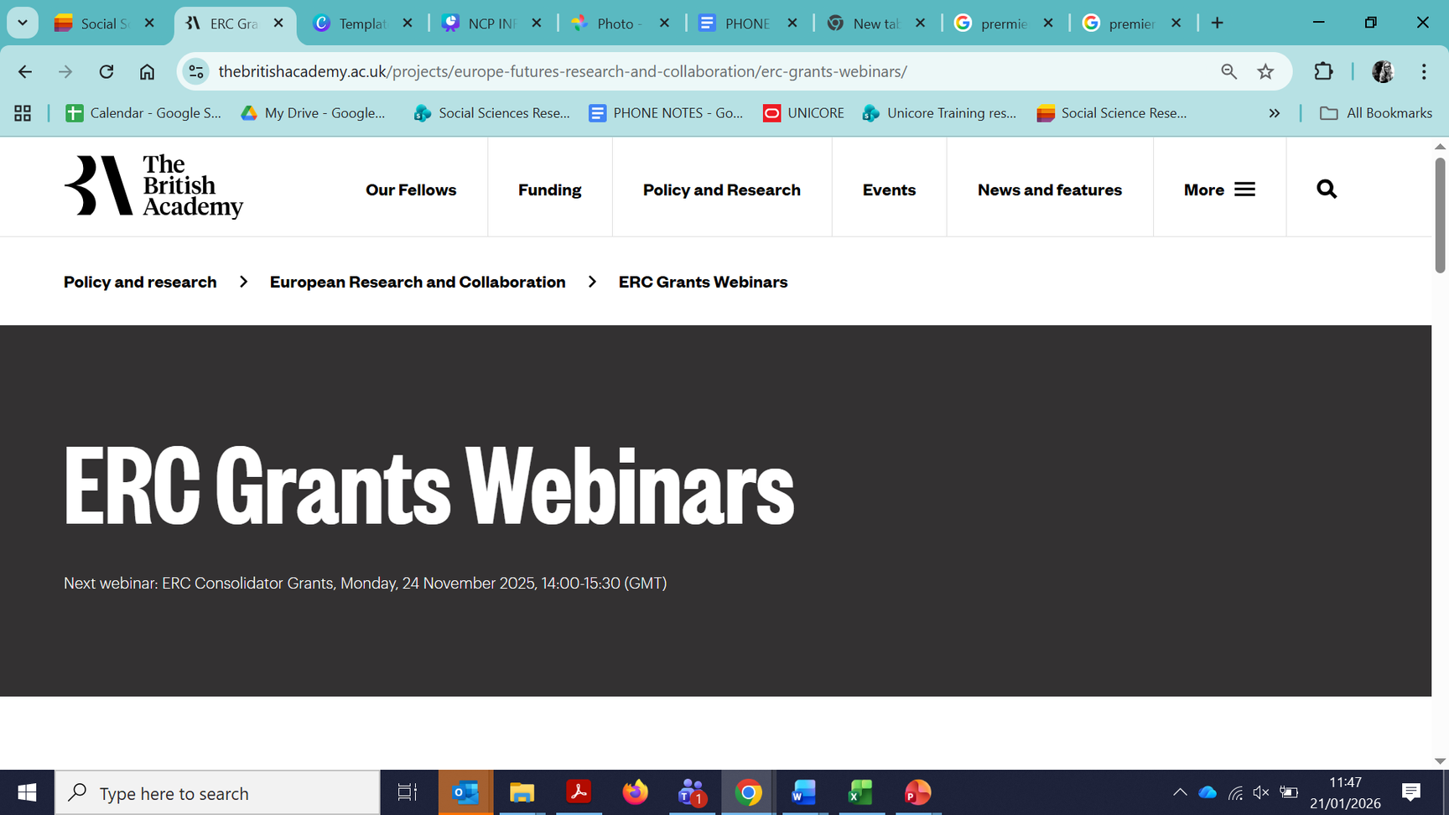

Slide 17

Over to you!

Slide 18



Do not edit How to change the design
What is your biggest challenge in developing a competitive Horizon Europe proposal?
The Slido app must be installed on every computer you’re presenting from

Slide 19
Do not edit How to change the design
What support, resource or action would most help you overcome this challenge?
The Slido app must be installed on every computer you’re presenting from

Slide 20
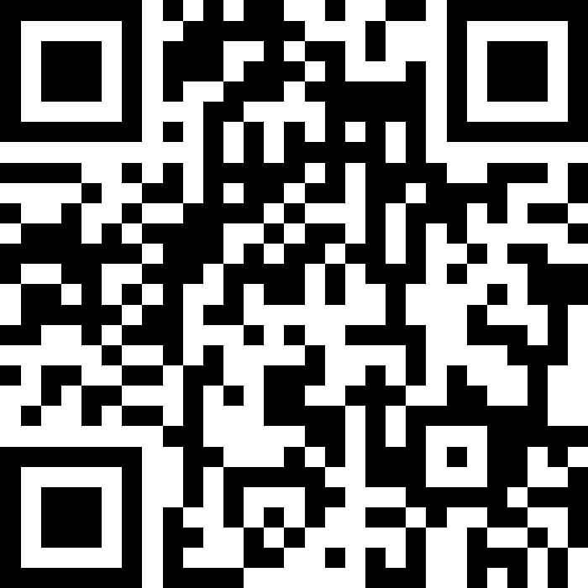

What is your biggest challenge in developing a competitive Horizon Europe proposal?
What support, resource or action would most help you overcome this challenge?
Notes:
https://app.sli.do/event/j613wWG9AGXg7HbBFzjzHL

Slide 21

Thank you for your attention.
Time for questions and discussion.
Notes:
What is your approach to preparing an application and what type of support systems do you have in place ?
For example:
Do you have a specific approval process for EU projects?
Do you require Memorandum of Understanding, Non-Disclosure Agreements or Letter of Intent?
What types of development activities do you do?
Do you have different approaches for single stage and two stage applications?
Do you have separate pre-award and post-award EU teams?

