Slide 1




COST – Leicester 28 January 2026
Hazel Dalgård, COST CNC (UKRI)

Slide 2
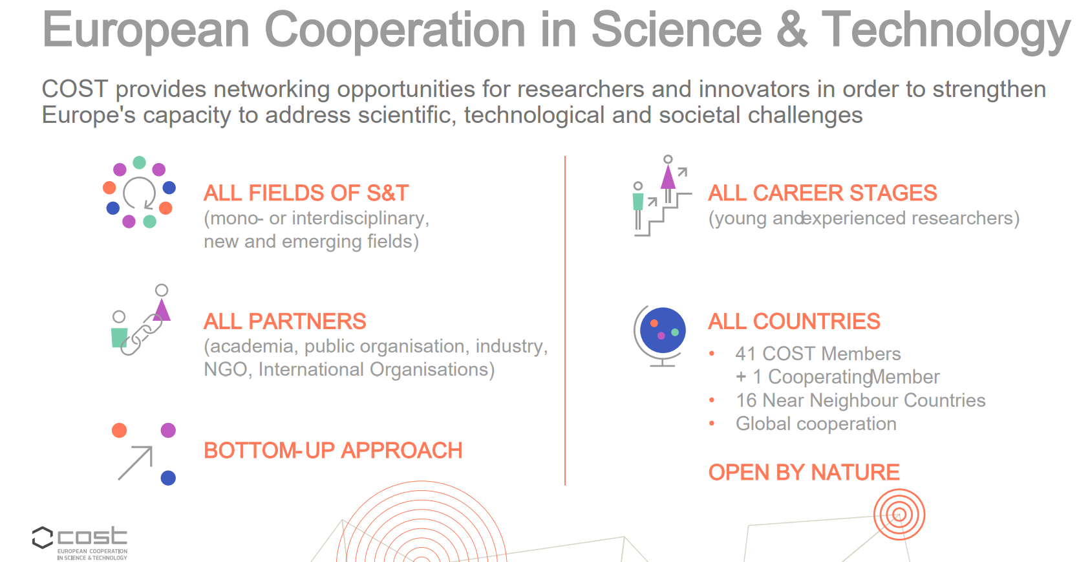

Slide 3

All submitted proposals – by field - https://www.cost.eu/oc-2025-1-initial-analysis/ * 55% of proposals have two or more Main Fields of Science.
42 COST countries submitted as a main proposer – IT (110); UK (109); ES (96).
Networks - The average size is 47 proposers (main and secondary).
Gender balance - remains 52% male/48% female main proposers.
Inclusiveness - 25% younger/75% experienced researchers as main proposers.
31% ITCs/ 69% COST Member Countries as main proposers’ institutions

Slide 4
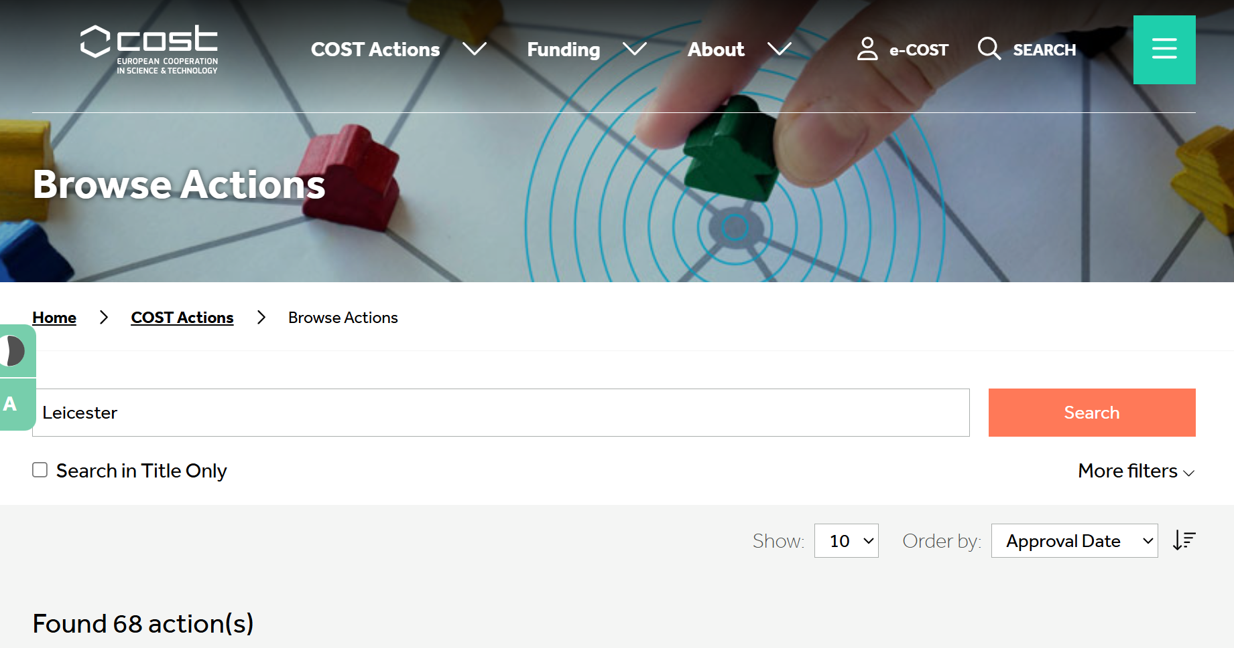
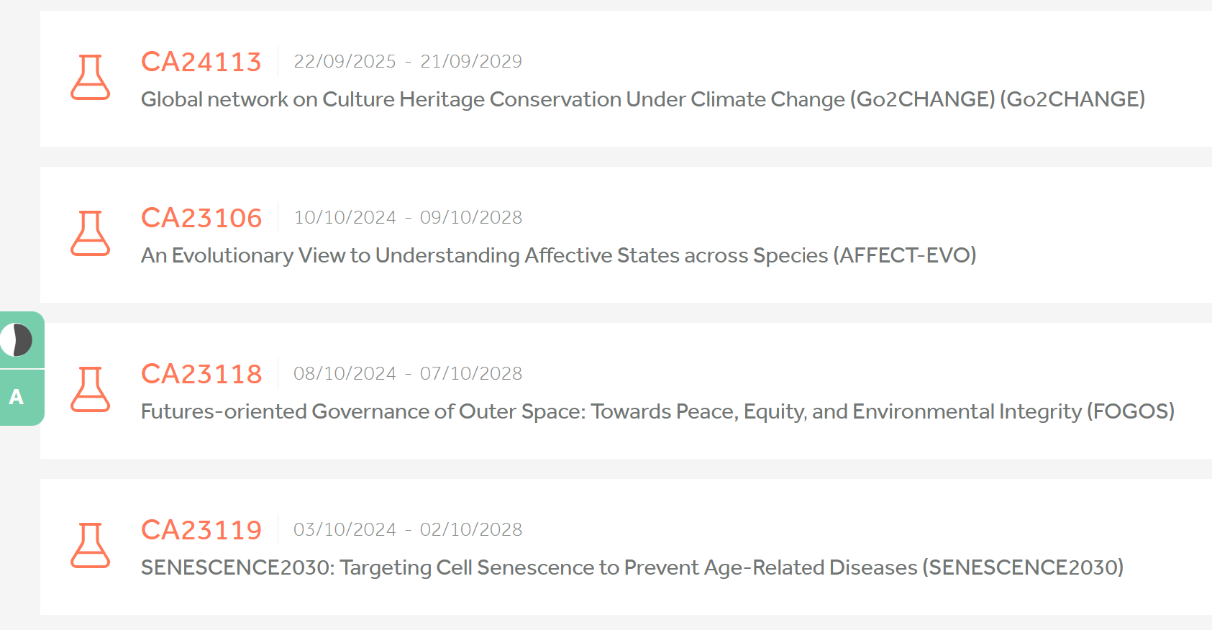
Leicester = 68 running COST Actions

Slide 5
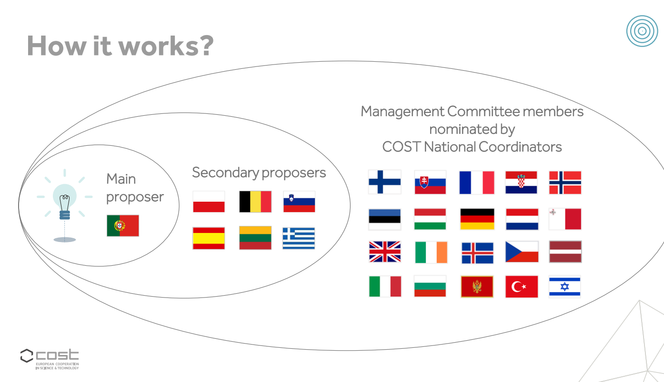

Slide 6

COST Membership
41 Full COST Members
Albania
Armenia
Austria
Belgium
Bosnia and Herzegovina
Bulgaria
Croatia
Cyprus
Czech Republic
Denmark
Estonia
Finland
France
Georgia
Germany
Greece
Hungary*
Iceland
Ireland
Italy
Latvia
Lithuania
Luxembourg
Malta
The Republic of Moldova
Montenegro
The Netherlands
The Republic of North Macedonia
Norway
Poland
Portugal
Romania
Serbia
Slovakia
Slovenia
Spain
Sweden
Switzerland
Türkiye
Ukraine
United Kingdom
1 Cooperating Member
1 Partner Member
Israel
South Africa
COST Members non-ITCs (Inclusiveness Target Countries)
COST Members ITCs
COST Cooperating Member
COST Partner Member

Slide 7


Min 7 countries, average participation 34 countries in a COST Action.
A COST Action typically lasts for 4 years.
Funding is typically ~ €680,000 over lifetime.
Around 70 new Actions start each year (around 300 run in parallel)
Cost Action collaboration and capacity building activities:

Slide 8

Proposals
General features
Network of proposers
COST Excellence and Inclusiveness Policy
Specific objectives
Excellence in S&T and Networking
Impact
Implementation

Slide 9
Open Call for proposals
Technical Annex
SECTIONS
SUB-SECTIONS
EXCELLENCE in S&T and NETWORKING
Main challenge
Objectives
State-of-the-art
Rationale for choosing networking to address the main challenge
Critical mass of the network
1.
2.
IMPACT
Impact related to objectives
Involvement of stakeholders
Communication, dissemination and valorisation
Downloadable
Word template
Max. 15 pages
Diagrams and figures accepted
3.
IMPLEMENTATION
Action Structure
Work plan (tasks, activities and timeframe)
Deliverables
Gantt chart

Slide 10
Evaluation criteria
EXCELLENCE in S&T and NETWORKING
IMPACT
IMPLEMENTATION
  Soundness of the challenge
  Research coordination and capacity-building objectives.
  Progress beyond the state-of-the-art
  Added value of networking in S&T excellence
  Critical mass of the network
  Impact on science, society, policy, or any other relevant area, and short-, medium- or long -term.
  Involvement of stakeholders, their role and added-value.
  Plans for communication, dissemination and valorisation of results and target audience
  Coherence of the Action structure
  and effectiveness
  of the work plan
5 questions
3 questions
1 question
  Range of marks: 0 – 5 Threshold: 3
  Range of marks: 0 – 5 Threshold: 3
  Range of marks: 0 – 3

Slide 11
As a participant in a running Action
Find the Action in your field
of interest on the COST website
READ THE PROJECT PLAN (MoU) – identify your potential contribution
Browse the Action’s website – check their activities
Identify the opportunities
to join the Action and your contact person

Slide 12
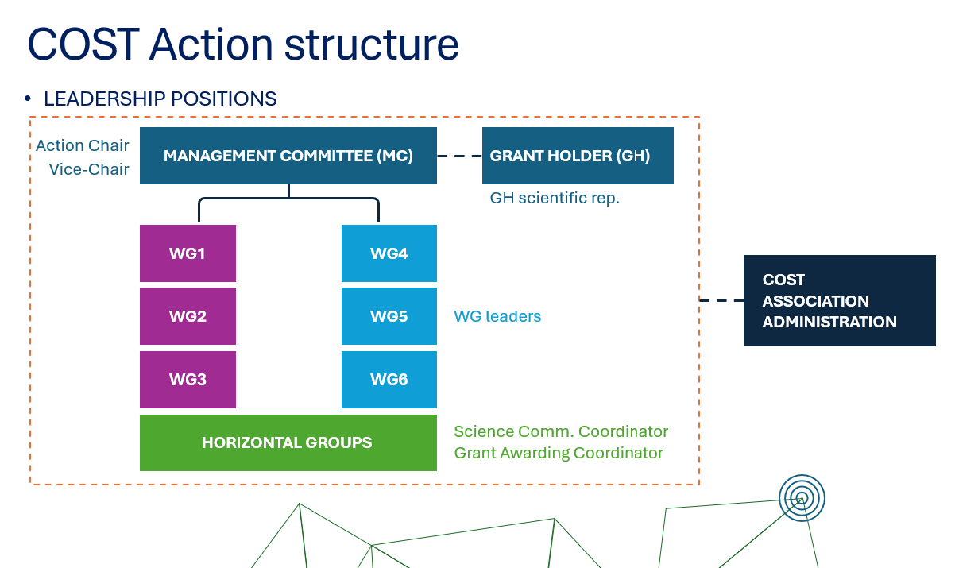

Slide 13
What can be funded by COST
Networking Activities
Events
Meetings
Training schools
Presentations at external conferences
YRI conference grants
Mobility of researchers and innovators
Short-term scientific missions
Virtual mobility
ITC conference grants
Dissemination conference grants
Other expenses specifically supporting the Action
Dissemination and communication products
Other expenses specifically supporting the Action
Other expenses related to scientific activities (OERSA)
Virtual Networking Support

Slide 14
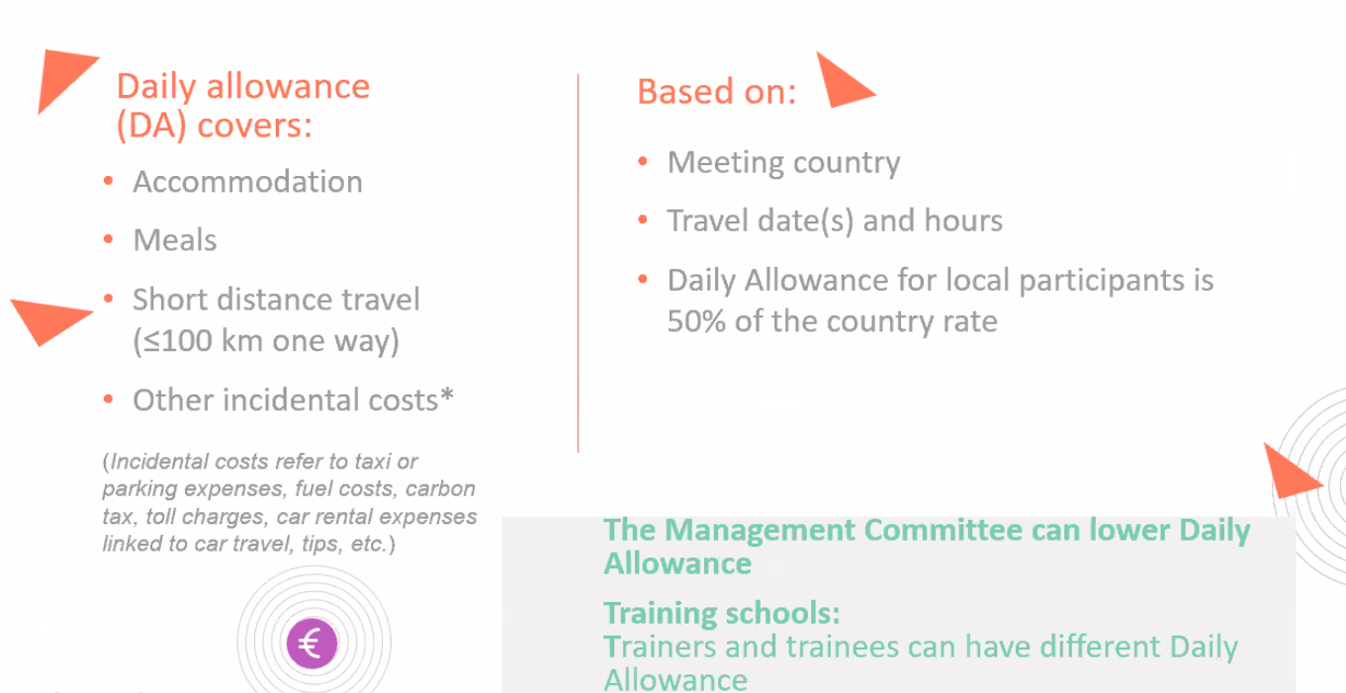

Slide 15
COST - FAQs
FAQ | Answers - Funding Documents & Guidelines | COST, Annotated Rules FAQ – COST.
Eligibility – network composition, academic career stage, elements of a good proposal? | Eligibility (Level C (ARs) parts 1.1, 1.3) COST principles (policies around excellence, inclusiveness, geographic, gender and age balance, ethics “peaceful purposes” etc) (Level C (ARs) p6.) Preparing and submitting a proposal for a COST Action (Open Call – Level C Rules, part 2)(SESA part 4) Evaluation, Selection, Approval core principles (and COI) (Open Call – Level C, part 3.)(SESA parts 6.2, 6.3, 7 &8)
Join a Working Group/Management Committee in an action? | MOU (Level C (ARs) part 1.2) COST Action Management Committee nomination, role, access to l/ship positions (Level B rules, part 3. Level C (ARs) part 3.)
FSAC (Financial Support to Cost Actions) – what does it pay for? | COST Action funding and administration – AGA, Grant Holder, reporting, final assessment (Level B, part 7, Level C (ARs) parts 7&8.) Financial Support to Cost Actions (Level C (ARs) part 6, Annex 5.)(Level B, part 6.)
Participate in activities only – how? | Funding of networking activities organised through action events. (Level C (ARs) Annex 1) Funding of networking activities organised through a grant awarding process. (Level C (ARs) Annex 2)

Slide 16


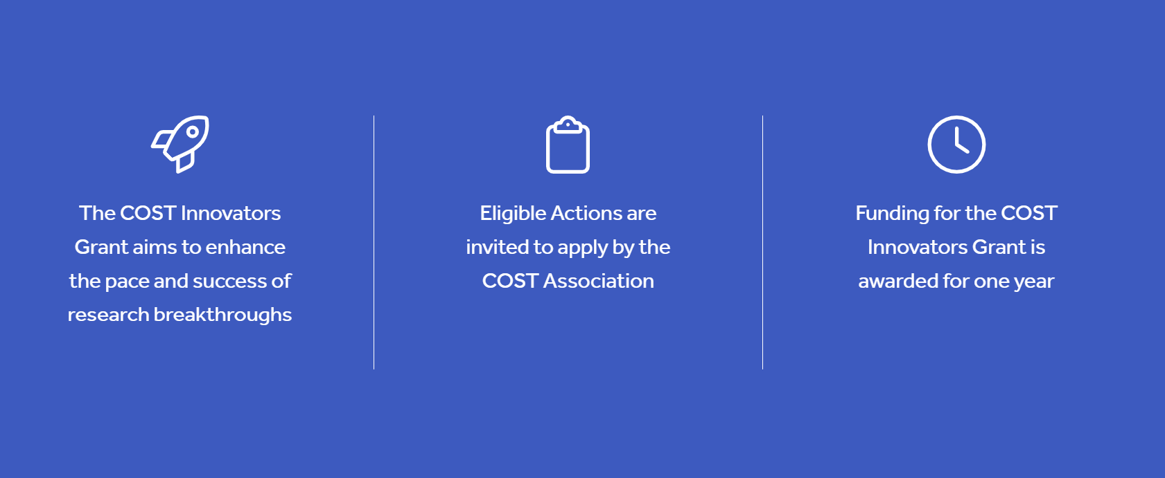

COST-EIT MoU renewed 22/05/2025 until 2028 https://www.cost.eu/eit-cost-strengthen-innovation-in-europe/
https://www.cost.eu/cost-innovators-grant/

Slide 17

Survey for ECRs
Launched in December 2024 this new Cross-Cutting Activity dives into the need to improve career development conditions to attract and retain the best researchers in Europe. It will run until 31 January 2026.
https://www.cost.eu/about/strategy/cross-cutting-activities/

Slide 18


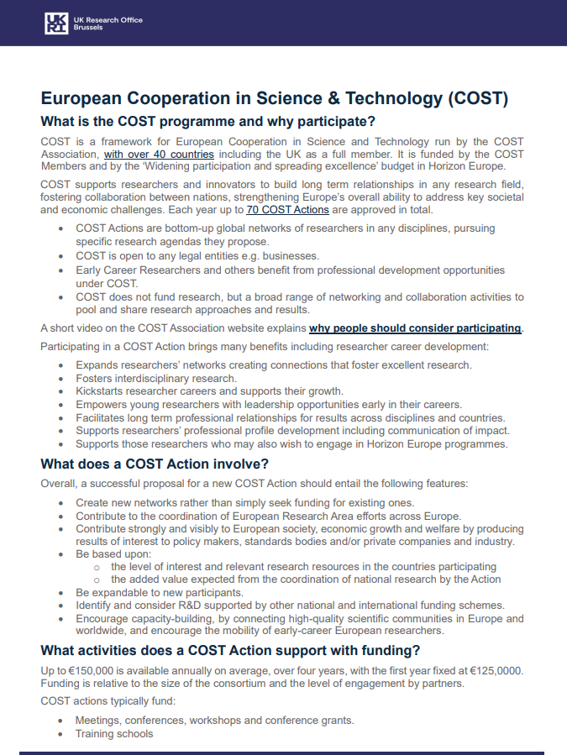
Resources
UK COST National Coordinator - cost.ukcnc@dsit.gov.uk cost@ukro.ac.uk
Portal (subscribe for free) - COST Factsheet
https://www.ukro.ac.uk/publications/european-cooperation-in-science-technology-cost/
COST website
What is a COST Action
How to join existing COST Actions
Browse actions
COST “am I eligible” tool
Eligible countries
Tips for a winning proposal
      Key documents
Annotated Rules FAQ – COST
COST Strategic Plan (2017-2027)
COST’s UK country website
COST CIG
We await the COST Open Call documentation for 2026
[For reference only- COST Open Call 2025 -COST Info Day 2025 recording and slides
COST 2025 call factsheet
COST Open Call for new Actions]
COST Newsletter
COST’s YouTube channel (@costoffice)
LinkedIn: COST Association

Slide 19



Slide 20




UK Research
and Innovation
UKRIforResearchers

Slide 21
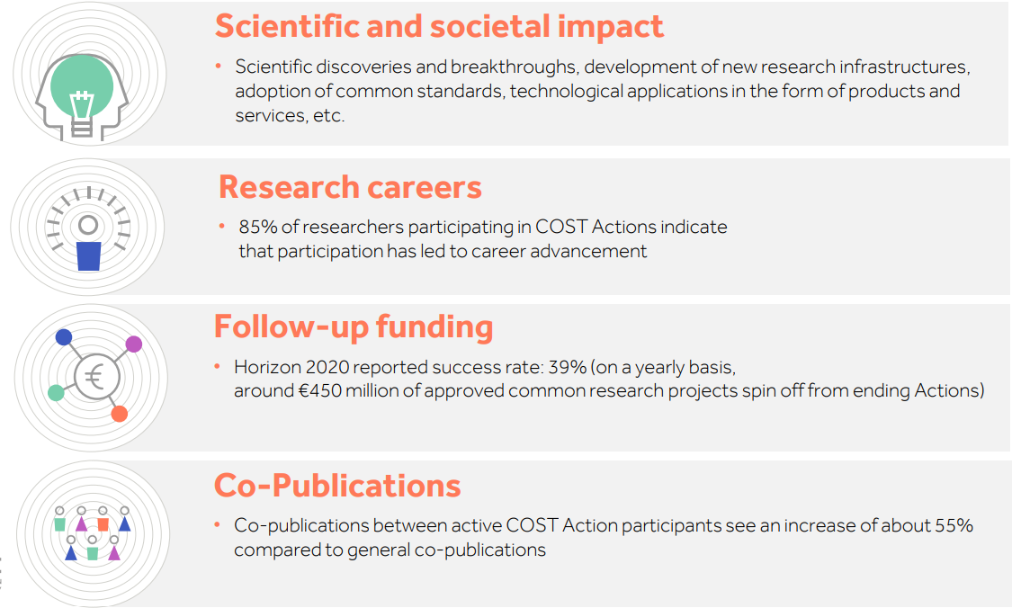

Slide 22
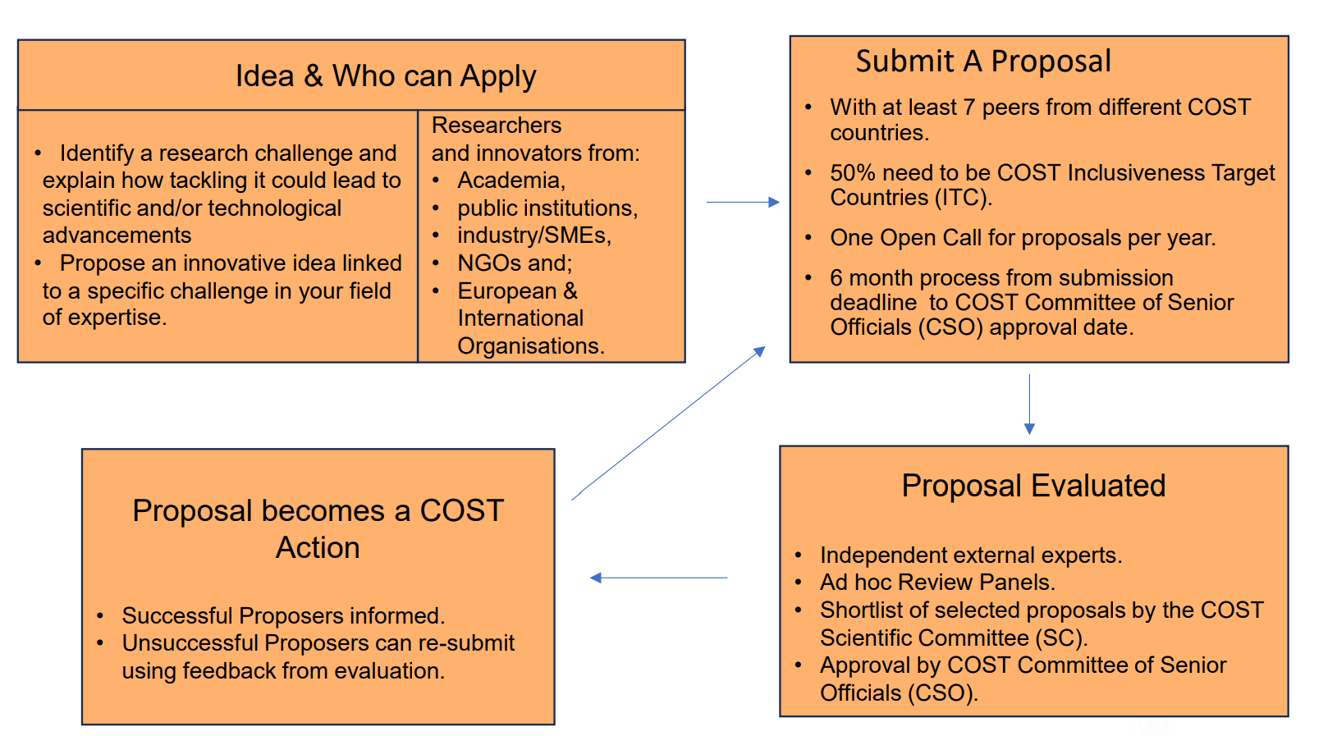

Slide 23
COST Documents related to Rules
Rules and principles for COST Activities
Level A - CSO
COST 088/21
Annex I country and organisation table
Annex II definitions and abbreviations
COST Action Proposal SESA
Rules for
COST Actions
Rules for COST
Innovators
Grants
Level B - CSO
COST 101/21
COST 089/21
COST 098/21
COST Open Call Proposers’ Guidelines (SESA)
COST Annotated Rules for
COST Actions
CIG Guidelines
Level C - EB
COST 104/21
COST 094/21
COST 105/21

Slide 24
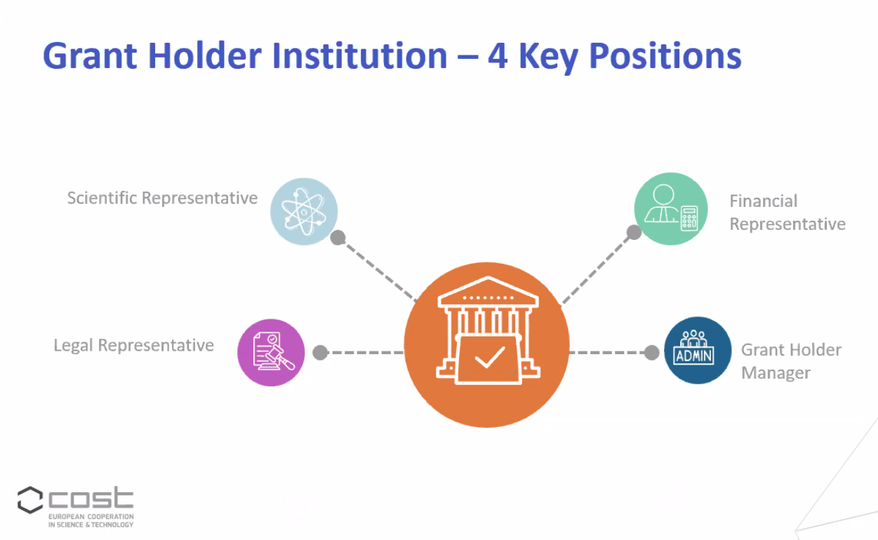

Slide 25

Gender Equality Plan for COST Activities
This GEP outlines guiding targets that help to promote gender balance in:
Participation in COST Actions for both ITC and non-ITC participants and young researchers;
COST Action leadership positions.
What is expected from a COST Action?
Monitor gender balance in the research networks;
Identify and invite participants from the under-represented groups;
Nominate a Gender Equality Advisor;
Develop a COST Action Gender Equality Plan;
Organise Action events with a gender focus;
Use gender inclusive language in all network communications;
Participate in gender equality events organised by COST e.g. COST Academy and COST Connect.
GEP for COST activities
Visit the COST web page on gender equality to learn more about gender equality at COST

Slide 26

Open Research Europe
ORE is the European Commission’s Open Access publishing platform for research results stemming from EU funding;
COST Actions can submit directly to ORE, free of charge. Many article types are possible from all fields of science;
Must be original content (not be submitted anywhere else) and stem from a COST Action;
ORE offers rapid publication, open peer review, and indexing in databases such as Scopus and PubMed;
COST Actions can create Collections (a compilation of content relating to a specific community) and there is no deadline;
Complementary to the existing Open Access expenses covered by the COST rules.
For more info visit: https://open-research-europe.ec.europa.eu/

Slide 27
COST Impact Model
IMPACTS
Scientific impact
Societal impact
OUTCOMES/
RESULTS
Interdisciplinary research
Coordination
New research
Career advancement
OUTPUT
Research proposals
Publications
New research collaborations
New research leadership skills
ACTIVITIES
Networking
INPUT
Ideas
Resources
People

