Slide 1

Horizon Europe Research Manager Event, Leeds Two years to go - what do we do next?
Franziska Enichlmayr
Policy Officer (Europe)
12 February 2026

Slide 2

About UUK: our strategy & priorities
Universities UK is the collective voice of 142 universities across the UK. Our mission is to help UK universities be the best in the world, through their research and teaching, and the positive impact they have locally, nationally and globally.
Policy priorities:
Securing a sustainable, competitive environment for international staff and student recruitment;
Enhancing the scale, scope and impact of the UK’s global R&I activities;
Delivering growth in and effective regulation of Transnational Education;
Maximising international experiences for UK-based students;
Managing and mitigating the risks of international engagement.
Notes:
Just a quick bit of context about my organisation, Universities UK International. Universities UK acts as the collective voice of 142 universities across the UK.
As Universities UK International, or UUKi, we operate as the international branch of UUK to represent UK universities on the global stage.
And while we work across all aspects of internationalisation, fostering new collaborations in research and innovation is a core priority for our team. Horizon Europe is a really large part of that picture for us, and I spend a fair amount of time focused on the policy context surrounding Horizon, so I'll be reflecting on how the UK has done so far and what's next at the programme level.

Slide 3
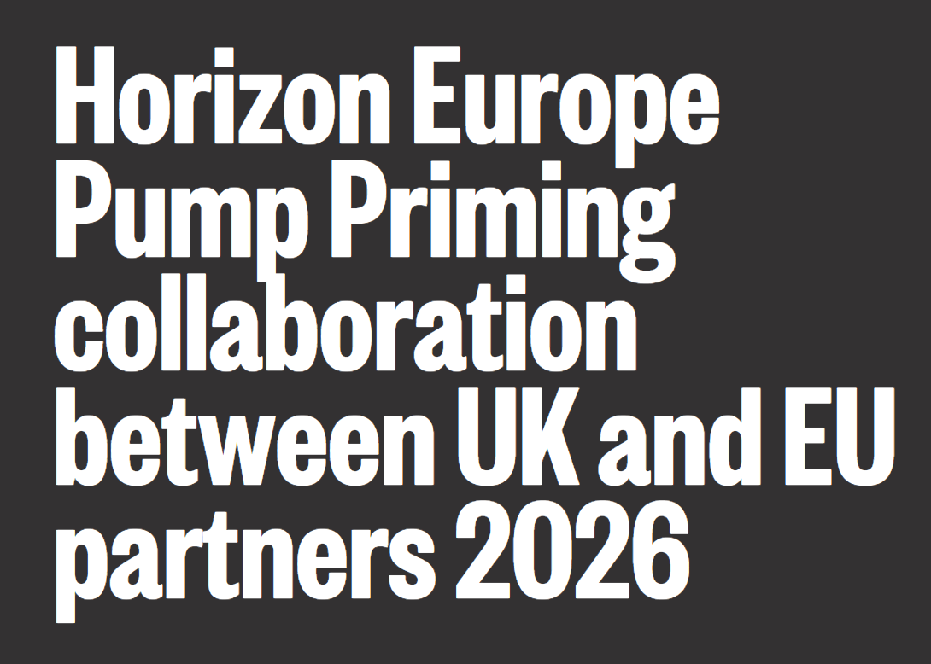
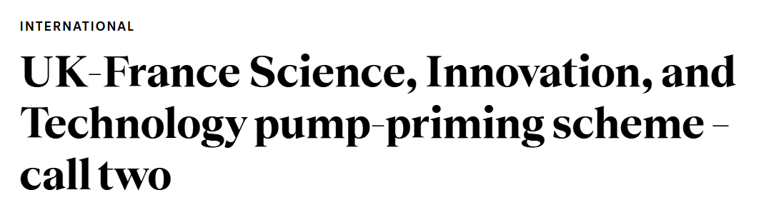
Successes in 2024 and 2025
Participation/successes 2024 and 2025:
Pillar I: Bounced back strongly (ERC and MSCA)
Pillar II: Bounced back less strongly
Pillar III: Notable UK engagement in the EIC, not as much in other schemes
Indication that 80% of UK participation is HEIs.
Notes:
Now we've been associated for two years, we have a full year of 2024 data and a nearly complete year of 2025 data to say with confidence where the UK has got to since joining the programme.
Looking at your institution-level data, it may not be a surprise to hear that we have bounced back really strongly in Pillar I. Over 2025 we had excellent news about Advanced Grants and Consolidator Grants under the ERC, with the UK being the top country both for Advanced 2024 calls and Consolidator 2025 calls, both with about 20% of awards. The UK was also top for proposals to MSCA Doctoral Networks and Postdoctoral Fellowships, showing huge demand which is incredibly positive to see. The UK has historically been strong in Pillar I but it's great to see the demand and success in this scheme recover so well.
Pillar II has bounced back less strongly, and this is where a lot of focus on boosting participation is focused. For example, a quick look at the dashboard data for 2024 calls indicates the UK was about sixth for grant awards. To be clear, this is still really impressive given the cooling off period that a lot of relationships have seen, and it takes much longer to put together a competitive Pillar II consortium as you will all know, but there is more work to be done here.
On Pillar III, we've seen pretty good UK engagement in the EIC, particularly in Pathfinder, though this scheme has really low success rates, but less so elsewhere. Historically the UK hasn’t necessarily engaged as much in Pillar III, but with a potential greater emphasis on Pillar III in FP10 compared to the current programme, it would be great to see more uptake here wherever possible.
On the UUKi side, we ran a UK-France pump priming scheme to support researchers in making connections that may develop into Pillar II applications, and the British Academy have also recently run Horizon Europe pump priming schemes to enable competitive bids to be developed.
So, what do we need to do next?

Slide 4

2026 and 2027
Boost participation - lots of opportunities still!
Champion areas where we do particularly well (Pillar I).
Continue driving Pillar II (and Pillar III) despite challenging context.
Share best practice/capacity build (events like today!).
Continue proactive engagement: EU MS, associated countries, LMICs, Brussels.
Notes:
Continuing to boost participation is the real priority. There are still lots of calls coming up in the next two years and we've heard lots of brilliant ways today that we can engage and make them a success. As it says on the slide, we can really maximise success by championing the areas where we do particularly well, especially Pillar I; continue to drive Pillar II and Pillar III, even if there are low success rates especially in Pillar III, and keep doing the brilliant work that you all do with your academics to submit high-quality proposals as much as possible, including by sharing best practice and building capacity, which of course today's event is part of!
We do have a lot to pick up after the gap in association, but we also have amazing teams and expertise all across the sector, and partners are really keen to work with us, both in EU member states as well as other associated countries and LMICs. This is really the main thing that we've seen from our work taking delegations across Europe over the last year and a half – colleagues across the continent and beyond are thrilled to see us back and keen to pick up where we left off, it just takes a little while to get the gears turning. So continuing proactive engagement, possibly encouraging academics to note with their networks that the UK is back and ready to engage, will go a really long way.

Slide 5
FP10 and European Competitiveness Fund
Draft MFF 2028-2034
EU/DSIT budgets: good news/bad news
Likeminded trusted countries
Proactive associated country voice: meeting with Commission representatives on 4 December, MEP session in collaboration with EUA on 14 January
​ | 2025/2026 ​ | 2026/2027 ​ | 2027/2028 ​ | 2028/2029 ​ | 2029/2030 ​ | Total ​
EU programmes (cash terms, £m) ​ | 2,736 ​ | 2,121 ​ | 2,195 ​ | 2,200 ​ | 2,200 ​ | 8,716 ​
Notes:
I was also asked to do a bit of looking forwards to FP10 and what developments we might expect. The Commission released their drafts for FP10 and Multiannual Financial Framework in July, with a proposed budget for FP10 of €175 billion, around an 84% increase from the current budget of around €95 billion. We were very pleased to see that FP10 is proposed as being separate from other activity around European Competitiveness, though it does look like Pillar II priorities may be shaped around priorities set by the European Competitiveness Fund.
While this commitment to a self-standing R&I programme is very welcome, and we’re thrilled to see the importance that the Commission places on research and innovation, there may be some tension around budget (as always!). On government's side, we have had continuous positive signals from DSIT that they intend for the UK to associate to FP10, including the fact that budget has been earmarked all the way to 2030 for our continued participation, which is very reassuring. I should note that what has been set aside is based on the cost of the current programme, so if there were to be a significant increase as the Commission has proposed, that could put strain on DSIT’s budgets. However, a larger programme may also mean more available for the UK to win, so it’s all to play for.
Our positions as UUK are that we want to see: Association from day one to reduce uncertainty and ensure ongoing participation.​ Horizon should continue to be open to the world, with the UK treated as a likeminded partner, and barriers to participation reduced.​ FP10 should be based on excellence, with increased money for fundamental science.​ We are working proactively with other associated countries to make the point about the importance of an open programme with quick association, and we held an event in European Parliament in collaboration with the EUA on the 14th January with representatives from Switzerland, Norway and Japan. We also had senior representation in Brussels in December to meet with the Commission and with colleagues from other associated countries to continue advocating for these issues, and we’re seeing a really positive cohort of likeminded trusted countries speaking – not necessarily with one voice, but certainly in alignment, which we hope will be really helpful as we enter negotiations over the next two years.
​
​

Slide 6
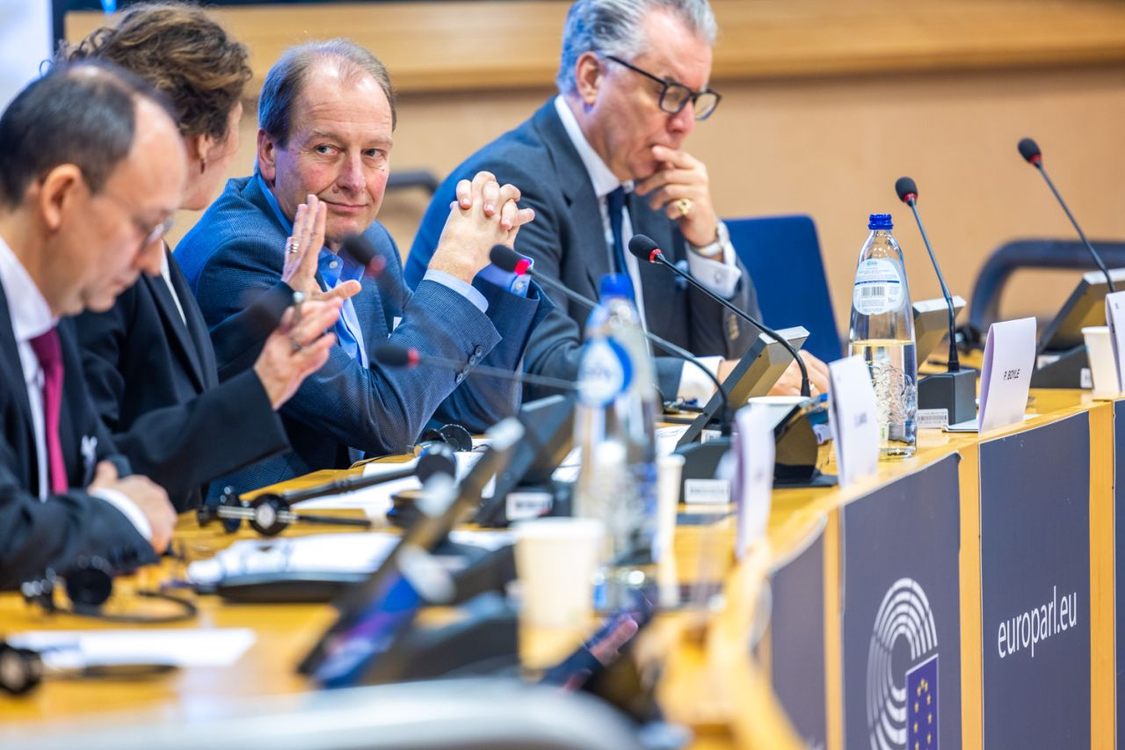
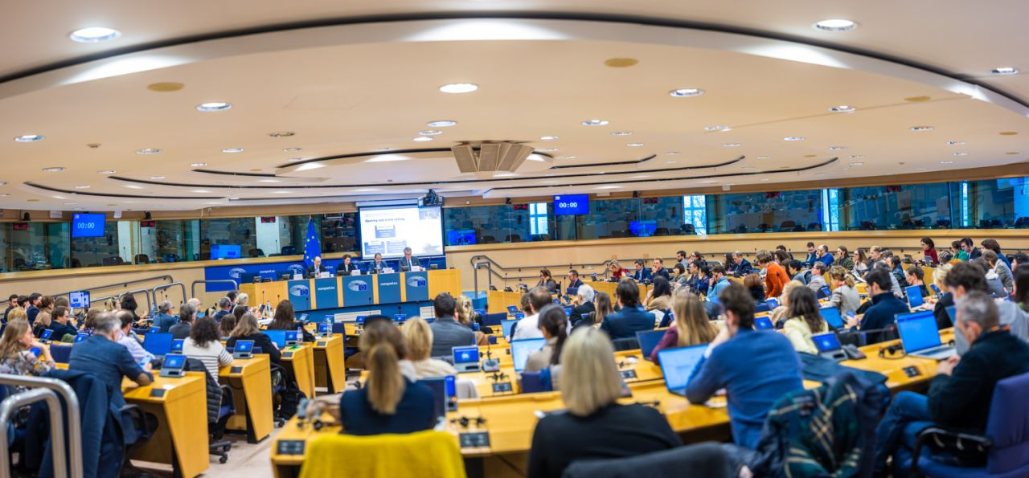
Harnessing a joint UK approach
UUKi - six Horizon Europe delegations to MS/ACs, UK-France pump-priming and researcher mobility scheme, Brussels engagement (incl. EUA).
DSIT - recently specifically focussed on Germany and Spain; brokerage events; Horizon Europe as part of bilateral dialogues
Better connectivity across the system: NCPs, feedback mechanism, draft WPs.
Addressing gaps (incl. industry participation).
Thinking strategically and long-term.
Notes:
Just to end on work that’s happening across the piece – as UUKi we’re certainly not the only ones advocating for continued participation in Horizon Europes present and future, and I wanted to highlight some of the great work we’re seeing on a broad basis. DSIT is doing a lot of really positive work, including a campaign promoting the UK as the partner of choice in Germany and Spain, and brokerage events for specific research fields. I think we’re seeing better connectivity across the whole system as we get further into the programme, particularly with a lot of the fantastic work UKRO and Innovate UK are doing to support colleagues across the sector. And as we get more into the rhythm of the day-to-day of supporting colleagues to make competitive applications as we wrap our heads around what’s new in this programme, we’re also starting to find headspace – hopefully – to take a breather and think strategically and long-term about what we’re getting from Horizon Europe now, and what we’d like to see in the future.

Slide 7


Slide 8
Thank you
Franziska Enichlmayr, Policy Officer (Europe), franziska.enichlmayr@international.ac.uk ​
Find us online: https://www.universitiesuk.ac.uk/universities-uk-international​
LinkedIn: Universities UK International

