Slide 1
Horizon Europe
Artificial intelligence in proposals preparation
European Commission, DG rtD
Common Implementation Centre
9 December 2025

Slide 2
Generative AI for preparation of proposals
Using generative AI for preparation of proposals
Disclaimer included in the proposal application forms (Part B).
Applicants are reminded:
to exercise caution and careful consideration while using generative AI tools;
to review and validate thoroughly any AI-generated content to ensure its appropriateness and accuracy, as well as its compliance with intellectual property regulations;
that they remain fully responsible for the content of the proposal;
to be transparent in disclosing which AI tools were used and how they were utilised.

Slide 3
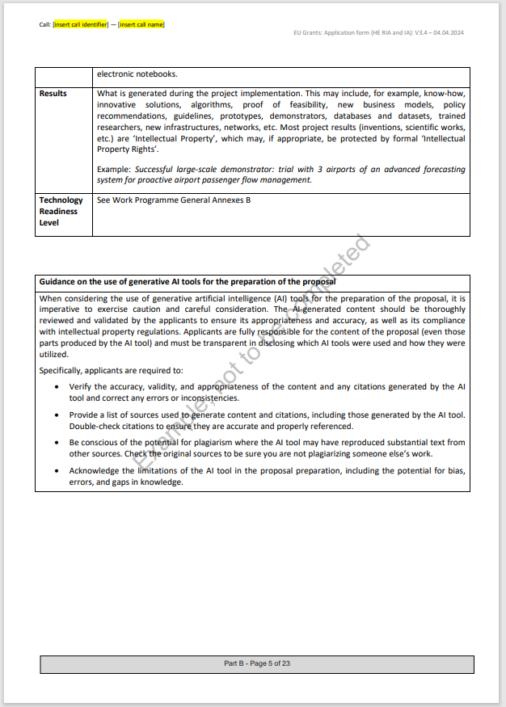
Generative AI for preparation of proposals
Disclaimer
“When considering the use of generative artificial intelligence (AI) tools for the preparation of the proposal, it is imperative to exercise caution and careful consideration. The AI-generated content should be thoroughly reviewed and validated by the applicants to ensure its appropriateness and accuracy, as well as its compliance with intellectual property regulations. Applicants are fully responsible for the content of the proposal (even those parts produced by the AI tool) and must be transparent in disclosing which AI tools were used and how they were utilised.
Specifically, applicants are required to:
Verify the accuracy, validity, and appropriateness of the content and any citations generated by the AI tool and correct any errors or inconsistencies.
Provide a list of sources used to generate content and citations, including those generated by the AI tool. Double-check citations to ensure they are accurate and properly referenced.
Be conscious of the potential for plagiarism where the AI tool may have reproduced substantial text from other sources. Check the original sources to be sure you are not plagiarising someone else’s work.
Acknowledge the limitations of the AI tool in the proposal preparation, including the potential for bias, errors, and gaps in knowledge”.
Notes:
Disclaimer included in Application Forms (Part B)

Slide 4
Generative AI for preparation of proposals
Summary
Applicants may use generative AI tools when preparing proposals.
Applicants must be fully transparent towards the granting authority and declare the use of AI tools and the way how the tools have been utilised
As a rule, the use of generative AI tools in drafting proposals cannot be considered by expert evaluators as a reason to penalise a proposal.
Notes:
Applicants may use generative AI tools when preparing proposals in relation to both, the structure of the proposal and its substance.

Slide 5
AI in proposal evaluation
Using AI tools in HE evaluation
Any use of gen AI tools by the expert evaluators remains their own responsibility:
responsible for keeping the confidentiality of the proposal information and ensuring its adequate protection.​
responsible for adopting appropriate measures to ensure the protection of personal data.
should be aware of the risk of breaching confidentiality obligations, which may be subject to the measures outlined in their contract.​
should avoid over-reliance on AI tools and acknowledge its potential limitations (hallucinations and biases).

Slide 6
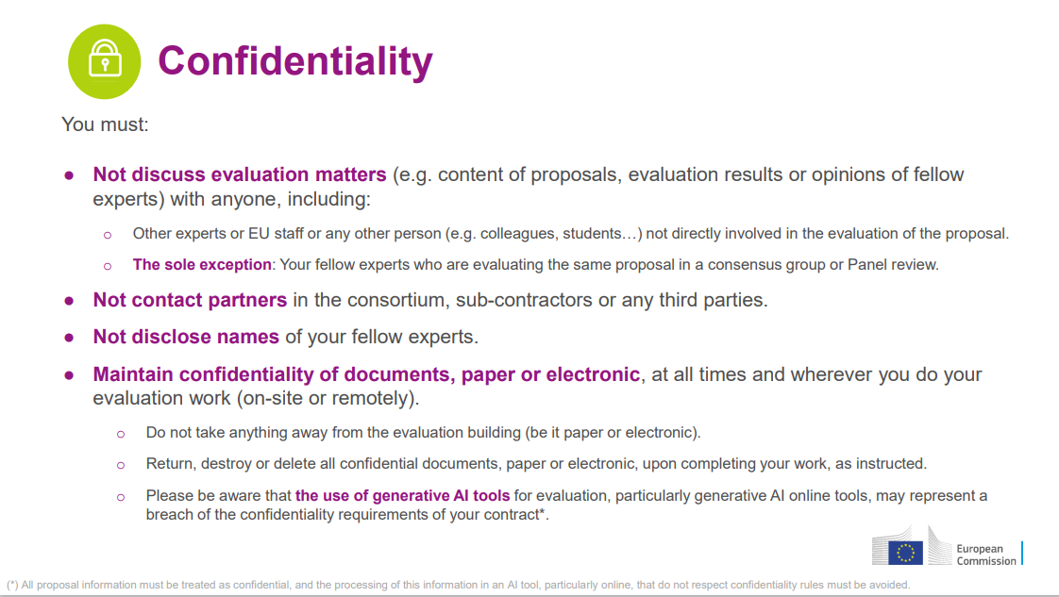
HE Standard briefing slides for experts
AI in proposal evaluation
Notes:
(*) All proposal information must be treated as confidential, and the processing of this information in an AI tool, particularly online, that do not respect confidentiality rules must be avoided.

Slide 7
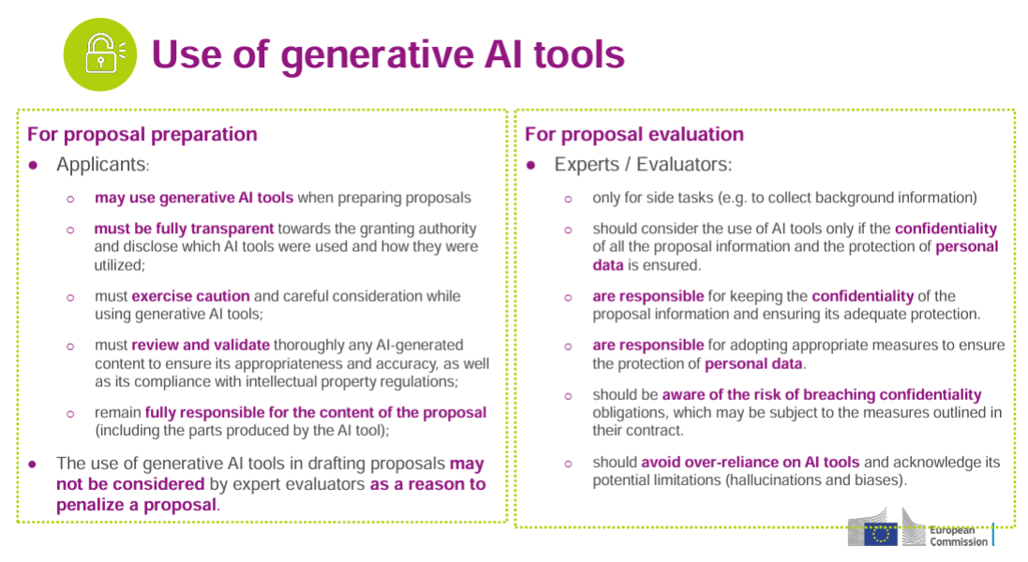
HE Standard briefing slides for experts
AI in proposal evaluation
New slide
Notes:
(*) All proposal information must be treated as confidential, and the processing of this information in an AI tool, particularly online, that do not respect confidentiality rules must be avoided.

Slide 8
Do we use AI tools in the application process?
We do use AI based tools in the application process:
To detect plagiarism, double funding and re-submissions (based on semantic search)
To help the admissibility checks in blind evaluations (based on semantic search)
Allocation of expert evaluators to proposals (based on semantic search)
Search in F&T portal (semantic search)
Others in the pipeline (e.g. summaries of topic conditions – based on generative AI, Portal chatbot to help with guidance)

Slide 9
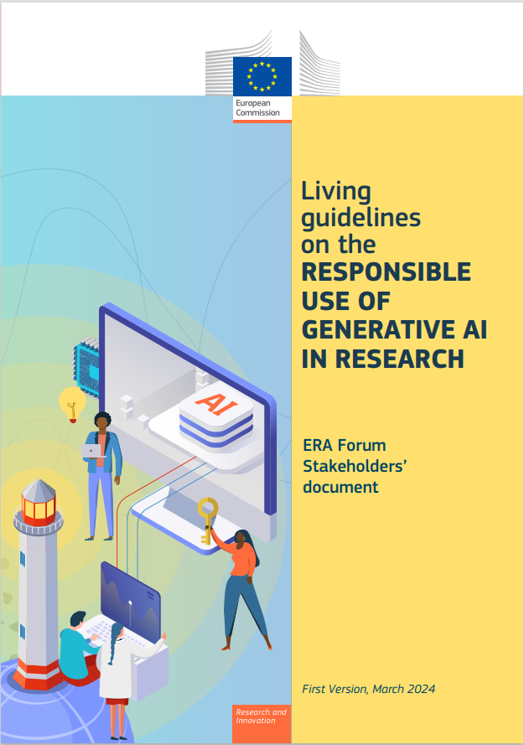
Our approach
The EC promotes the responsible use of generative AI and requests transparency from applicants
Key takeaways from the guidelines:
Researchers refrain from using generative AI tools in sensitive activities such as peer reviews or evaluations and use generative AI respecting privacy, confidentiality, and intellectual property rights.
Research organisations should facilitate the responsible use of generative AI and actively monitor how these tools are developed and used within their organisations.
Funding organisations should support applicants in using generative AI transparently.
Notes:
The ERA Forum is a platform for dialogue and cooperation between national governments, the European Commission, and stakeholders in research and innovation.
It was established in 2022 to support the development and implementation of the European Research Area (ERA) policy agenda.
The Forum includes representatives from EU Member States, countries associated to Horizon Europe, the European Commission, the Committee of the Regions, the Economic and Social Committee, and stakeholders from research and innovation communities.
The main tasks of the ERA Forum are to:
Assist the Commission in relation to the implementation of existing Union legislation, programmes and policies
Assist the Commission in the preparation of legislative proposals and policy initiatives
Coordinate with Member States, exchange of views
The ERA is the EU’s policy initiative for improving and harmonising research activities across Europe. It has been underway for more than two decades and was revamped in 2020 to renew progress that had begun to stall.

Slide 10
Thank you!
# HorizonEU
http://ec.europa.eu/horizon-europe

